Slide 1
SYNERGY MINERAL RESOURCES LIMITED
PRESENTATION TO NIGERIA MIDSTREAN AND DOWNSTREAM REGULATION AGENCY
BY
AFANGA LEONARD WODAR AND TEAM
CHIEF EXECUTIVE OFFICES

Slide 2
SYNERGY MINERAL RESOURCES LIMITED
TABLE OF CONTENT
SYNERGY MINERAL GROUP INTRODUCTION
VISION AND MISSION
KEY PERSONNEL
ORGANISATION STRUCTURES
PERMIT/CERTIFICATES
INTRODUCTION TO CARGO INSPECTION
SAMPLING PROCEDURES
TECHNICAL PARTNERS
ANALYTICAL PROCEDURES
LABORATORY EQUIPMENT

Slide 3
SYNERGY MINERAL RESOURCES LIMITED
SYNERGY MINERAL RESOURCES LIMITED
INTRODUCTION
Synergy Mineral Resources Limited is a company registered in Nigeria with the head office Situated at 18/19 SPC Road, Federal Housing Estate, Calabar Cross River State with our subsidiary’s companies’ offices located at the following addresses:
RIVERS STATE: TRUST INSPECTION SERVICES LIMITED,
4A CHIEF NDAH STREET, ELIADA ESTATE OFF FIRST ARTILLARY, PORT HARCOURT, RIVERS STATE.
DELTA STATE: SYNERGY MINERAL RESOURCES LIMITED, OBIALEGBE KOKO ROAD, WARRI NORTH LGA BY GREENMAC DEPOT. DELTA STATE.
LAGOS STATE: SPECTRUM INSPECTION COMPANY, 4/5 APAPA-OSHODI EXPRESS WAY, LAGOS STATE.
We have also extended our services to other West African countries like Gambia and Sierra Leone with our laboratory located at the premises of General Petroleum Services Limited (GPS) terminal Manadinary, Kambo North West Coast Region the Gambia. Synergy Mineral Resources Limited was incorporated on the 14th of September, 2009 with registration number RC: 844775. The company was established with the sole purpose of Proffering solutions to clients in the Oil and Gas, Environmental, Solid Mineral Industries, Educational Institutions, Production Industries, Government Institutions etc., with high level of professionalism in line with our set goals and objectives. From inception, the company has made customers satisfaction the fulcrum of its business activities. In order to achieve this major objective, we have devised a work system that applies industrial standards to great

Slide 4
SYNERGY MINERAL RESOURCES LIMITED
efficiency and drives a flawless process in our operations. Synergy Mineral Resources
Limited has been in operations in Nigeria since 2009, this primary agenda and a sound
financial base, has seen us in a short space of time rendering excellent and satisfactory services to all our clients. Our extensive skills encompass all aspect of oil and gas operations such as; Oil and Gas facilities set-up, Quality control/Assurance, inspection, Cargo Blending, Cargo Superintendent, Calibration and Pressure Testing, Solid Mineral Analysis, Laboratory Equipment Supply and Installation, Training and Researched services, Health and Environmental consultancy services. We carry out our services in an accelerated turnaround time to avoid demurrage for our clients, using approved methods and instruments that are dedicated to each volatile and semi-volatile product to provide consistent high quality analytical data.
Synergy Mineral Resources Limited operates four Laboratories in Nigeria making us the most spread operating facility in the country.
Vision: Our aim is to remain a first-choice provider of Services of International standard in all areas of our specialization.
Mission: To ensure that all our operations and developmental activities have a positive impact on the future of our clients’ businesses by providing inspiring activities that will motivate our clients to achieve their corporate goals.
OBJECTIVES
The company’s business objective with its client centers on:
Consistent interaction with our clients for sustained improvement of our services.
Setting market trends by understanding the ever-changing needs of our clients.
Responding swiftly to customers’ needs through the provision of high-quality services in a flexible and effective manner with the highest business ethics.
Keeping up to date with innovative ideas all over the world.
Awareness of All International regulations regarding Quality, Inspection and Calibration services, Training, HSE Management and Human development in the Various Industries we are currently servicing.

Slide 5
SYNERGY MINERAL RESOURCES LIMITED
KEY PEOPLE
CHIEF EXECUTIVE OFFICER AFANGA LEONARD WODAR
Afanga is a graduate of Chemistry from the University of Calabar with M.SC degree in Applied chemistry from University of Calabar, apart from his degree in chemistry, Afanga has attended several professional trainings in the oil and Gas and other industrial related sector. He has over 30years working experience in the Mineral Resources sector, haven started his career with Pipeline and product marketing company system 2B Mosimi depot and Area office which is a subsidiary of Nigeria National Petroleum Company. He later joins Sahara Bulk Storage a subsidiary of Sahara Energy Group. He proceeded to set up Synergy Inspection Company Limited where he still serves as a director. He joins Rainoil Limited as the company operations and quality control Manager and was later move to head trade and marine department. He works for Enegas Power Limited as trade and Marine Manager.
Afanga is a member of several technical organizations and has serve in various government and private committees in Nigeria to provide result to our day-to-day activities in the oil and gas industry.
EXECUTIVE DIRECTOR FINANCE AND ADMINISTRATION
MR. EJOVWOKE PAUL ‘KIGHO holds a Master’s in Business Administration from the
Metropolitan School of Business, London and a Bachelor’s Degree in Computer Sciences at the Nnamdi Azikiwe University Awka Anambra State, Nigeria. Mr. ‘Kigho is currently the Managing Director of Trust Inspection Services Ltd, in which capacity he has the responsibility of overseeing the day-to-day running of the company. Prior joining the company, Mr. ‘Kigho had worked in various organizations, including Benny Paul Petroleum Nigeria Limited where he worked at a managerial level.

Slide 6
SYNERGY MINERAL RESOURCES LIMITED
EXECUTIVE DIRECTOR BUSSINESS DEVELOPMENT
PAUL AGBA OPUE holds a B.Sc. in Chemistry, University of Calabar and a Masters in
Environmental Management (MEM) University of Lagos, Akoka. A member of several professional bodies.
Paul was the Laboratory Manager of Synergy Inspection Services Ltd (SIS).
LABORATORY MANAGER: SPECTRUM INSPECTION COMPANY LAGOS.
MR. Olajide Filegbe holds a HND in Laboratory Science, Kwara State Polytechnic. He was the Laboratory manager of Clairgold Oil & Gas Engineering Company. A member of several professional bodies.
LABORATORY MANAGER: TRUST INSPECTION SERVICES LIMITED PORT HARCOURT
Mr. PETER OGHENEKEVWE is currently the company’s Laboratory/QHSE Manager; He holds a Bachelor’s degree in Pure Chemistry. He is a Project Management professional, Member Chemical Society of Nigeria, Member Institute of Chattered Chemists of Nigeria, Member Institute of Safety Professionals of Nigeria (MISPON) and a Certified ISO 9001 2015 Lead Auditor. He has over 13 years of quality and quantity inspection/superintendence in the marine, oil and gas industry.
LABORATORY MANAGER: SYNERGY MINERAL RESOURCES LIMITED
MR. CHUKWUEMEKA SONDE
Chukwuemeka sonde is a graduate of Laboratory Science Technology, from University of Science and Technology, Wudil, Kano state with 8years of post graduate experience, in Oil and Gas Industry with several training certificates in the industry. He has work with a couple of organization, Such as Clairgold oil and gas Engineering company as Laboratory chemist, Beach secondary school, Koko, delta state as chemistry teacher before joining Synergy Mineral Resources Limited.

Slide 7
SYNERGY MINERAL RESOURCES LIMITED
ORGANIZATIONAL STRUCTURE
In order to realize its vision and mission as well as provide optimal service to its customers, Synergy Mineral Resources Limited (SMRL) have been structured as
follows;
The company intend to carry out the following services in the country
CARGO INSPECTION SERVICES (Quantity)
CARGO INSPECTION SERVICES (Quality)
CALIBRATION SERVICES
TRAINING SERVICES
CARGO INSPECTION SERVICES (Quantity)

Slide 8
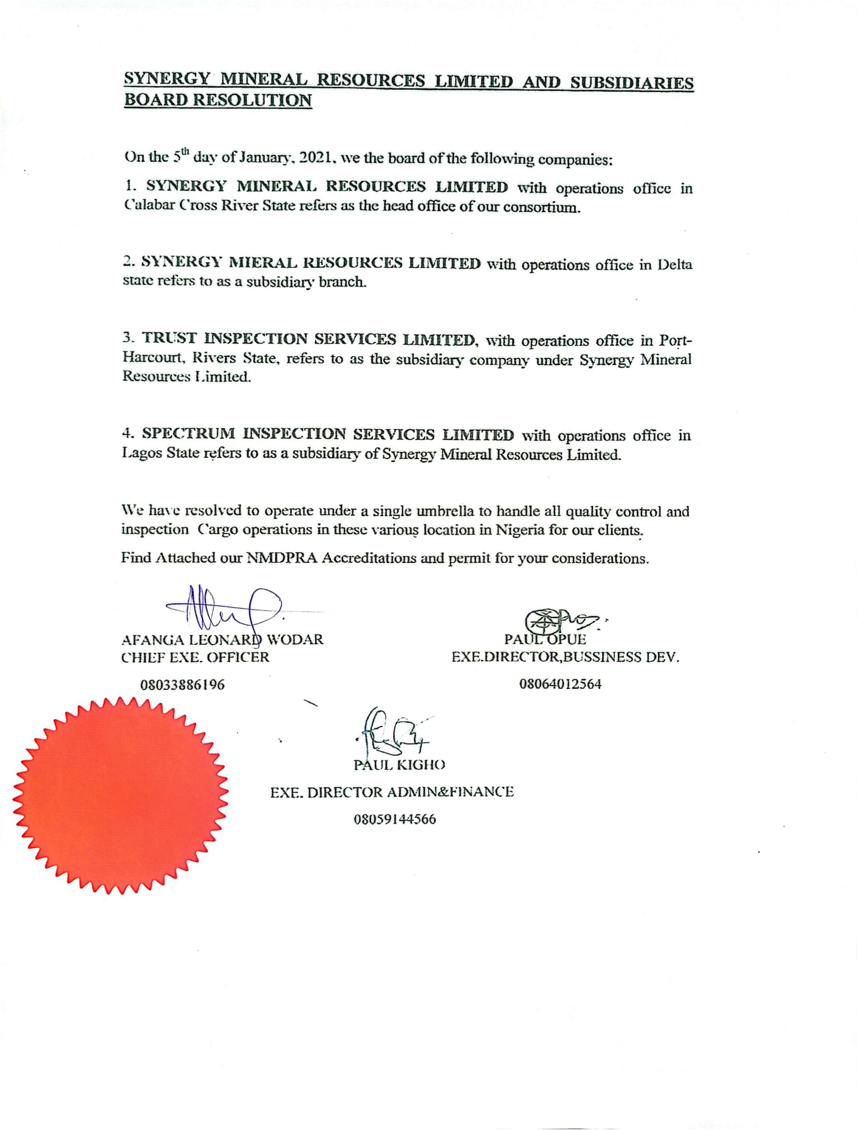

Slide 9
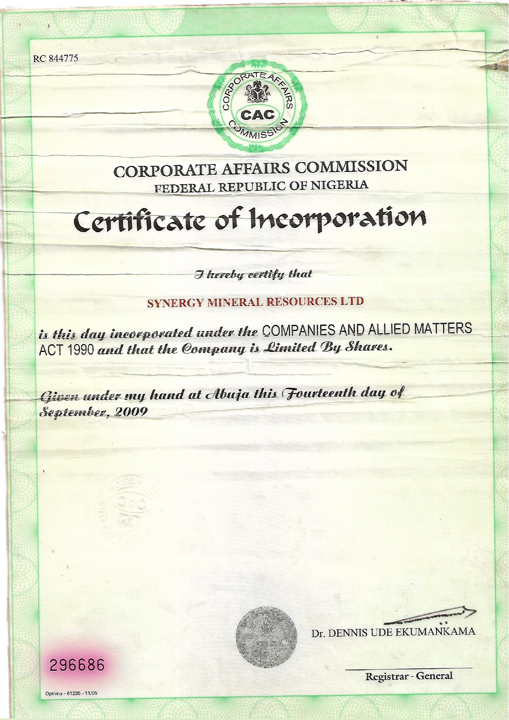

Slide 10
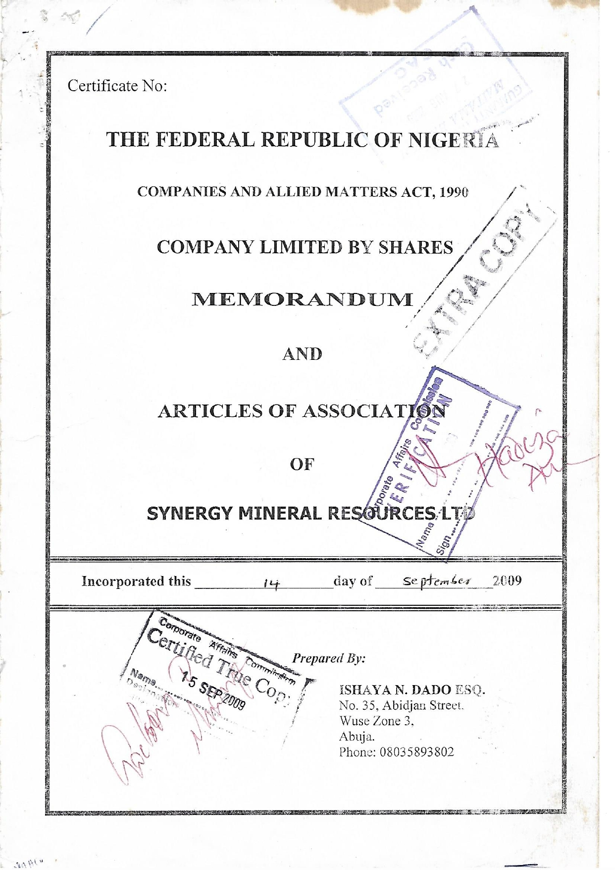

Slide 11
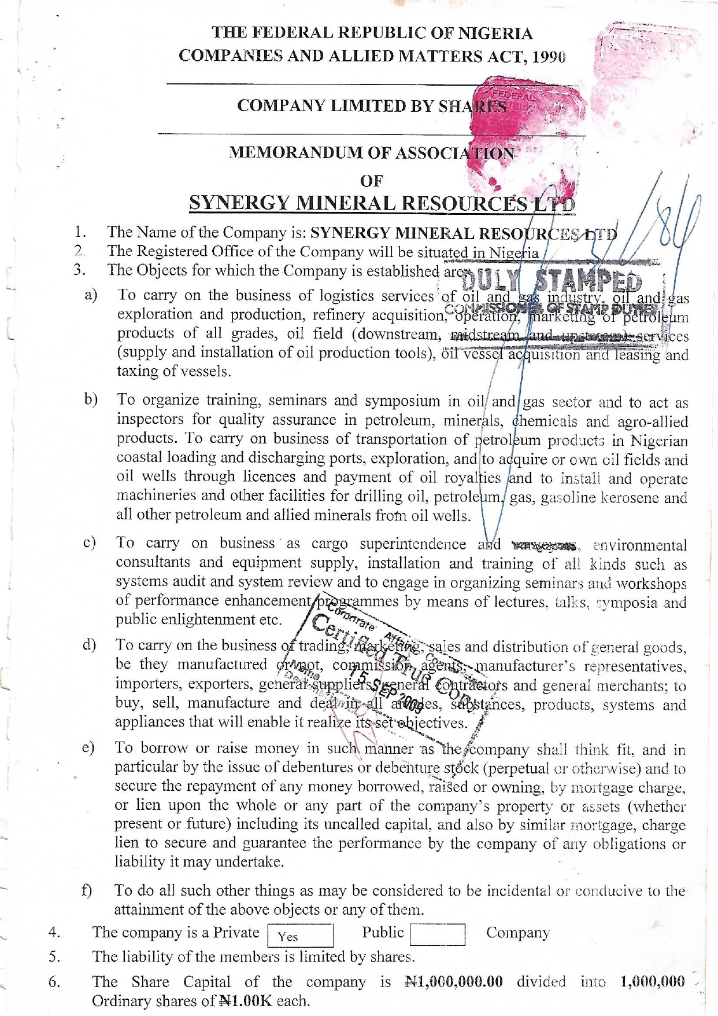

Slide 12
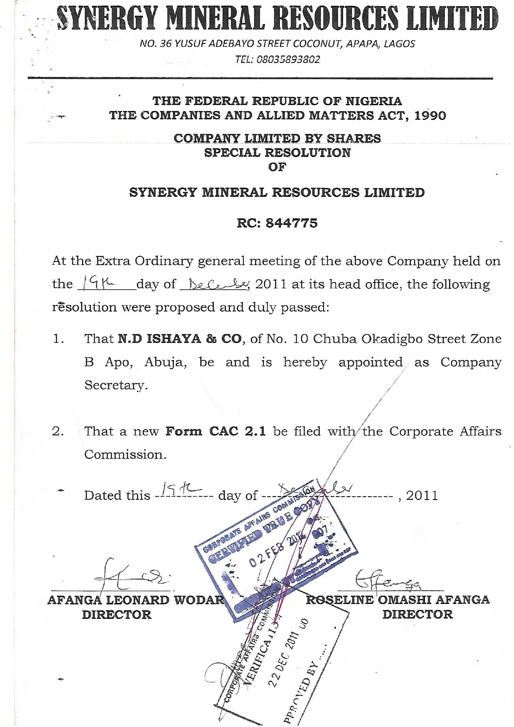

Slide 14
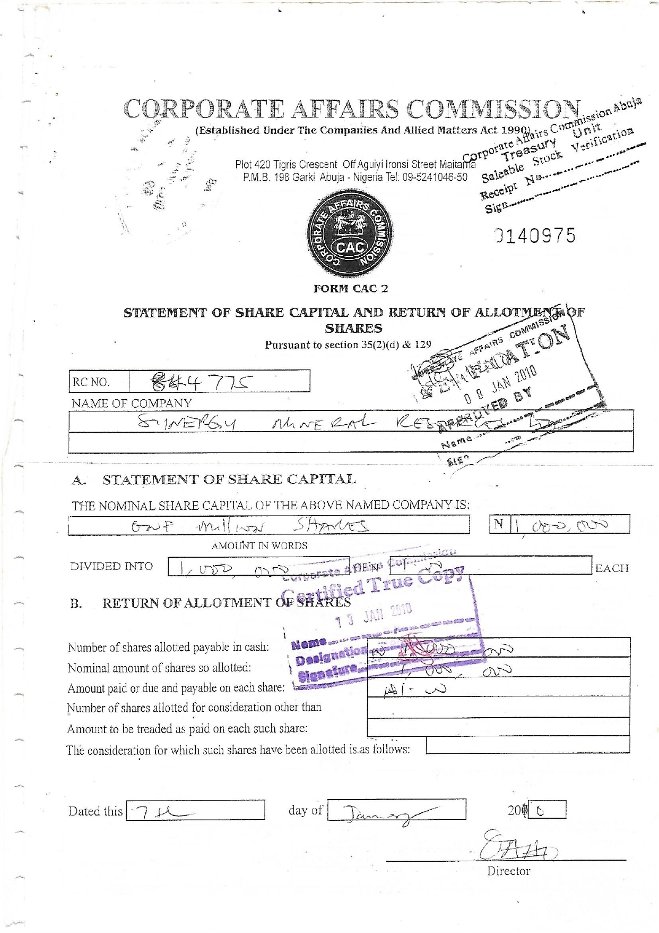

Slide 15
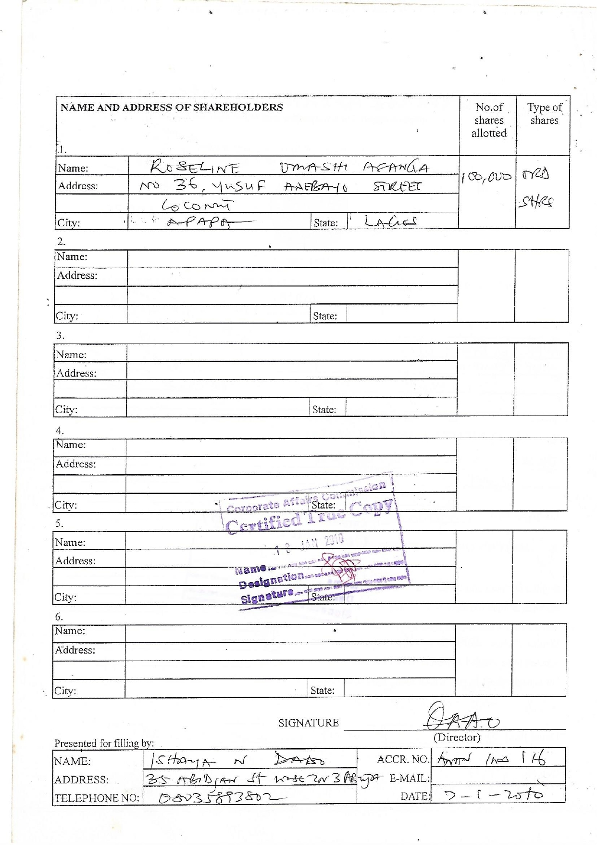

Slide 16
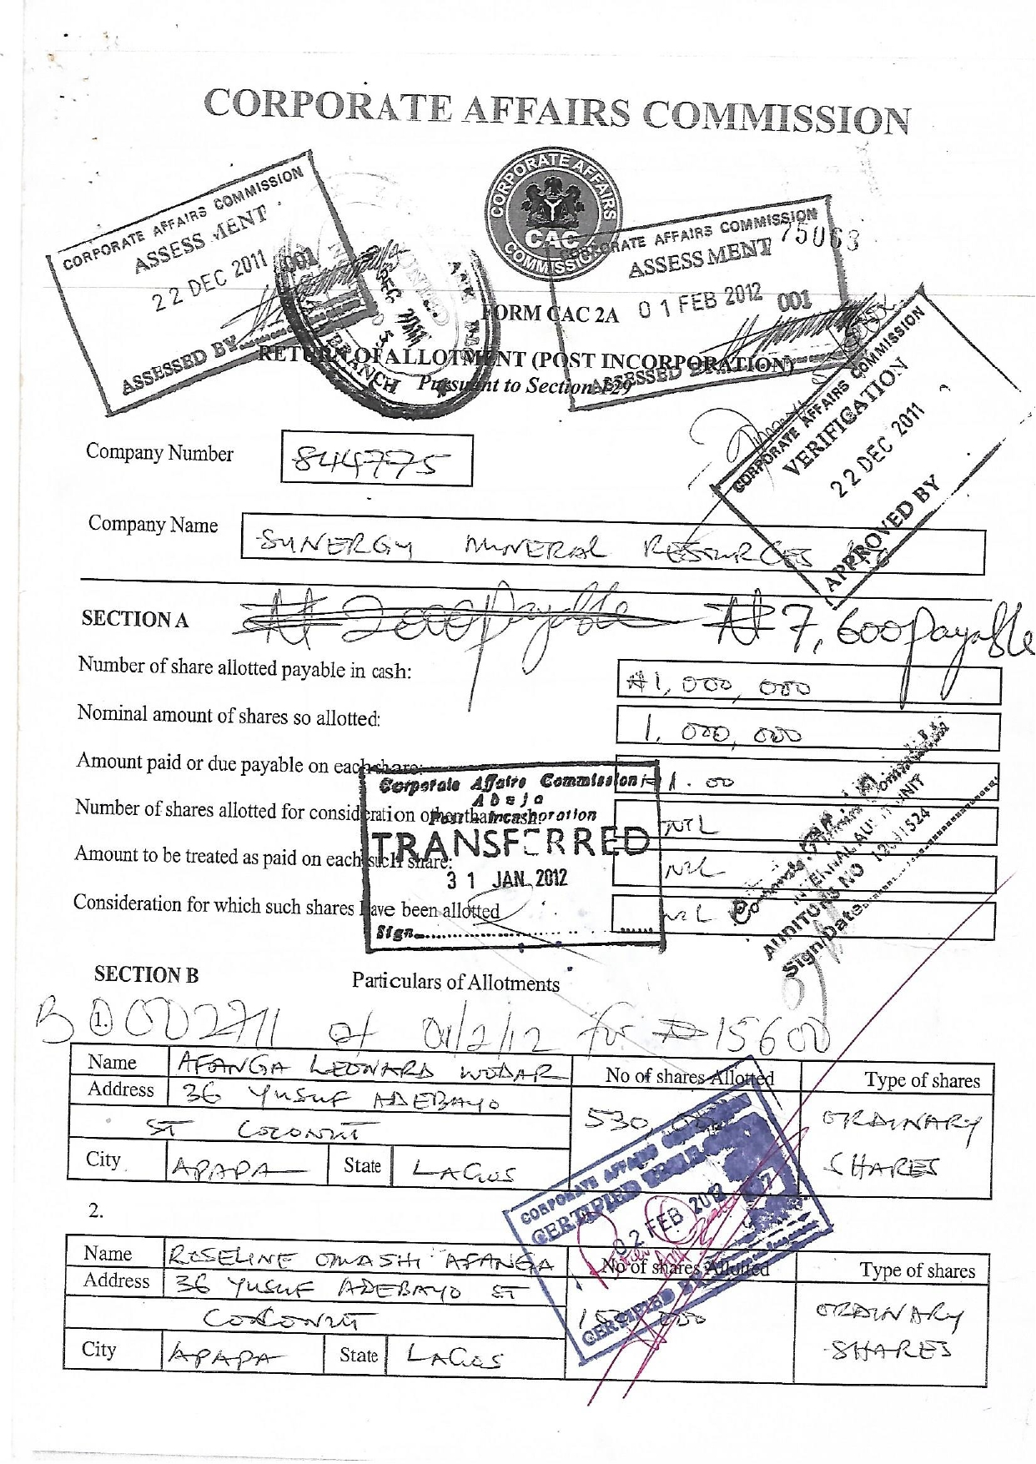

Slide 17
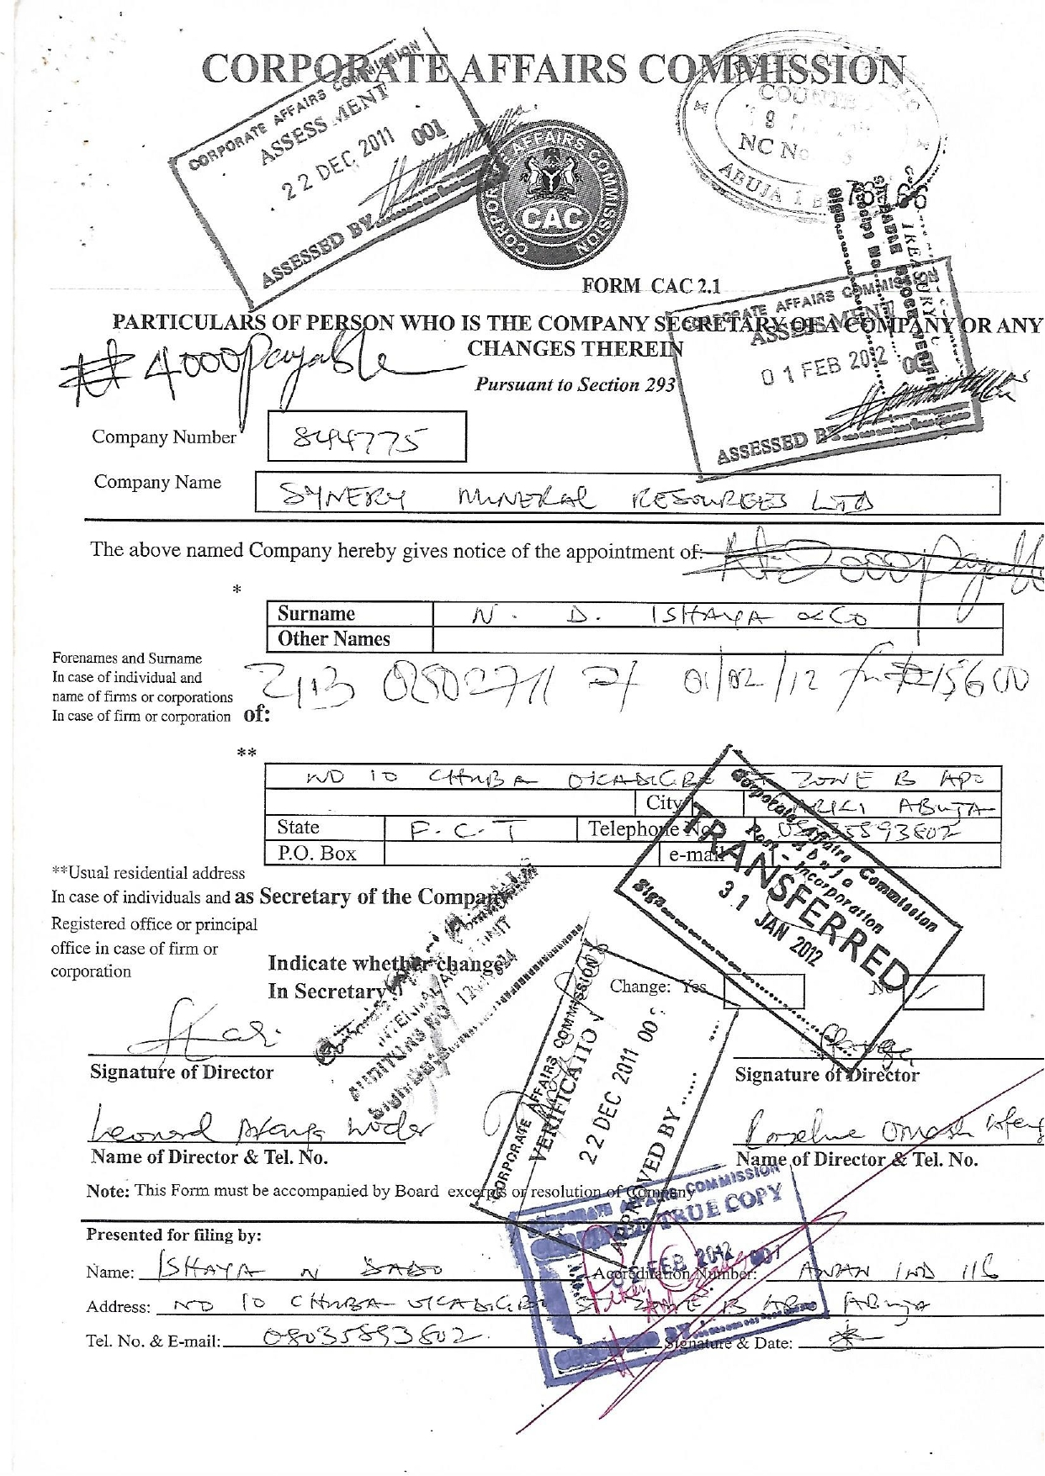

Slide 18
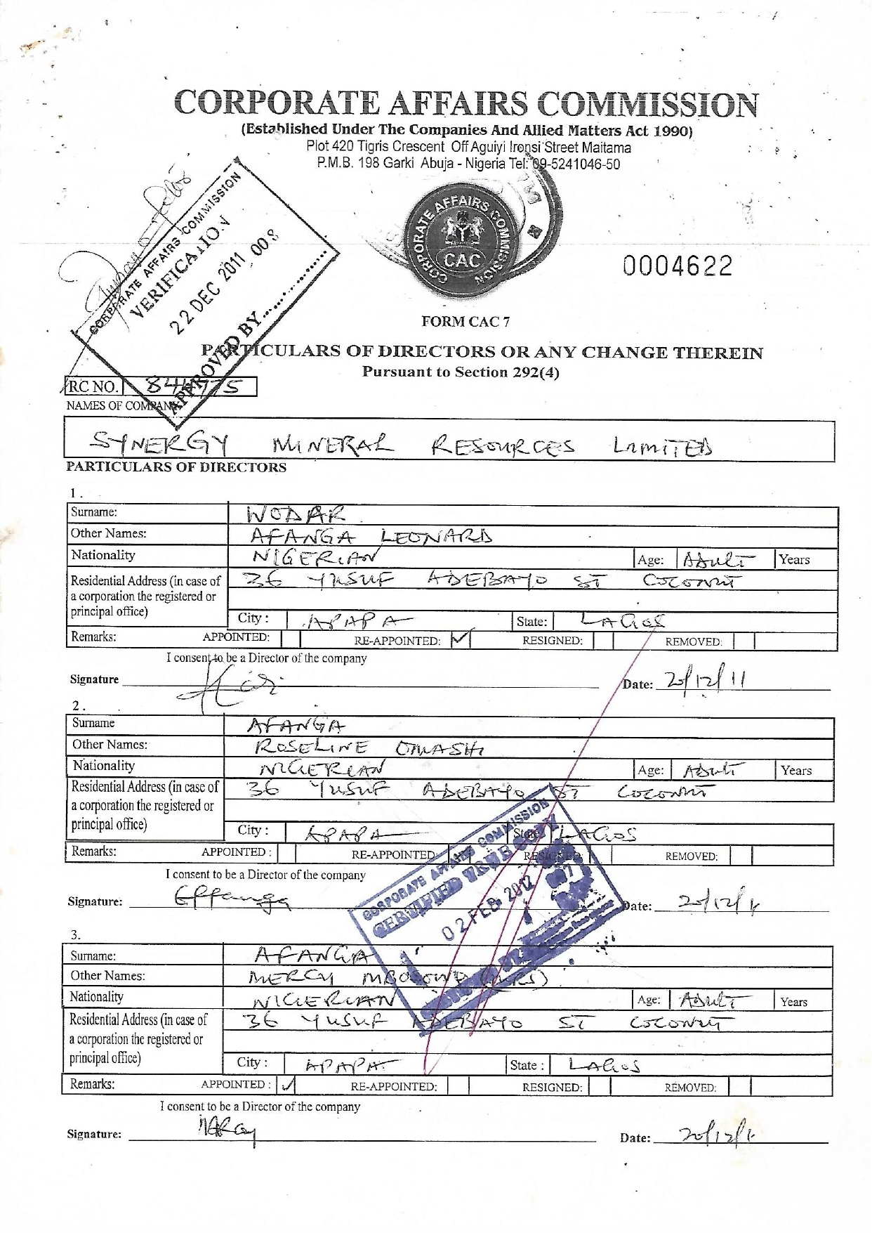

Slide 19
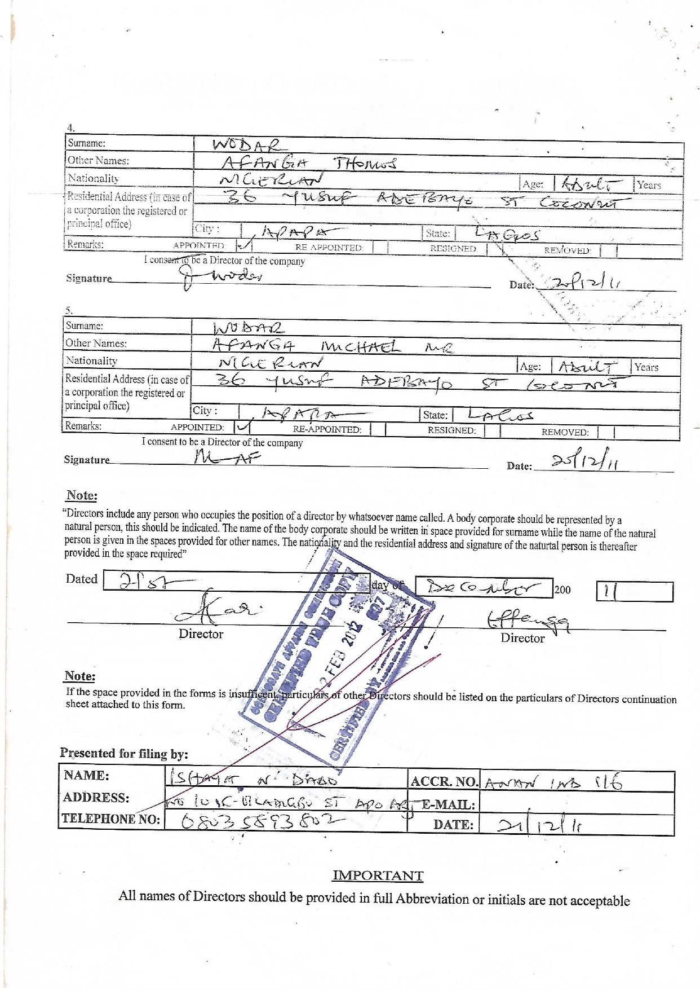

Slide 20
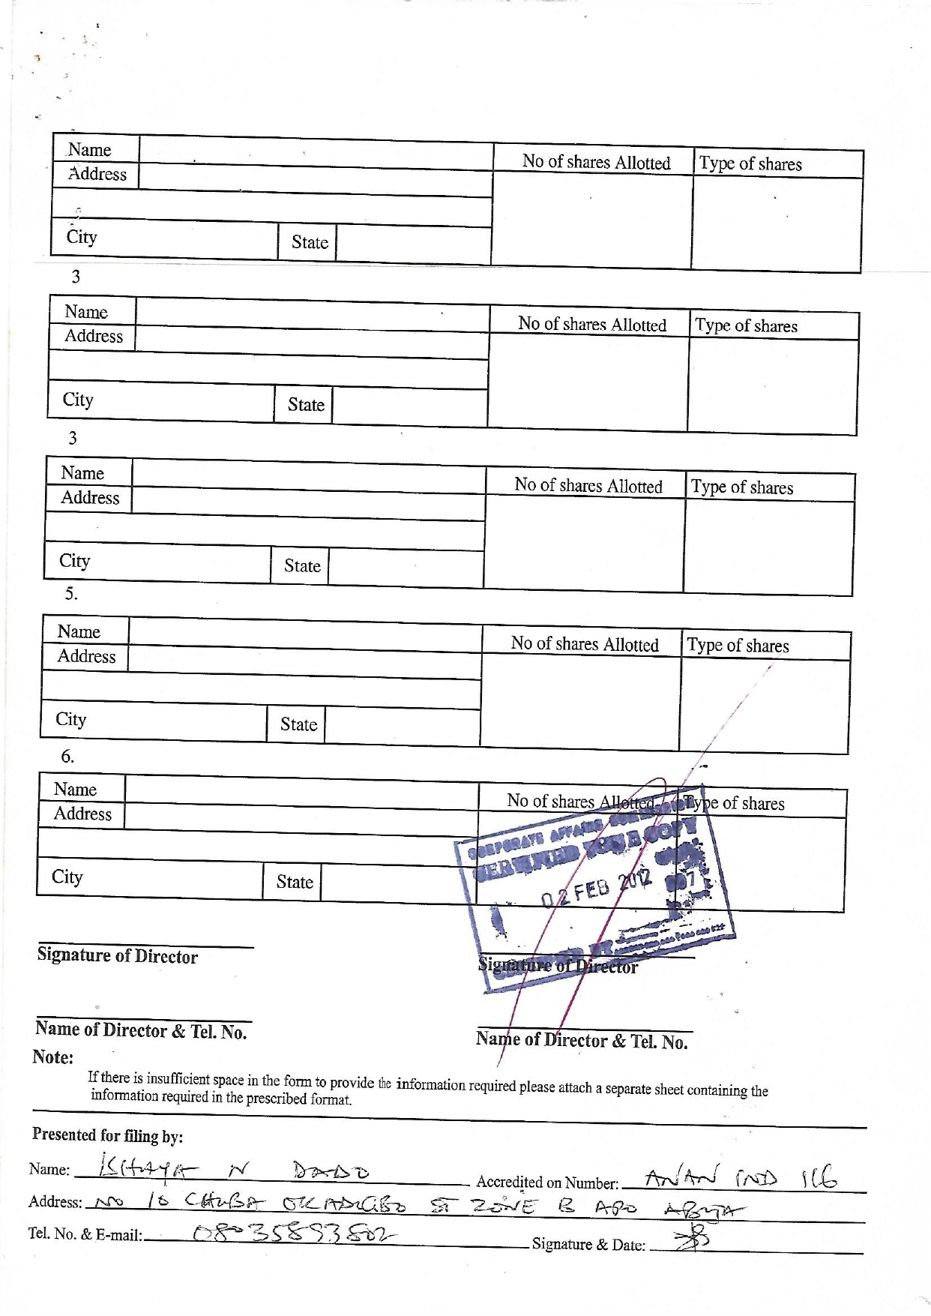

Slide 21
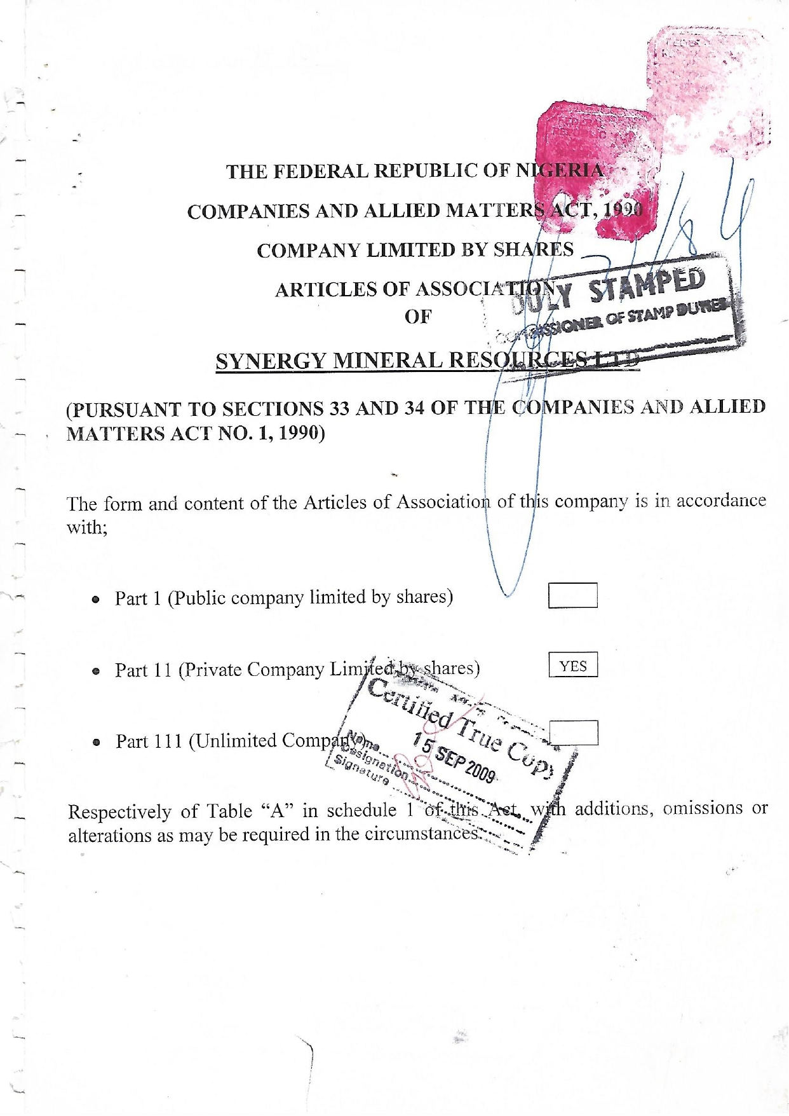

Slide 22
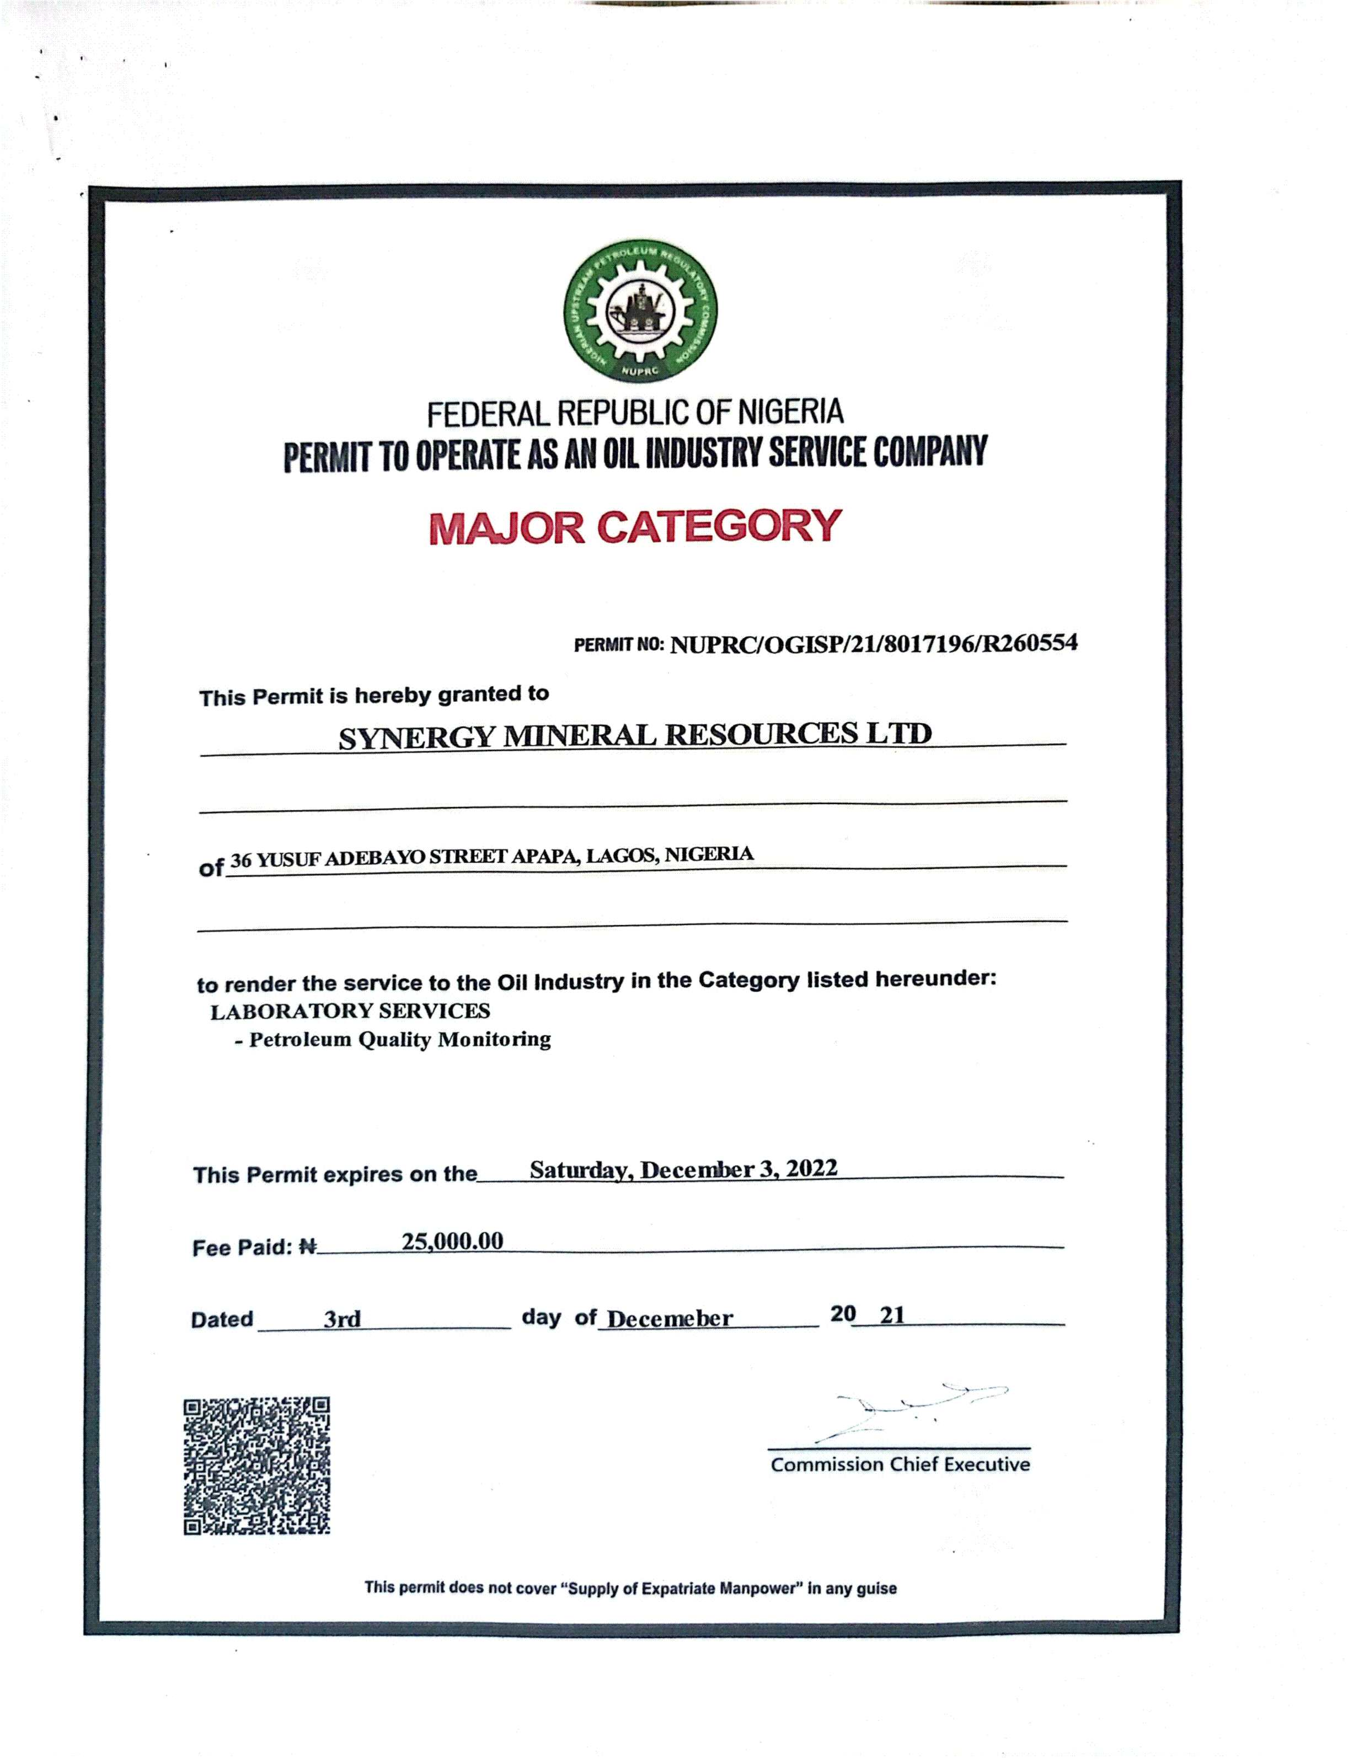

Slide 23
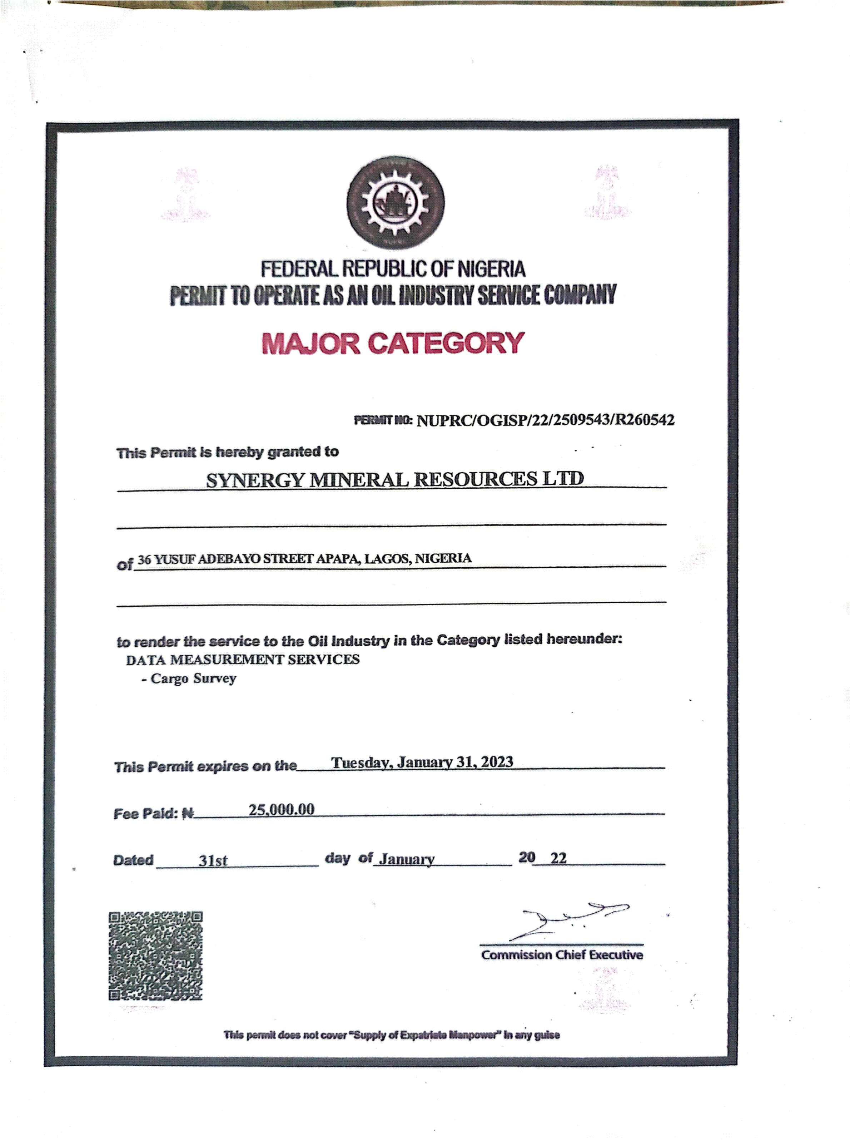

Slide 24
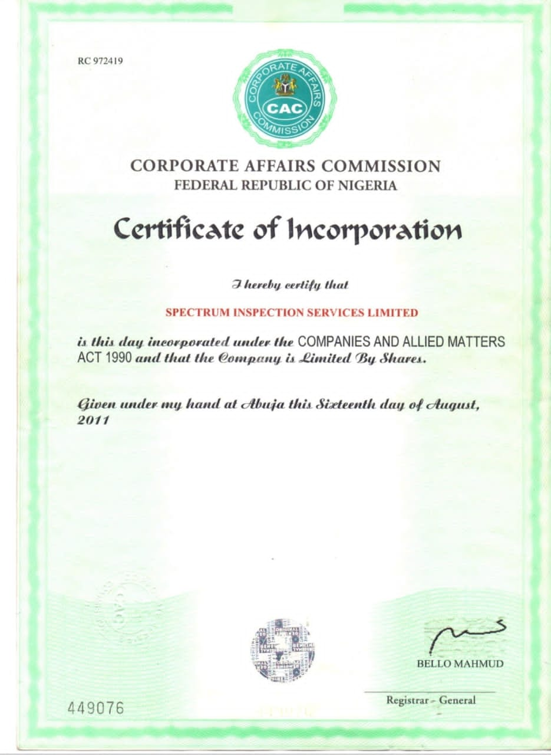

Slide 25
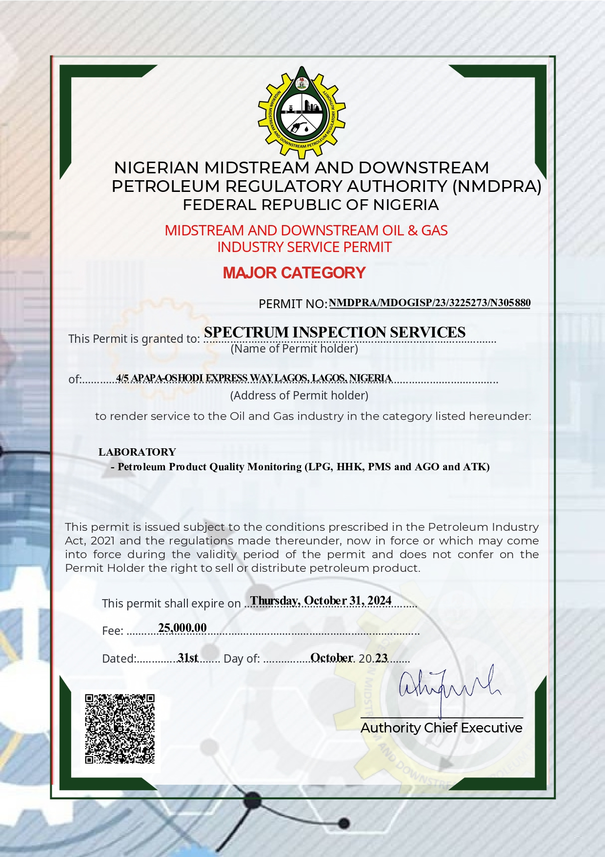

Slide 26
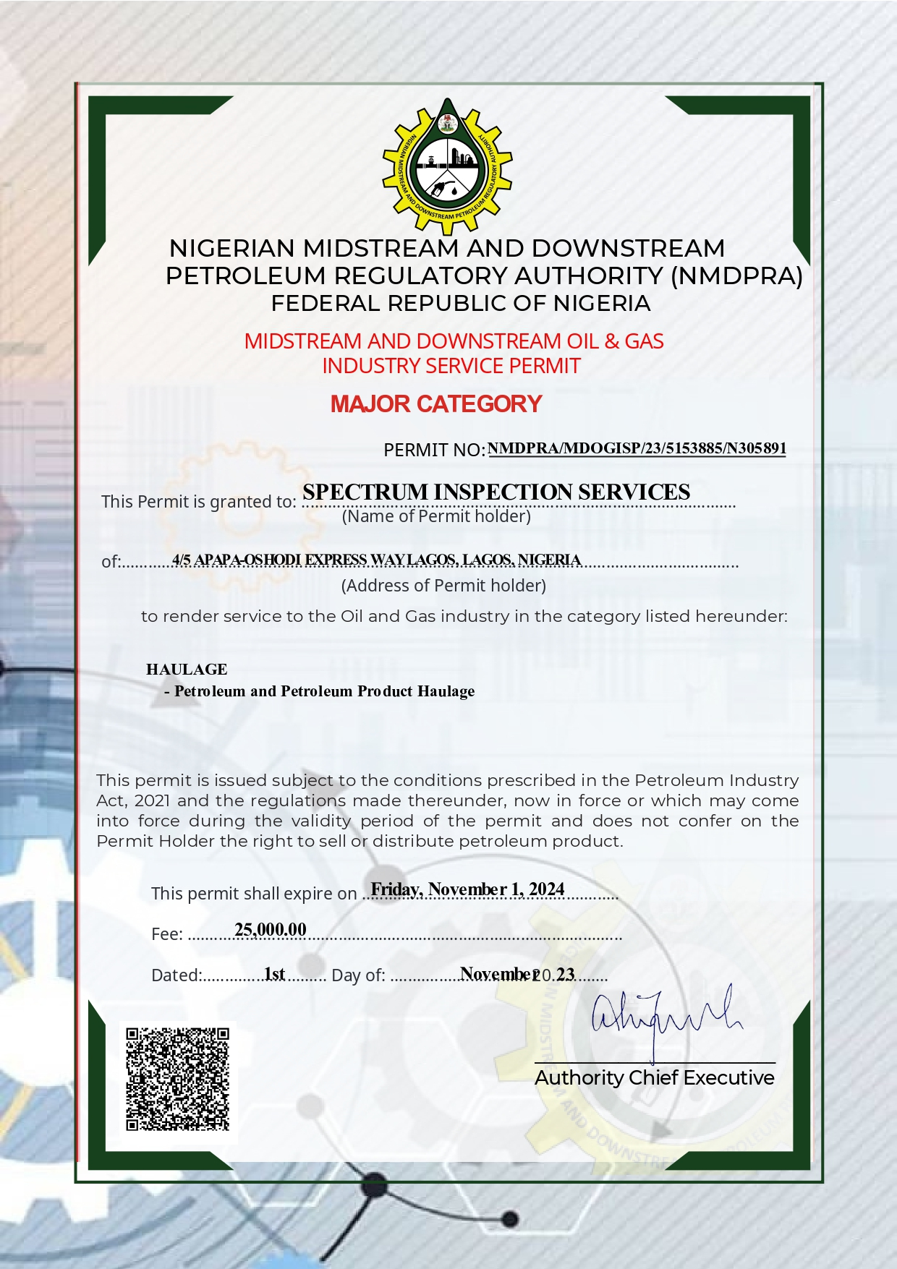

Slide 27
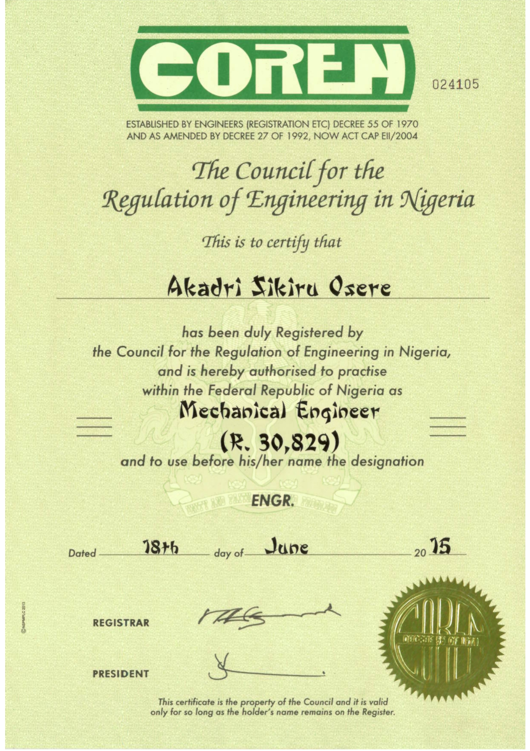

Slide 28
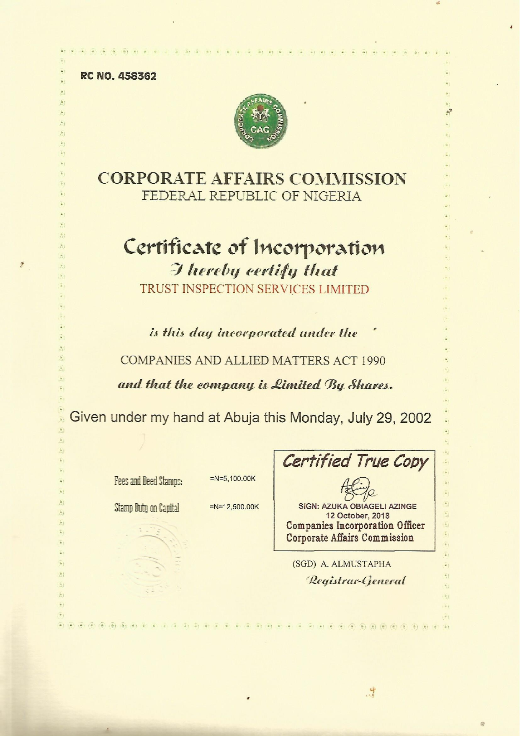

Slide 29
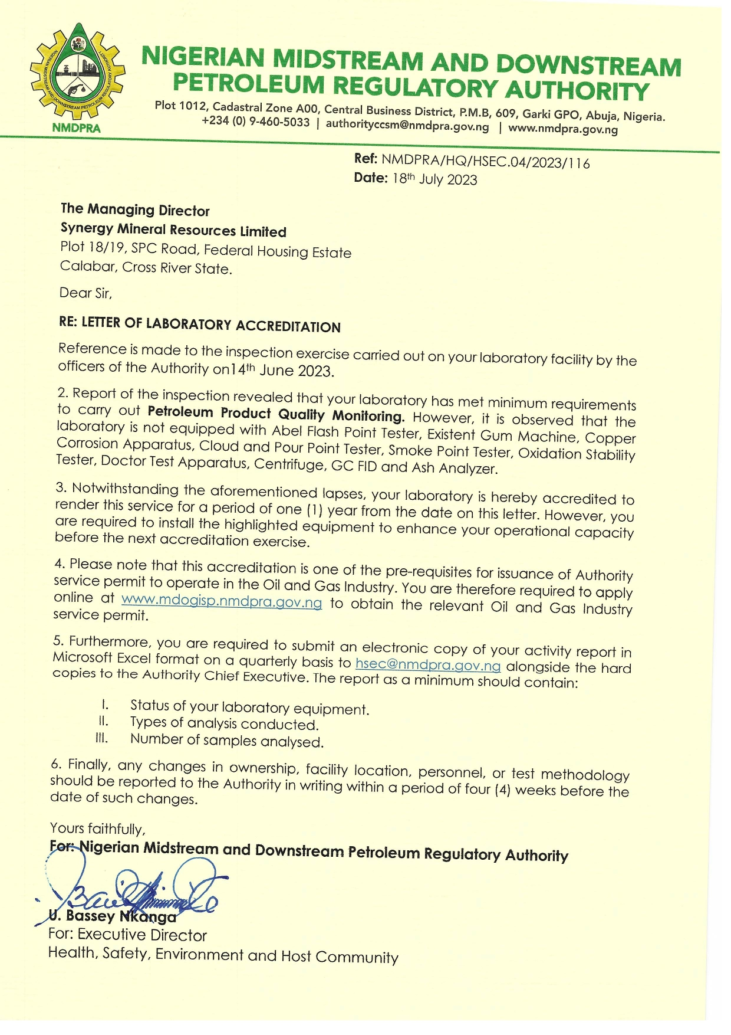

Slide 30
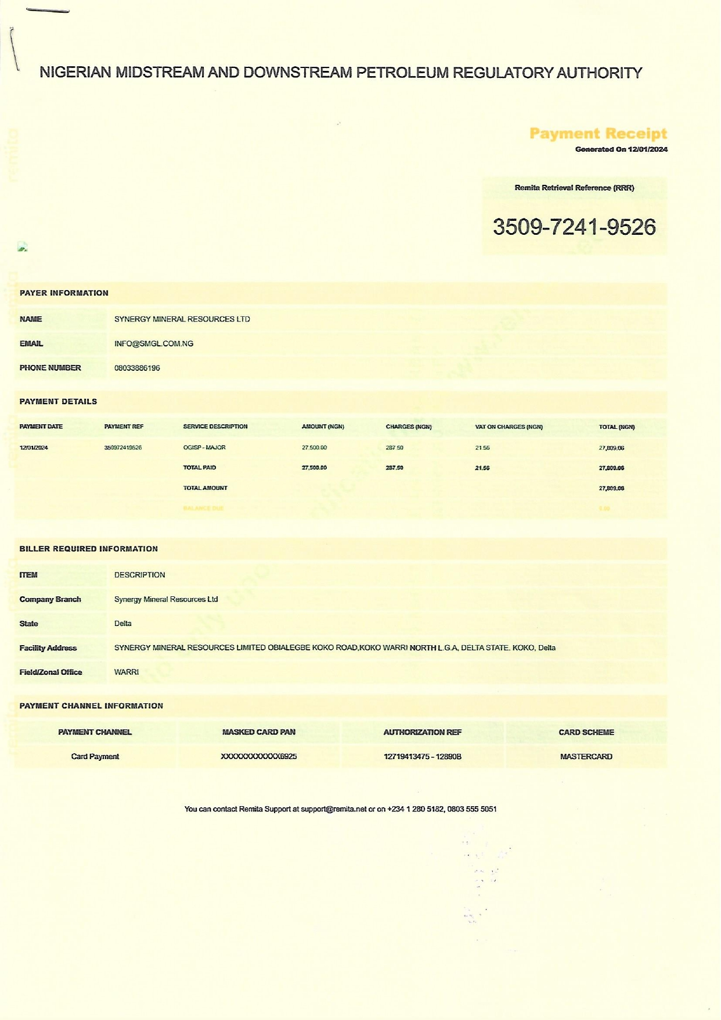

Slide 31
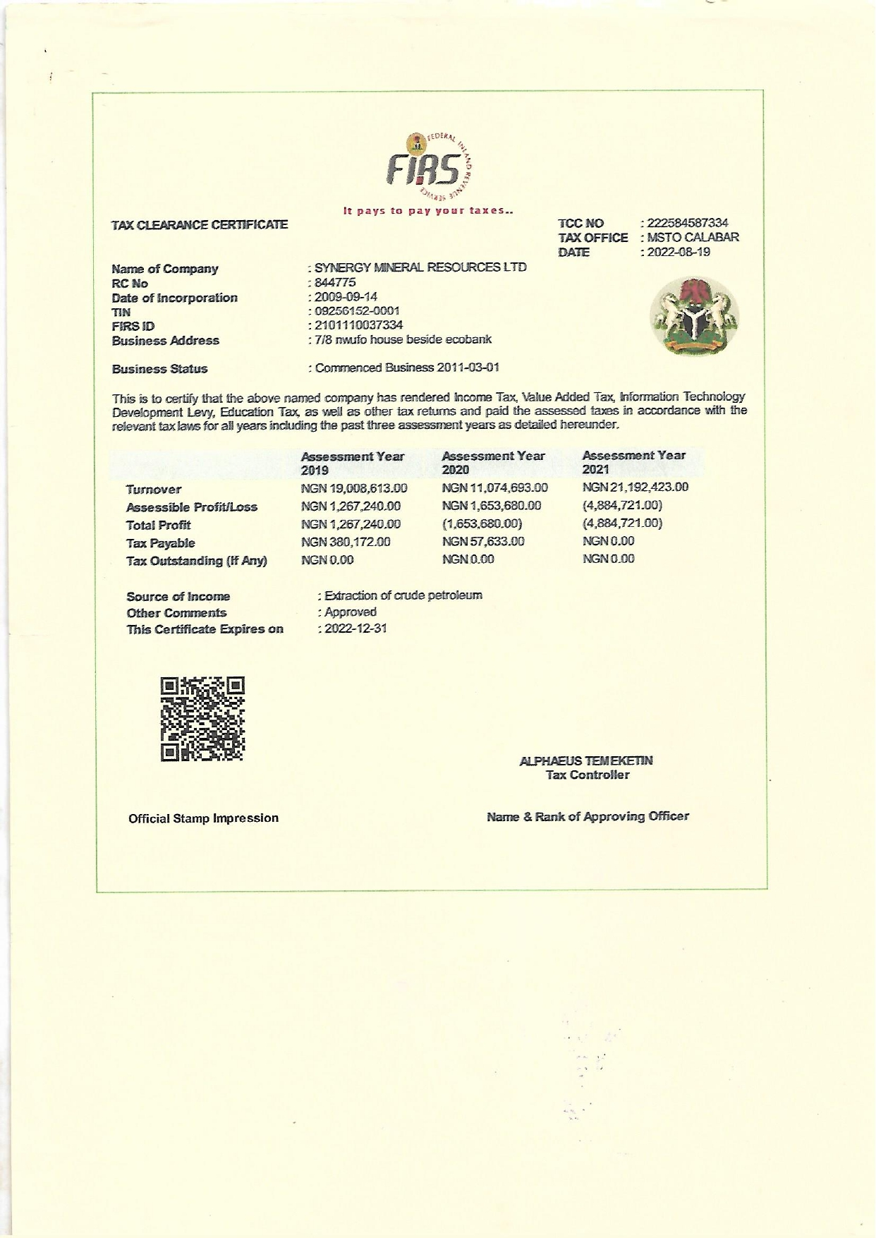

Slide 32
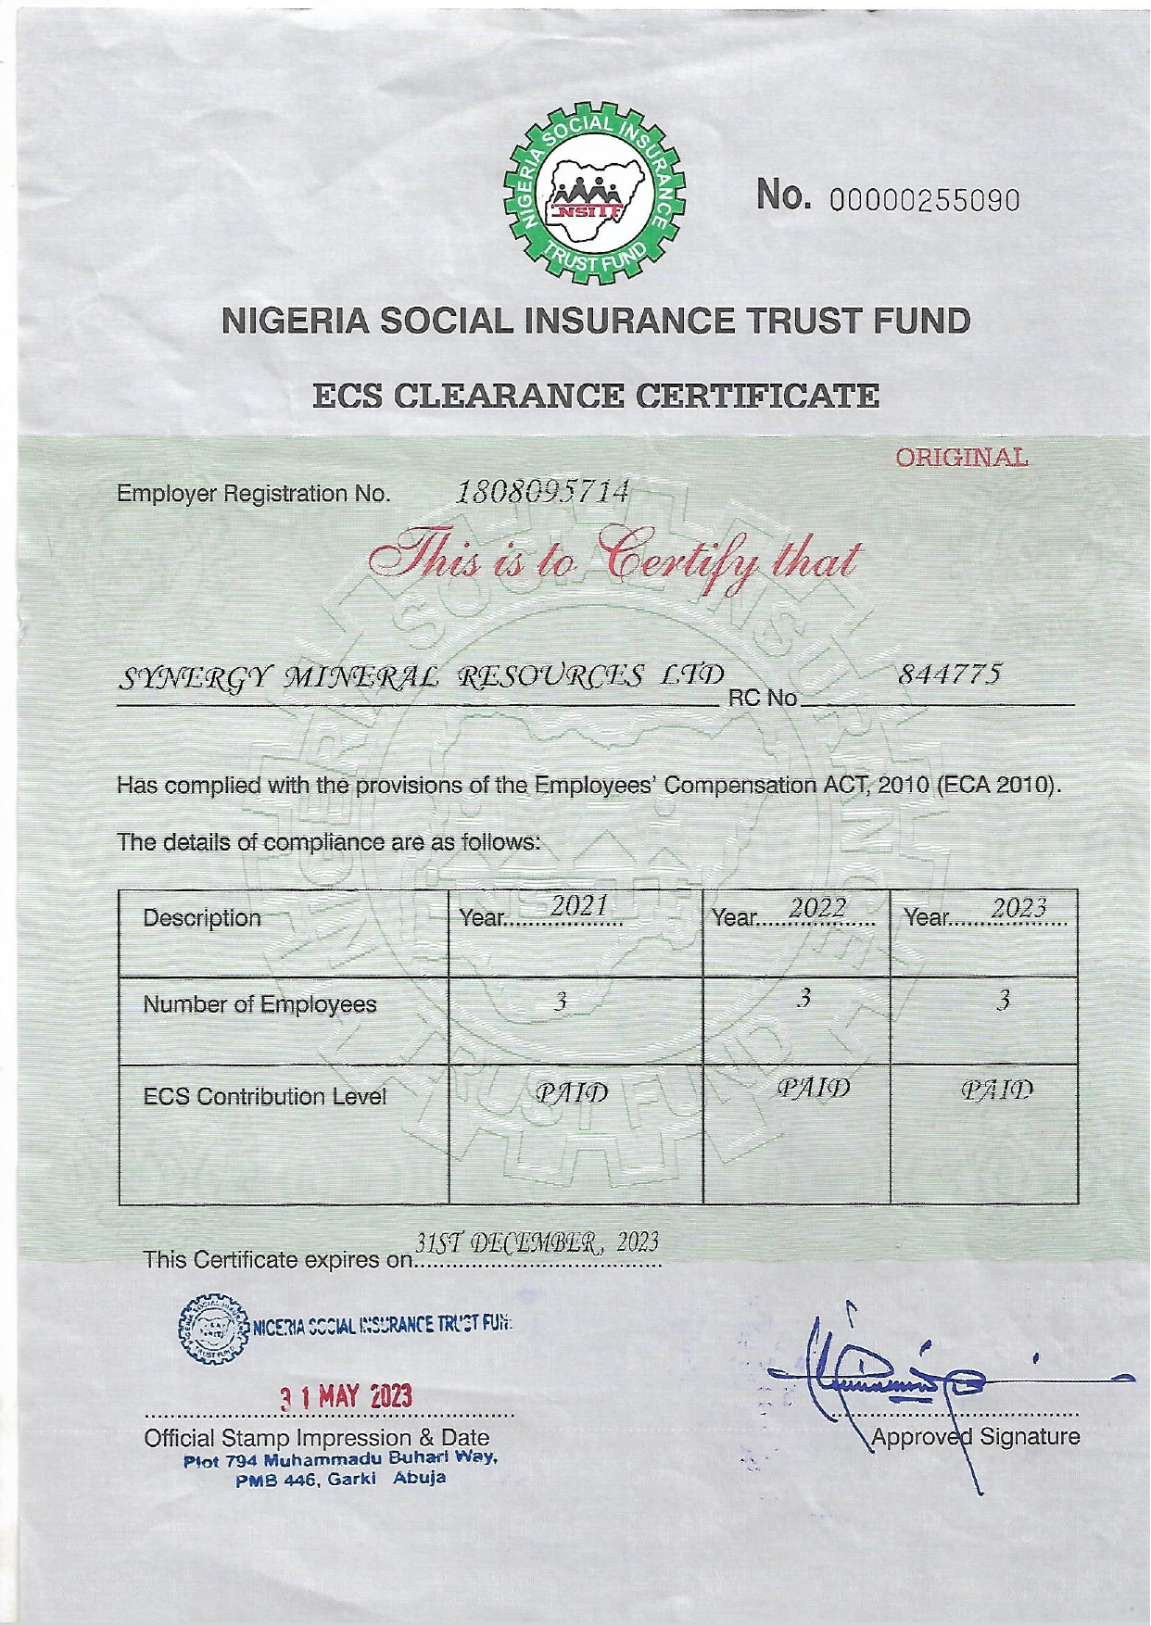

Slide 34
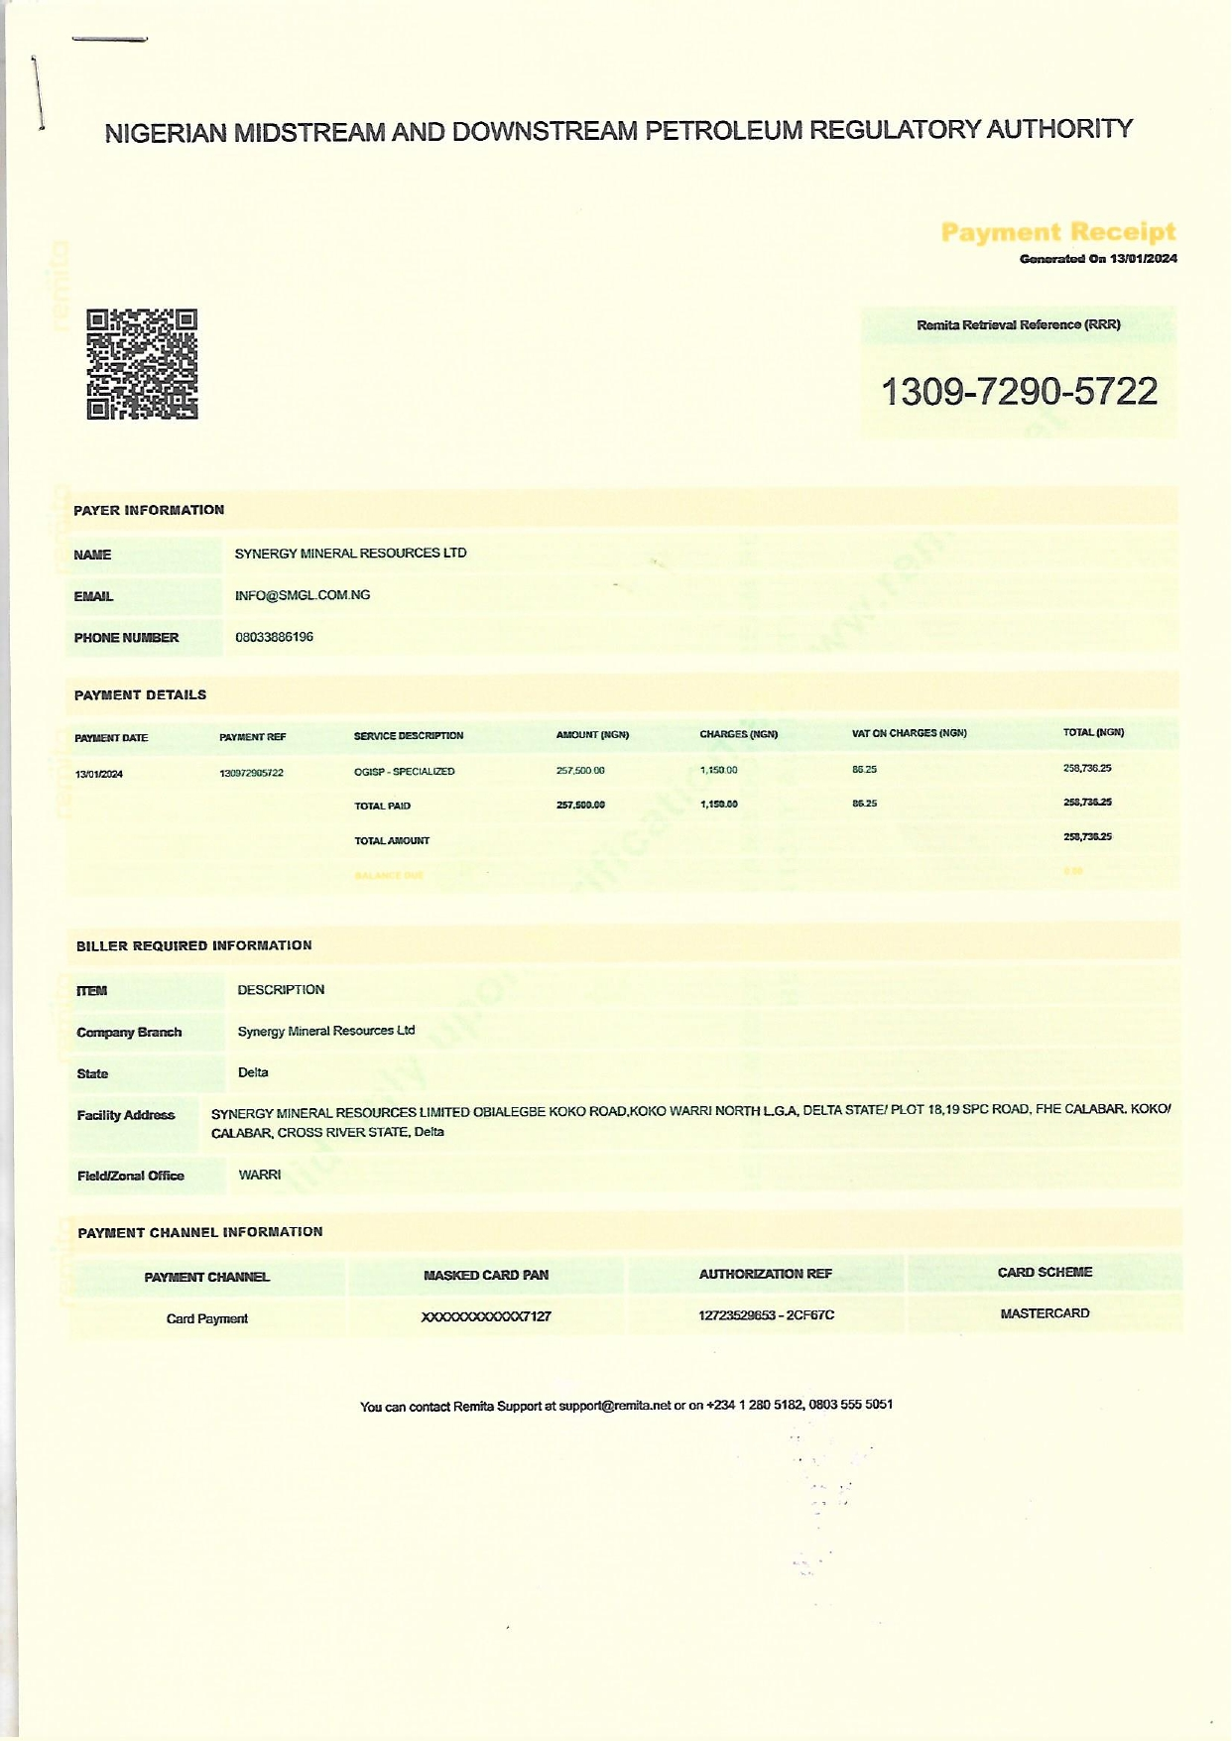

Slide 35
SYNERGY MINERAL RESOURCES LIMITED
The petroleum industry is known to be one of the world’s most regulated and competitive
market places, sound technical support, along with extensive local knowledge can mean the
different between conducting a profitable trade or not: whether financial or by reputation. Synergy Mineral Resources Limited and its subsidiaries have highly trained professional inspectors who are offering services to our clients whenever cargoes are being loaded, unloaded or transfer. Our inspectors and field representatives are supported by an adequate infrastructure and group of experienced professionals, many of whom are active members in the petroleum related organizations such as the federation of inspection agencies, American petroleum institute, the energy institute, the American society of testing and materials. Our inspectors are equipped with the latest technology and are formerly trained in all aspect of the inspection process. Many have achieved professional certification as IFIA “certified inspector of petroleum”.
Our extensive experience of many commodity areas includes;
Crude Oil
Light Distillates: LPG, LNG, Gasoline
Middle Distillates: Jet fuel, EN 590 Diesel, Naphtha, ULSD
Heavy Distillates: Bunker Fuel, Fuel Oil
Biofuels: Bioethanol, Biodiesel, Vegetable
Petrochemicals
We also provide a full menu of services including, but not limited to:
Custody Transfer
Inventory Control
Offshore Lightering
Tank measurement and calibration
Sampling
Bunker Surveys
cleanliness inspections
Tank Wall Wash inspection and testing
Auto-sampler operations
Investigation of Cargo Discrepancies
Laboratory Testing and Retain
Atmospheric Monitoring
The process of thorough examination of the condition of goods or product as such as minerals,
chemicals, drugs, consumers goods, agricultural product, equipment, tools, crude oil and other hydrocarbon liquids etc, period to or after custody transfer, using a certified equipment or a
master prover to ascertain their quality and quantity based on known standard or given specifications as stated by regulatory authorities, association or bodies is known as inspection.

Slide 36
SYNERGY MINERAL RESOURCES LIMITED
Some of this regulatory bodies, are API, MPMS (American Petroleum Institutions) (Manual Of
Petroleum Measurement Standard) ASTM (American Society for Testing Materials) IFIAS
(International Federation for Inspection Agency) NMDPRA (Nigerian Midstream and Downstream Petroleum Regulatory Authority) SON (Standard organization of Nigeria) NAFDAC (National Agency for Food, Drugs Administration and Control) or a standard put in place by the country of assessment.
CARGO HANDLING AND CLASSIFICATION
The form of cargo handling usually employed is determined by the nature of the actual cargo and the type of packing procedure used. Basically, the handling and movement of dangerous cargo by sea has to follow or conform to the regulations of the International Maritime Organization (IMO) code.
The classification and the code are as stated bellow:
Class One: Explosive
Class Two: Gas Compressed Liquefied or dissolved under pressure
Class Three: Inflammable Liquid
Class Four: Inflammable Solid and Substance
Class Five: Radioactive Substance
Class Six: Corrosive Substance
Class Seven: Miscellaneous Dangerous Substance
Class Eight: Poisonous (Toxic) and Infectious Substance
The ship owner will only handle such dangerous cargo by period writing arrangement and with the express condition the shipper provides a very and adequate description of the cargo.
CARGO SURVEYOR (PETROLEUM INSPECTOR)
Cargo Surveyor is an individual who is professionally trained to carry out petroleum product recertification in an unbiased manner in order to determine the quality and quantity of the product in accordance with set out standard and specifications. It may also be seen as an individual with technical knowledge and requisite expertise for the certification and quantification of goods and petroleum products based on stipulated regulatory standards or specification and relating same to he’s or her client.

Slide 37
SYNERGY MINERAL RESOURCES LIMITED
QUALITIES OF A GOOD CARGO SURVEYOR
He has to be knowledgeable of the ethics and standard practice of the profession.
Must be professionally competent, independent, and unbiased in the discharge of he’s duties.
Must at all times, have the interest of he’s employer or client at heart.
Proficiency in communicating correctly, both verbal and official rating language, probably English Language or any other languages considered.
Must be analytically, scientifically, and mathematically sound to a reasonable degree
Must be proactive and smart in the conduct of the job as the profession generally is problem prone. That is, he must anticipate problem and design a troubleshooting ideology.
Possess high level of human relationship. He has to psychologically, socially and emotionally balanced, as he may sometimes encounter some difficult client vessel operators and charterers.
Be committed in the discharge of he’s duties and have a teachable mind so as to embrace change in the operation procedures.
Exhibit high level of endurance and tolerance as the job most at times is risky and emotionally challenging.
Show willingness most at times to sacrifice the comfort of the home and families. This is because the job can take one to remote areas where weeks are spent without seeing friends and families.
However, other challenging attributes or qualities may be acquired in the cause of doing the job if other basic requirements are met.
ROLES OF INDEPENDENT INSPECTION AGENCIES IN CUSTODY TRANSFER OPERATIONS
Independent inspector or cargo surveyor is an independent observer with an unbiased mind, sound technical knowledge and requisite expertise for the certification of quantity and quality of product or goods involved in the custody transfer in accordance with set out standards and

Slide 38
SYNERGY MINERAL RESOURCES LIMITED
specifications and report the findings accordingly to the client. Independent inspection agency
serve as the umbrella under which cargo surveyor operates. It is a registered corporate
organization or company saddled with the responsibility of quality and quantity cargo specification based on global standard and procedures.
The roles of inspection an agency in custody transfer includes but not limited to these:
To provide the requisite technical knowledge needed for the control or specification of quantity and quality of products before and after the custody transfer as required by the client. Note, the word (client) as used here refer to those parties who engage or higher the service of an independent inspection agency. This includes the Government agency, the bank, the chatterer, the vessel owners or operators, tank farm operators, oil marketers, and refinery owners or operators.
Represent their client in remote areas like the offshore locations where such clients are unable to reach in the cause of their business transaction.
They help in business risk reduction and loss minimization
Help in ensuring contract compliance and improving the rate and efficiency in the custody transfer.
Play advisory role to their clients in relation to the type of vessel to hire, operator to use and other logistics with regards to the oil business transaction.
Serve as third party in product reconciliation and as a witness in case of litigation.
Assist in advising their clients on intrinsic quality of the products they intend to buy, to avoid buying contaminated products or products that is off specification.
Interestingly, despite of the explicit functions or roles of independent inspection agencies in custody transfer operations, many oil business men, banks, and operators are in financial mess today because they thought the advice of the cargo surveyor or independent petroleum inspection agencies are not one of their major cardinal points of call before going into such risky prone business transactions.
It is very expedient that the independent inspection agent or cargo surveyor understands to a reasonable degree, the nature, location and operation of the contract binding he’s clients. this will enable a petroleum inspector or cargo surveyor to work hard in putting he’s decisions, actions and inactions in a proper perceptive to ensure that client’s interest is ultimately protected.

Slide 39
SYNERGY MINERAL RESOURCES LIMITED
TYPES OF CARGO INSPECTIONS
Prior to custody transfer, the basic cargo inspection types with respect to product or cargo acceptability or marketable marketability are cargo quality certification and quantity cargo inspection. However, on cargo inspection job specification, we have
ON THE SPOT INSPECTION: The job of the surveyor or petroleum inspector begins and ends at the port of inspection and no further superintendence on the voyage/port of discharge. The job of the surveyor may just be to ascertain the cargo quality, arrival quantity or loaded quantity at the port or to determine the cargo received quantity or discharge from ship, terminal or shore tank. Cargo pre-shipping inspection activities are part of on-the-spot inspection.
SUPERINTENDENCE CARGO INSPECTIONS: Here, the jobs of the surveyor or the petroleum inspector run across the voyage. He is in charge or responsible for the supervision of the cargo certification and quantification from the load port to the discharge port of the cargo and sometimes up to the receiving shore tank at the terminal.
STOCK MONITORING/CARGO TRUCKING INSPECTION: The job of the cargo surveyor ranges from monitoring and daily stock taking of the quantity of petroleum products in the shore tank as received in to the depot or terminal. Recording the trucking activities from the cargo from the nominated tank down to the depot gantry (metering point) and finally to the designated trucks for the product loading.
INVESTIGATIVE CARGO INSPECTION: It is an inspection process, usually carried out by an independent inspector or a third-party inspector, especially, as a quantity or quality recovery inspection process where there has been occurrence of huge ship-shore quantity and or quality variance as established by the first assigned inspectors.
PROCEDURES ON CARGO INSPECTION SHIP-TANK
In custody transfer measurement operations, there are three distinct procedures on liquid hydrocarbon quantity inspection with respect with the marine or sea hydrocarbon liquid shipment or movement chain. This includes:
Pre cargo inspection
Cargo Inspection

Slide 40
SYNERGY MINERAL RESOURCES LIMITED
Post-Cargo inspection
PRE-CARGO INSPECTION: Pre-Cargo inspection involves all pre-fisicalisation activities prior to cargo quantity measurement or certification it guarantees to a reasonable degree minimal error and consequently, loss minimization in measurement of cargo quantity onboard or in shore- tank #. The pre-cargo inspection varies with the job mandate or job specification the location and operation to be executed. Though we have
Pre-cargo inspection ship: Pre-cargo inspection on the ship has different approach with respect to the conditions of ships cargo tanks. That is, whether the sheep is empty or loaded.
Pre-cargo Inspection, Empty Ship (Pre-Loading): Prior to cargo loading, the ship’s cargo tanks have to be inspected to ascertain its worthiness or cleanness to load the said cargo. The process is carried out in other to avoid contamination of the incoming cargo to ascertain the OBQ if any and to make sure there are no trace of free water in the tank before loading operations
Pre-Cargo Inspection Checks Prior to Cargo Loading:
Opening the drop line and cargo lines to allow if any previously discharged cargo or water which may have been trapped in the line top flow into the cargo tank. This helps to prevent the contamination of the to-be-load cargo. The first foot and manifold samples should also be taken immediately cargo loading commence as a correlation to the quality of the after loaded cargo and the incoming cargo.
Inspect the cargo tank with both MMC and Product-Water finding paste in a close cargo tank with I.G (Inert Gas) for possible OBQ or water retention.
Open the void space, cofferdams etc, and inspect cargo tanks that have neither inert gas nor entrapped gas visually.
The Chest Valve should be short and sealed off.
Find out the cargo lines and Drop Lines Valve to be used for the operation and every other one should be closed and sealed off.
Confirm the integrity of the pump room, engine room, and then shot and seal off all lines and valve that are required for the present operation.
You should request for the loading plan for the present operation to make sure the tanks are planned to be slackened on completion of loading especially in an open sea loading.

Slide 41
SYNERGY MINERAL RESOURCES LIMITED
CUSTODY TRANSFER/ CUSTODY MOVEMENT:
The material needs of a man and the commercial or economic value attached to those material over the years and the ways of sourcing for these materials from where there are found or produced to where there are needed as always prompted man and the material to be moved or transferred from one place to another. When the owner of such resources decides to mover it from where there are produced to where there are needed for economic purpose, that is custody movement. However, he may decide to give out these materials or goods in he’s custody to another person in an exchange for something equivalent to what he has, that is custody transfer.
In summary, when two or more parties (based on accruable economic benefits) binding by the law financially and legally, agree on specific terms or contracts to engage on business transactions with respect to custody movement or transfer.(with a resultant monetary exchange or its equivalent) from someone ‘s custody or possession known as consignor (either through ship to shore, ship to ship, or shore to shore via pipeline to another person, custody or possession known as consignee it is termed custody transfer.
Area of interest in custody transfer
Basic areas of interest in custody transfer operations emanates from coordinated web of activities within the hydro-carbon liquid movement chain. This includes
Technical interests: All products or goods must undergo inspection to ascertain their quality and quantity prior to and after the custody transfer. The type of inspection conducted majorly depends on the technical procedures and the requisite expertise employed in the operation with respect to specification and standard given by the regulatory body. The product has to be on specific condition on transfer from one point to another with its legal and financial binding. The need to employ the service of an independent inspection agency to supervise and to make sure the terms of the contract are not violated becomes inevitable. Independent inspector or cargo surveyor ensure there is minimal risks through laws minimization and in tracking the product movement in order to know precisely at what point the quantity or quality of the goods or products was altered. Independent inspection agencies play a very important role in custody
transfer by providing indispensable technical information to the transacting parties. Also, where there is litigation between the parties, the technical report and independent inspection agency will serve as a witness in the law court.

Slide 42
SYNERGY MINERAL RESOURCES LIMITED
Legal Interest: There is always, a contractual agreement between the parties engaged in
the transaction in custody transfer which is legally binding. The parties are bound by the
terms of the transaction in relation to quality and quantity, time and safe conduct of operations. Any breach of the terms amount to litigation and that is why parties involved are very careful and cautious of what documents they sign or not to sign in the cause of the custody transfer operations. One of the reasons for the legal interest is that, if there be any violation in contract terms, the parties already have a platform on which reconciliation can proceed.
SAMPLING PROCEDURES
Synergy Mineral Resources Limited laboratories are conscious of the fact that the results obtained from an analysis can be as the representative as the sample obtained, involving the services of third-party laboratories in conjunction with our laboratory to ensure full analysis in all our products.
To achieve this, we have to put in place the following vital procedures for sampling:
Nature of sampling
Sampling equipment
Sampling container
Time of sampling
Proper Storage of left-over samples after analysis
Quality Analysis
TANK SAMPLING METHODS
Tank to Tank sampling
Upper, Middle and Lower sampling
Composite sampling
To achieve the desire result, proper sampling techniques and equipment are used, this comprises of cork stopper, theft can with graduated cord and, sampling cans.

Slide 43
SYNERGY MINERAL RESOURCES LIMITED
In case of third party, sampling requirements that conform to standard methodology should be
followed and the laboratory should be notified if there are any questions. Sample containers
and preservatives that comply with standard methods are provided to our clients at affordable charge.
In the event that samples are not collected or stored properly, or they have exceeded their standard recommended holding time prior to submission to the laboratory, a disclaimer is provided in a cover letter that is sent out with the analytical reports. The disclaimer for expired samples reads as follows: "This sample had exceeded the recommended holding time as set forth by the data contained in this report should be used for qualitative purposes only".
Since synergy’s primary analytical product is the organics, the following summary contains the proper bottles, preservatives, temperature, and holding times.
A. TRACKING OF SAMPLES THROUGH LAB
Log-In / Storage
Sample log-in takes place in a designated area for sample log-in only. The chain of custody form
is reviewed upon submission for completeness before samples are accepted. The samples are checked against the chain of custody form for any discrepancies, errors or omissions. A "chain of custody" is a standard form that is filled out by "requesting parties" indicating information for the sample identification and the analyses to be performed, along with reporting and invoicing information. All chain of custody forms is kept in a binder by the QA/QC manager until all requested analyses have been performed.
Upon receipt in the lab, each project is given a unique tracking number, and is logged into a log book. Log-in information includes: date received, tracking number, client name, project name and analysis requested.
Each sample container is clearly labeled with a unique tracking number using a permanent marker or label-maker. Samples are stored in dedicated locations based upon the analysis to be performed. Samples for volatile analyses are placed in the refrigerator, and are not transferred to avoid contamination by semi-volatile compounds. Semi-volatile samples have a separate refrigerator.
Each sample is recorded on a dedicated, wall mounted scheduling board in the appropriate section of the laboratory, based upon the analysis to be performed. The information logged onto this board includes the tracking number and requested analysis to be performed. This scheduling board is for the instrument operator's use only, and alerts the chemist to new projects in-house and any analyses to be performed on a rush deadline.
An extraction log is kept which records the date, analyst, analysis number, matrix and method used for all extractions. A separate extraction log is kept for volatile methanol extractions and semi-volatile extractions.

Slide 44
SYNERGY MINERAL RESOURCES LIMITED
TECHNICAL PARTNERS
COMPANY REPRESENTATIVE IN WEST AFRICA
Synergy Mineral Resources Limited is a representative of U-THERM INTERNATIONAL H.K. LIMITED IN WEST AFRICA.
1. U-THERM INTERNATIONAL H.K. LIMITED (LABORATORY EQUIPMENT MANUFACTURING COMPANY).
RM 803 CHEVALIER HOUSE, 45-5, CHATHAM ROAD SOUTH TSIM SHA TSUI KOWLOON
HONG KONG.
Tel: 0085282283663
Below are some equipment manufactured by our technical partners and with their support we will be able to offer comprehensive analyses of all types of petroleum products.
ANALYTICAL PROCEDURES
RESEARCH OCTANE NUMBER (RON) ANALYSER ASTM D2699 PROCEDURE:
Connect the battery appropriately (positive side of the battery to positive side marked on the equipment)
Rinse the RON Analyzer cup properly with the sample you are to analyze and fill to the marked region of the cup
Attach the cable of the cup to the port on the equipment appropriately Power on the equipment
Select Octane if you are analyzing PMS while if you are analyzing AGO select Cetane
Wait until the equipment finish analyzing the sample, record the last result gotten after a beep sound from the equipment as your final result
Disconnect after the equipment shows good bye and goes off on its own.
DISTILLATION UNIT ASTM D86 IP 123
PROCEDURE:

Slide 45
SYNERGY MINERAL RESOURCES LIMITED
Fill in water into the water chamber of the distillation unit which help to cool the sample as it
flows through the distillate pipe. Note: ensure to use Ice when distillation volatile samples e.g., PMS, Naphtha etc.
Take a round bottom flask and measuring cylinder, rinse them properly with the product you intended to work with and drain off completely the sample by turning the flask upside down on the rack.
With the aid of a measuring cylinder, measure 100ml of the sample and pour it into the distillation flask neatly.
Open the distillation chamber and place the filled flask on the appropriate ceramic sitter that will fits the base of the flask perfectly and fitting the fix the fume channel pipe into the hole were the distillate pass through that is constructed on the distillation unit with the aid of a cork to hold it tightly
With the aid of a cork, place the appropriate thermometer on the top of the distillation flask firmly. Note always use thermometer that is graduated up to 400 degrees Celsius.
Plug the equipment into the socket and power on
Switch on the light to help you see the distillate cylinder placed at the other side of the equipment clearly
Regulate your heat source to required voltage by using the voltage regulator. Note: for PMS set it at 150volt while for other heavy product the voltage should be set at 200volt
Take your readings as follows initial boiling point(0c), temperature @5ml, 10, 50ml, 90ml, volume(ml) for PMS recovery@700c @1250c @1800c, for AGO @2000c, @3570c final boiling point(0c)
3. SULFUR TESTER ASTM D 4294 IP 136
PROCEDURE:
Plug the equipment to the socket, power it on and read the instruction on the digital screen telling you top press enter to start the warming process of the equipment which usually takes 30mins.
Prepare the sample cup with the sulfur nylon and measure 5ml of the product you want to analyze and pour it on the prepared cup.

Slide 46
SYNERGY MINERAL RESOURCES LIMITED
Place the cup containing the sample on the sample chamber
Select 1 for sample measurement as instructed on the screen and then press start or enter key for it to measure the sample. Note; this repeat for 3 times in every 60sec and the average (total sulfur content) is calculated and prints out from the equipment.
Discard sample, power off the equipment and unplug from the socket for safety reasons.
4. COLOR COMPARATOR TESTER ASTM D1500 IP 196
PROCEDURE:
Open the compartment at the top of the equipment and bring out the empty glass at the left- hand side leaving the other one as standard
Rinse and filled the glass with the product sample to about 75ml. Insert it back into the compartment and close the lid
Plug the equipment to the socket and power it on
On regulating the adjustment knob at the right-hand side of the equipment, compare the color that best matches the other by viewing through the monocular lens on the equipment
Note the number on the number screen and trace to get the equivalent value on the color chat for final color result
Remove the sample, replace the cup back to its position and power off the equipment.
5. FLASH POINT TESTER ASTM D 93 AND D92
PROCEDURE:
Open the compartment, take the cup and rinse properly
Fill the cup to the mark with the sample to flash and replace it back to the compartment Close with the lid and insert the thermometer with the holder on the port on the lid
Connect you gas cylinder to the equipment appropriately and spark your flame on the right place
Plug the equipment to the socket and switch it on

Slide 47
SYNERGY MINERAL RESOURCES LIMITED
Regulate the voltage to 200v
Continue flashing the sample at every 1 minute by twisting the flash turner until it flashes Record the temperature at wish the product flashes as you flash point result.
REID VAPOUR PRESURE TESTER ASTM D323
PROCEDURE:
Fill the water bath up with water to at least 25.5mm higher that the top of the gas compartment
Plug the equipment to the socket and switch the heating element on
Set the temperature of the water bath to 37.80c and wait until this temperature is attained at stable 37.80c ±0.10c.
Take out the pressure bomb (Manometer) from the equipment compartment having the gauge on top
Loose out the lower cup of the pressure bomb(manometer), fill in the sample tightly.
Turn it upside down and shake it for about 8 times, and this should be done quickly at a maximum time of 5mins.
Put the manometer back into the water and leave for 5mins ensure that there is no leakage, and knock the manometer and observe the readout
Take out the manometer again and turn upside down and shake for another 8times then place it back into the water bath.
Do this repeatedly for three times in not less than 5 times of shaking and observe the readout.
Read the last pressure output accurately to 0.25kpa record the value as the un-corrected vapor pressure.
After the test, take off the manometer and turn the equipment off
KINEMATIC VISCOMETER TESTER ASTM D445 PROCEDURE:
STEP 1: Plug the equipment to the socket and switch the power button on

Slide 48
SYNERGY MINERAL RESOURCES LIMITED
Switch On the temperature button to heat the water bath up to the required set temperature
to 400c for viscosity @400c
On the stirrer to aid in stirring the water been heated to a uniform temperature and wait until it is achieved
Ensure that your temperature sensor reading connected to the water bath been displayed on the digital screen of the equipment correspond with the temperature reading of the mercury in glass thermometer inserted to attain accuracy if there is variation between the two reading , ensure it is set by long pressing the set button on the equipment until the PV changes to SC and change the value by subtracting or adding depending on the variable noticed between the glass thermometer reading and the temperature sensor reading.
Take your viscometer tube(U-tube) and pour a small amount of the sample to fill up the lower ‘U’base and half of the lower bulb.
Clamp the viscometer glass tube with the provided clamp and inset it to the chamber on top of the water bath and wait for 15mins to allow the temperature of the sample to be uniform with the temperature of the water bath.
With the aid of the rubber sucker, suction up the sample to fill up the middle bulb of the viscometer tube completely and half of the first bulb.
Hold your timer and allow the sample to drain down slowly from the half of the first bulb and when it gets to the mark in between the first and second (middle) bulb, start your timer and allow it to read continuously the time it takes to flow through from the second bulb to the mark under the second bulb and stop your timer immediately this is achieved.
Record the time (seconds) and repeat the suction process three times and take the average time(seconds) as your time,
Turn off the equipment and calculate for your final viscosity result
Formula
Viscosity (V) = CXT
Temperature T measurement obtain Constant C is given as 0.035
Kinematic Viscosity (µ) = V*Density of the sample
The unit is centistoke ( CST)

Slide 49
SYNERGY MINERAL RESOURCES LIMITED
DATA REDUCTION, VALIDATION & REPORTING
CROSS CHECKS FOR CALCULATIONS & TRANSCRIPTIONS
Data generated at synergy passes through various stages of review before final reporting. All raw data is compiled and reviewed by the individual chemist operating the instrument, which
are submitted to the QA/QC manager. The QA/QC manager checks all quality control procedures and validates the data. Results are entered into the computer database and a final report is printed. The final report is reviewed by the acting chemist, who either resubmits for changes or signs off.
Reports are posted to the web site, or a FAX is sent to the client, when requested. If reports are posted to the web site, an email confirmation is sent. Reports are maintained in an Access database and the original report is sent to the client with a copy of the chain of custody form.
STANDARD TURN AROUND TIME
Rush analysis is provided, upon request, at the following rates:
Same Day Analysis: 3 times list price Next Day Analysis: 1 times list price Second Day Analysis: 1 times list price
Rush charges are billed to the client unless agreed upon by synergy and the requesting party prior to the sample being submitted to the laboratory.
CORRECTION OF ERRORS
Errors generated during analysis/review/reporting that are attributed to transcription are reviewed and corrected throughout the analytical process. During analysis, calibration errors
can occur with the input of an incorrect calibration standard concentration, which would be reflected in a failing calibration check or a non-linear curve. Analysts are trained to correct these errors and to document the discrepancy for the QA/QC manager in the form of a corrected bench report. The error is reported for review to ascertain whether or not a procedural problem is occurring.
All organic analysis reporting is generated via computer to the QA/QC manager, where upon review, a report is generated. Transcription errors generated at this point are corrected in the final reporting and again it is reviewed for procedural problems.

Slide 50
SYNERGY MINERAL RESOURCES LIMITED
Errors generated during the transcription of the QA/QC managers’ report to the final hard copy
are often corrected during review by the QA/QC manager by striking through the error and
writing in the correction. Errors are also identified and corrected during the acting chemist’s review. The hard copy of the final report is sent back to reporting for correction and regeneration.
RECORDKEEPING PRACTICES
All generated reports are kept in an Access database in the laboratory for a minimum of three Years.
Chain-of-custody records are kept on file along with the raw data that was generated.
EQUIPMENT:
Laboratory Glassware, plastic ware, utensils - All laboratory glassware and
Plastic ware, are resistant to corrosion, high temperature and routine cleaning. metal utensils are
Made of aluminum or stainless steel. Glassware is borosilicate glass and is free of chips, cracks or
flaws. All volumetric glassware used is Class A. Glassware is dedicated to each section of the
Laboratory, and no glassware is shared between sub-sections of the laboratory.
Refrigerators - refrigerator temperatures are maintained between 1 and 4 degrees C.
A thermometer with the bulb immersed in liquid is used to monitor the temperature.
Sample Containers – Complimentary sample containers are provided to all clients by synergy, When required, the sample containers are pre-cleaned according to standard protocol.

Slide 51
SYNERGY MINERAL RESOURCES LIMITED
USE OF PE's AND INTERNAL QC's
Source/frequency
Performance evaluation studies include ERA check samples for biannual performance. All results of performance evaluation studies are kept on file, and are available for perusal.
Use of Information
Performance evaluation samples are used internally as quality control checks, for locating problem areas and corrective action.
Independent Checks
Certified stock standards are purchased from a source other than those used in calibration. A midlevel 'independent check' is run after each initial calibration.
CORRECTIVE ACTIONS
The following brief summaries concerning corrective action policy are the general guidelines that are explained in more detail in the individual SOP'S.
EXCEEDING CONTROL LIMITS ON DUPLICATES
For any analysis, control limits that are exceeded are reviewed for the source of the problem other than matrix interference. Proper calibration is reviewed, and if calibration is at fault, initial calibration is repeated along with repeated sample analysis. If instrument maintenance is required, the correction IS documented and analysis is repeated. If the exceeded limit is due to matrix interference and cannot be overcome by dilution or cleanup, the sample results are flagged along with a disclaimer as to the matrix interference at the bottom of the final report.
FAILURE OF BLANKS and PE's
Reagent blanks in volatile organics that show contamination caused from the extraction process require a period of time after the extraction shift is done before volatile analysis begins. Sparge tubes are re-baked, and the blank analysis is repeated. Carryover from high level samples requires cleaning of the glass vessel as specified in the volatile organics SOP, and may require repeated analysis of the blank.
Performance evaluations are reviewed with the analyst, upon failure to locate the problem. Stock standards are checked for expiration and proper standard preparation is reviewed if the

Slide 52
SYNERGY MINERAL RESOURCES LIMITED
calculations are correct. Instrument performance is also reviewed for possible fault. Any maintenance as a result of failed PE's is documented in the instrument maintenance log.
OUTSIDE CALIBRATION RANGE
Sample results that are outside of the calibration curve range are diluted to an appropriate level and analysis is repeated. The impact of the dilution is reflected in the final report with an elevated detection limit that corresponds to the dilution made.
RESULT ADJUSTMENT
Organic analysis results are not adjusted, and are strictly forbidden. Spike results that indicate poor recoveries in a sample analysis are flagged in the sample results and the recoveries are reported. The following disclaimer is printed on the analytical report: "A low spike recovery was calculated due to a matrix interference which was encountered during the analysis of this sample."
REFERENCES
EPA SW-846, EPA 8000B, DETERMINATIVE CHROMATOGRAPHIC SEPARATIONS, Revision 2,
December 1996.
EPA SW-846, EPA 8260B, VOLATILE ORGANIC COMPOUNDS BY GAS CHROMATOGRAPHY/MASS SPECTROMETRY (GC/MS), Revision 2, December 1996. EPA SW-846, EPA 8270C, SEMIVOLATILE ORGANIC COMPOUNDS BY GAS CHROMATOGRAPHY/MASS SPECTROMETRY (GC/MS), Revision 2, December 1996.

Slide 53
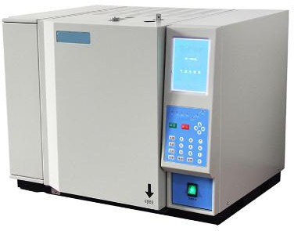
Gas Chromatograph
SYNERGY MINERAL RESOURCES LIMITED
Model: GC-7960A
Instrument Introduction:
GC-7960A gas chromatograph is the new type automatic gas chromatograph released by U-Therm International (H.K.) Limited, it was the improved model of our GC-7960. The instrument adopts large screen LCD monitor, audio-visual display, easy operation. Meanwhile the instrument is with digital interface, through one piece of communication cable realizing real-time data and signal acquisition, data processing and testing result on the computer. The artistic and compact appearance design, equipped with modern computer control technology, which makes GC-7960II become veritable, new type and high-performance gas chromatograph.
Features
The instrument adopts large screen LCD technology, audio-visual display, easy operation.
Self-diagnostic function, show trouble location.
Touching type keyboard is convenient for the user to set the operating data
The high-performance electronic components were used to improve the stability & precision. The life-span is longer with the extension function is better.

Slide 54
SYNERGY MINERAL RESOURCES LIMITED
Data power failure protection function, the operating data set by the instrument could be saved for long time after power failure.
Has the over temperature protection device. When the temperature is over setting limit, the instrument will stop heating and report malfunction on the display.
Large screen liquid crystal English display shows the instrument parameter intuitively, greatly convenient for the user to set parameters, such as each channel temperature, heating, detector,
bridge current, etc; Intuitively operate the functions, such as FID auto ignition, on-off bridge current, open and close temperature control, open and close heating and each time event, etc.
Split/splitless inlet system with diaphragm purge function makes the system more stable with better precision.
Flexible design which can install 4 detectors simultaneously, each detector has independent electronic controller and signal output port.
Flexible design for connecting different types of pack column and capillary column; 4 columns could be installed at the same time.
Main control circuit adopts advanced microprocessor, large capacity of Memory, making the data
saving more reliable. Meanwhile integrated design that integrating the measurement, control, power supply in one piece of circuit board, improve the anti-interference performance and reliability of instrument.
Adopt temperature controlling circuit of microprocessor, temperature accuracy of controlled object each heating zone reaches 0.1 degree.
Intelligent double back opening door technology, ensure that instrument column box temperature has good temperature control accuracy, and could cool quickly.
With standard 9-steps heating program, expandable to 21 steps program heating, fitting for analysis of complex samples of wide boiling point.
Unit type integral structure design, convenient installation and maintenance.
Technical Parameters
Column Oven: RT－450℃, precision ±0.01℃(@200℃). Inlet: RT－450℃, precision ±0.01℃(@200℃).
Detector: RT－450℃, precision ±0.01℃(@200℃).
Up to six channels of temperature control: suitable for multi-channel temperature control needs such as adding reformer.
Column Oven parameters:
Temperature control accuracy: room temperature 8℃－420℃accuracy±0.1℃. Column Oven volume:280mm×300mm×280mm.
Program heating order: 9 steps. (Can be increased to 21 steps) Program heating rate:1℃－50℃.
Constant temperature holding time of each order:0－300min(1min increment)
Automatic rear door opening design ensures fast cooling.
High-power, low-noise rotating fan ensures temperature uniformity.

Slide 55
SYNERGY MINERAL RESOURCES LIMITED
Pneumatic system
The carrier gas flow rate adopts the double stable design of first stabilized and stabilized flow. Accurate scale pneumatic control valve parts with high reproducibility and high stability.
Injection method
Fill the column head to inject. Packed column gasification injection.
Capillary split/splitless injection: backpressure valve control technology, linear splitting.
Six-way valve gas injection.
Online injection: continuous injection for 24 hours without supervision (patented technology).
High sensitivity detector parameters to ensure data accuracy
Parameter↓ Detector→ | Hydrogen flame detector (FID) | Thermal conductivity detector (TCD) | Electron capture detector (ECD) | Flame photometric detector (FPD) | Nitrogen and phosphorus detector (NPD)
Maximum operating temperature | 420℃ | 400℃ | 350℃ | 400℃ | 400℃
Detection limit | ≤3×10⁻¹²g/s | ≥6000mvml/mg | ≤1×10⁻¹³g/ml(r-666) | Mp≤5×10⁻¹²g/s Ms≤5×10⁻¹¹g/s | Mn≤5×10⁻¹³g/s Mp≤1×10⁻¹²g/s
Baseline drift | ≤0.10mv | ≤0.15mv | ≤0.10mv | ≤0.15mv | ≤0.15mv
Baseline noise | ≤0.01mv | ≤0.015mv | ≤0.02mv | ≤0.02mv | ≤0.02mv
Linear range | ≥106 | ≥104 | ≥104 | ≥103 | ≥103
Technical features | Fully automatic ignition; optional EPC | Imported tantalum tungsten wire Cross flow circuit | Ni63 radiation source with cleaning gas path | Top photomultiplier | Trace analysis
Other parameters: Dimensions: 590*480*500mm Total Weight: 55 kg Input power: AC 220V±10% 50HZ 1800W
AS-2902 Auto Sampler

Slide 56
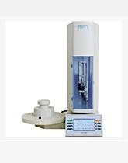
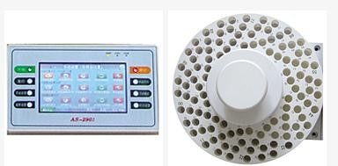
SYNERGY MINERAL RESOURCES LIMITED
Product name: AS-2902 auto sampler Product model: AS-2902 universal
Product introduction:
The AS-2902 auto sampler is economical device designed for chromatographic analysis which requires sample preparation. Eliminating the need for complex manual operations, improve work efficiency. The instrument uses precision imported motor drive, greatly improving the accuracy and reproducibility of the analytical sample; every driver part equipped with the coded feedback system to achieve real-time monitoring, and
reflect the stability of the instrument. The large size of the man-machine interactive interface is easier to operate. The instrument can be used for the high stability of the liquid samples and high-precision
quantitative injection.
Product features
A simple touch screen operation of the Interactive page.
Easily convert among more than two languages to facilitate the use of customers in different languages.
It can be also manual injection; stable injection speed and precise injection quantitative.
Precise stepper motor driver and encoder feedback system is high stability.
Auto-complete clean the injection needle, label and extract samples.
Support a variety of 120 sample tray specifications.
A variety of communication interfaces to complete with the synchronous operation of the chromatograph with the host computer.
Appearance, small size, light weight, easy installation and versatility.
High automation degree, unattended, 24 hours of uninterrupted work, greatly improved work efficiency.
It can be connected various types of gas chromatography and inject to a number of inlet.
Main Technical Parameters:
Syringe specification
Sample tray specification
1,5,10,25,50,100,250,500μl
15digit sample tray and 110 digit sample tray
Times for each line injection 1-99 times
Time distance for each injection 0～9999s Minimum quantity 0.1μl
Maximum quantity 500μl Method type 20

Slide 57
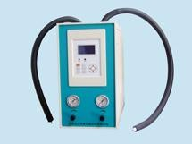
SYNERGY MINERAL RESOURCES LIMITED
Maximum support injection 2
Max support injection lines 110lines Max times for clean pin 20times Max times for pump20 times
Viscosity delay time 0～120 s
Interval pre injection or after injection : 0～300 s
Time interval for PTV Injection speed choose
Sampling precision
0～300 s
fast, medium fast, slow, user-defined
±1%
Headspace Sampling System
Picture:
Model: GC- JP-6010
Introduction:
GC-JP-6010 is an automatic injection system with new designing concept
Features:
1. High-pressure injection system without 6-way injection valve; so there is no problem for the valve- memory effects.
Spring quartz capillary pipes are adopted for transporting the sample; thus to avoid the abnormal effects on sample analysis.
With high precision & low repetition error.
Auto anti-reverse-blow function to prevent cross infection between different samples.

Slide 58
SYNERGY MINERAL RESOURCES LIMITED
Microprocessor controlling with timing function. Pressure adding, sample feeding, analysis, and anti- reverse-blow are automatic.
No need to modify the GC system.
Technical |  |  |  |  |  | Parameters:
1.InjectionBottles QuantityofBottles: |  |  |  |  |  | 9
MaterialofBottles: |  |  |  |  |  | NeutralGlass
Volume of | Bottles: | 10ml, | 20ml | or | other | volumes
2. Sample Sample | Feeding | Bottles: | Line: |  |  | Temperature RT+15℃～150℃ RT+15℃～150℃
3.Controlling |  |  |  |  |  | Program
Outer
Programming Grades: 4-grad programming
Controlling:
3
SYNERGY MINERAL RESOURCES LIMITED LABORATORY EQUIPMENT
1. Cleveland Open Cup Flash Point Tester
Order Id: PT-SYD-3536

Slide 59
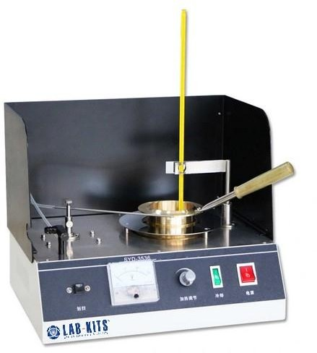
SYNERGY MINERAL RESOURCES LIMITED
Summary
This instrument is designed and made as per standards GB/T3536-2008 Petroleum Products - Determination of Flash and Fire Points - Cleveland Open Cup Method and ASTM D 92 Standard Test Method for Flash and Fire Points by Cleveland Open Cup Tester. It is applicable to all petroleum products with flash points above 79
℃ and below 400℃ except fuel oils.
I. Main technical features
It adopts special heating furnace to ensure the safety of test.
The heating power is continuously adjustable. It can meet requirements of test.
The instrument is fully self-contained complete. The operator can do determination as long as connecting with coal gas or other civil gas.
With fast cooling function, it can improve test efficiency.
II. Main technical specifications
Power supply: AC(220±10%)V, 50Hz.
Power consumption: ≦650W

Slide 60
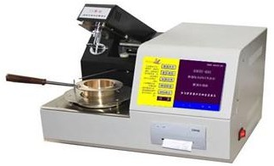
SYNERGY MINERAL RESOURCES LIMITED
Heating device: furnace heating, no naked fire, explosion prevented. The power is adjustable from 0W to
600W.
Test flame applicator: It applies the test flame automatically.
Thermometer: (-6～400) ℃. Scale is 2℃. It is the same as thermometer ASTM 11C.
Igniting device:
Ignition source: coal gas (or civil gas)
Nozzle aperture: about 0.8mm
Ambient temperature: (15∼35) ℃, Relative humidity: ≤85%
Dimension: 350mm×290mm×350mm (thermometer is not included)
Net weight: 5.5kg.
2. Fully automatic open flash point tester
Model ID: PT-OBS-2010
The product is designed and manufactured according to GB/T3536 standard. Advanced technology, simple operation, accurate test, good repeatability, high technology content is an ideal substitute for imported products.
1. Use color LCD widescreen display, all English man-machine dialogue interface, touch keyboard, can preset the value of the temperature, sample label, atmospheric pressure, test date and other parameters with a
prompt
2. Real-time tracking
menu prompt
shows the heating rate and test time function
input; curve;
With English operation, software failure tips, test date, test time and other parameters prompt function
Instrument can store 120 sets of historical data;
Automatically correct the impact of atmospheric pressure on the test and calculate the correction value;

Slide 61
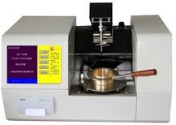
Differential
Scan, ignition,
8.
SYNERGY MINERAL RESOURCES LIMITED
detection, automatic correction of detection, print data automatically completed without
system human rises
deviation; intervention; and falls;
Tilt up
and down, the test arm automatically
9. Forced air cooling.
Technical Parameters
Range: room temperature -300 ℃, resolution: 0.1 ℃
Repeatability: ≤4 ℃, reproducibility: ≤8 ℃
Display: color wide screen, detection mode: automatic test Data output: printout, ignition: gas flame
Power supply voltage: AC220V, output power: 500W
3. Fully automatic open flash point tester
Model ID:PT-OBS-2010A
The product is designed and manufactured according to ASTM D92 Standard Test Method for Flash and Fire Points by Cleveland Open Cup Tester, and GB/T3536 standard. Advanced technology, simple operation, accurate test, good repeatability, high technology content is an ideal substitute for imported products.
Use color LCD widescreen display, all English man-machine dialogue interface, touch keyboard, can preset the value of the temperature, sample label, atmospheric pressure, test date and other parameters with a prompt menu prompt input;
Real-time tracking shows the heating rate and test time function curve;
With English operation, software failure tips, test date, test time and other parameters prompt function
Instrument can store 120 sets of historical data;

Slide 62
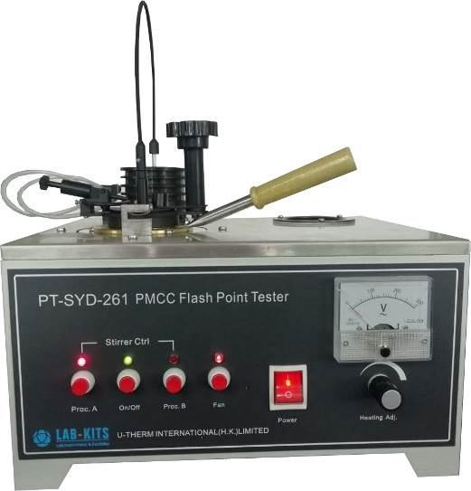
SYNERGY MINERAL RESOURCES LIMITED
Automatically correct the impact of atmospheric pressure on the test and calculate the correction value;
Differential detection, automatic correction of system deviation;
Scan, ignition, detection, print data automatically completed without human intervention;
Tilt up and down, the test arm automatically rises and falls;
Forced air cooling.
Technical Parameters
Range: room temperature -400 ℃, resolution: 0.1 ℃
Repeatability: ≤4 ℃, reproducibility: ≤8 ℃
Display: color wide screen, detection mode: automatic test Data output: printout, ignition: gas flame
Communication: 232 standard interfaces
Power supply voltage: AC220V, the output power: 500W
a. Closed Cup Flash Point Tester
4. PMCC Flash Point Tester
Order Id: PT-SYD-261
Summary

Slide 63
SYNERGY MINERAL RESOURCES LIMITED
This instrument is designed and manufactured as per standards GB/T 261-2008 Determination of Flash Point
- Pensky-Martens Closed Cup Method and ASTM D93 Standard Test Method for Flash Point by Pensky- Martens Closed Cup Tester. It is used to make determination of the closed cup flash point of the petroleum
products.
I. Main technical features
The heating power is continuously adjustable. The power is shown visually by voltmeter. The temperature control mode is advanced and reasonable.
Operation is easy. Test results are precise. The stainless-steel table board is beautiful and easy to clean.
II. Main technical specifications
Power supply: AC (220±10%) V, 50Hz.
Heating device: The heating power is continuously adjustable from 0 W to 600W.
Heating method: manual adjustment;
Stirring method: Mechanical transmission stirring;
Stirring rate: Procedure A: (90～120) RPM, Procedure B: (250±10) RPM
Oil cup: (1) Inner diameter: 50.7mm～50.8mm.
Depth: 55.7mm～56.0mm
The scribed line depth of capacity of testing oil: 33.9mm～34.3mm.
Capacity of testing oil: about 70ml
Igniting device: Pipeline coal gas, Liquid gas
Thermometers: Mercury-in-glass thermometer. Specifications are as below:
Scale -5℃～110℃, division 0.5℃.
Scale 20℃～150℃, division 1℃.
Scale 90℃～370℃, division 2℃.
Ambient temperature: ≤ (15～35)℃
Relative humidity: ≤ 85％

Slide 64
SYNERGY MINERAL RESOURCES LIMITED
Maximum power consumption:650W
Dimensions: 370mm × 320mm × 300mm (length × width × height);
Net weight: 7kg.
Ⅲ. Accessories
No. | Name | Unit | Quantity | Remark
1 | Main unit | Set | 1
2 | Thermometer -5℃～110℃, each scale division is 0.5 ℃; | Piece | 1 | As per GB/T 261-2008
3 | Thermometer 20℃～150℃, each scale division is 1.0 ℃; | Piece | 1
4 | Thermometer 90℃～370℃, each scale division is 2 ℃; | Piece | 1
5 | Soft shaft | Piece | 1
6 | Silica gel tube φ3 0.5 m | Piece | 3 | 1 is spare
7 | Thermometer adapter | Set | 1
8 | Thermometer liner band (cut suitable length of liner band to wrap the lower end of the thermometer, so that the thermometer is just inserted into the thermometer adaptor) | Piece | 5
9 | Operation Manual | Piece | 1
10 | Quality Certificate | Piece | 1
11 | Repair Guarantee | Piece | 1

Slide 65
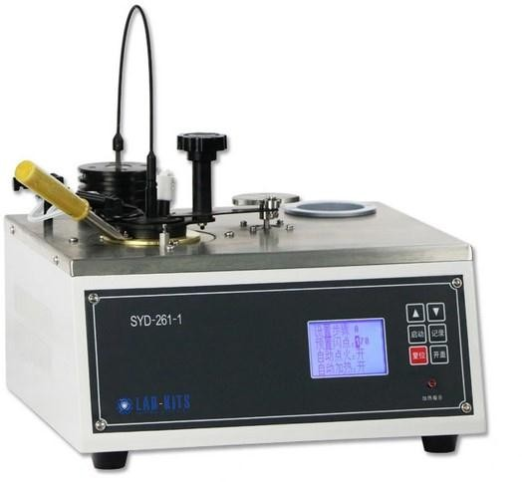
SYNERGY MINERAL RESOURCES LIMITED
5. Pensky-Martens Closed-Cup Flash Point Tester Model ID: PT-SYD-261-1
Summary
This instrument is designed and manufactured as per standards GB/T 261-2008 Determination of Flash Point - Pensky-Martens closed cup method and ASTM D93 Standard Test Methods for Flash Point by Pensky-Martens Closed Cup Tester. It is used to make determination of the closed cup flash point of the petroleum products.
I. Main technical features
The instrument is complete, and users only need to equip with gas or other civilian combustible gas to carry out the test.
The heating power is continuously adjustable.
II. Main technical specifications
Power supply: AC (220±10%) V, 50Hz.
Heating device:(1) The furnace is silicon carbide material. Power is 600W.
(2) The heating power is adjustable from 0 W to 600W.
Heating rate: Procedure A: (5～6)℃/min, Procedure B:(1～1.5)℃/min.
Stirring device:(1) Stirring motor: Driving mode: flexible shaft, Shaft size: 8mm×40mm

Slide 66
SYNERGY MINERAL RESOURCES LIMITED
Stirring rate: Procedure A: (90～120)RPM, Procedure B: (250±10) RPM
Oil cup: (1) Inner diameter: 50.7mm～50.8mm.
Depth: 55.7mm～56.0mm
The scribed line depth of capacity of testing oil: 33.9mm～34.3mm.
Capacity of testing oil: about 70ml
Igniting source: Pipeline coal gas, Liquid gas
Ambient temperature:≤ 15~35℃
Relative humidity:≤ 85％
Maximum power consumption:650W
Dimensions: 340mm × 330mm × 380mm (length × width × height);
Net weight: 9kg.
Ⅲ. Accessories
PT-SYD-261-1 Pensky-Martens Closed-Cup Flash Point Tester Accessories List and Documents
1. Full set of instruments
Item | Name | Unit | Qty | Remarks
1 | SYD-261-1 PMCC Flash Point Tester | Set | 1 | Including ignition unit, oil cup etc.
2 | Temperature sensor | Piece | 1 | Pt100 platinum resistor
3 | Driving flexible shaft | Piece | 1 | Installed by user himself
4 | latex tube φ3 0.5m | Piece | 2
5 | Igniting gun | Handle | 1
6 | Operation Manual | Piece | 1
7 | Quality Certificate | Piece | 1
8 | Repair Guarantee | Piece | 1
2. SYD-261-1 Pensky-Martens Closed-Cup Flash Point Tester Auxiliary Equipment
No. | Name | Specification | Quantity | Memo

Slide 67
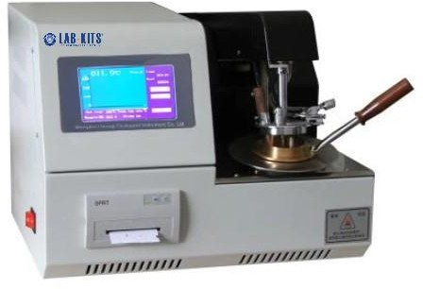
SYNERGY MINERAL RESOURCES LIMITED
1 | Fuel gas | Standard fuel gas steel bottle | 1 bottle | Liquefied gas bottle or pipeline gas
2 | Fuel gas professional reduce valve |  | 1 piece
3 | Fuel gas flexible pipe | Normal | 1.2～2 meters
Notes:
The reagent and equipment for installing the instrument are supplied by end-users themselves.
The usage, management and saving of poisonous and harmful reagent, pls operate according to the relative principle.
PLS read the operation manual and industry standard before using the instrument.
6. Automatic Pensky-Martens Closed-Cup Flash Point Tester Model ID: PT-SYD-261A
Summary
This instrument is designed and manufactured as per standards GB/T 261-2008 Determination of Flash Point
- Pensky-Martens closed cup method and ASTM D93 Standard Test Methods for Flash Point by Pensky- Martens Closed Cup Tester. It is used to make determination of the closed cup flash point of the petroleum products.

Slide 68
SYNERGY MINERAL RESOURCES LIMITED
I. Main technical features
The instrument can store 120 sets of data.
Calibrate the effect of atmospheric pressure to test and calculate the corrected value.
Open the lid, detect the flash point and print test data, the test arm rises up and lowers down automatically.
II. Main technical specifications
Power supply: AC (220±10%) V, 50Hz.
Flash point determination: Range: Ambient to 300℃. Accuracy: 0.1℃
Heating rate: Procedure A: (5～6)℃/min Procedure B:(1～1.5)℃/min
Stirring rate: Procedure A: (90～120)RPM, Procedure B: (250±10) RPM
Igniting mode: (1) Igniting source: Liquefied gas bottle or pipeline gas
Ambient temperature: ≤ 15~35℃
Relative humidity: ≤ 85％
Maximum power consumption: 500W
Overall dimensions: 410mm × 360mm × 310mm (length × width × height);
Net weight of the instrument: 14.5kg.
Ⅲ. Accessories
No. | Name | Unit | Quantity
1 | Main unit | Set | 1
2 | Oil cup | Piece | 1
3 | Power supply wire (250V 6A) | Piece | 1
4 | Printing paper | Roll | 1
5 | Igniter | Piece | 1
6 | Operation Manual | Piece | 1

Slide 69
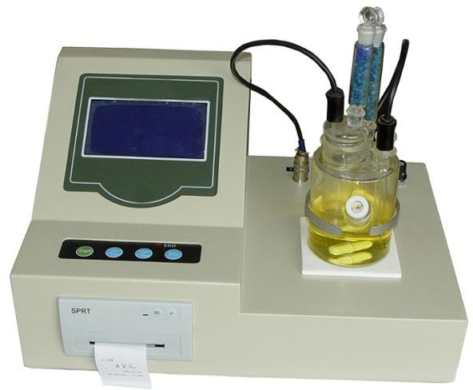
SYNERGY MINERAL RESOURCES LIMITED
7 | Quality Certificate | Piece | 1
8 | Repair Guarantee | Piece | 1
b. Water Content Tester
7. Automatic Karl Fischer Titrator /Trace moisture meter
Order Id: PT-BWS-2200
Purpose:
The instrument is designed and made as per the National Standard GB/T11143 “Test Methods for Water Content of Liquid Petroleum Products (Karl Fischer Methods)” and ASTM D 1744. It is suitable to determine water content in the liquid petroleum products by titration using Karl Fischer reagent. Adopt a microprocessor for control, so it has characteristics of rapid determination speed, high precision, LCD display, and automatic print. It also has function of self-diagnostics, menu selection. It is a multifunctional, convenient, and automatic analysis instrument.
Technical parameters
1. Titration mode: Coulometric titration controlled by a microprocessor

Slide 70
SYNERGY MINERAL RESOURCES LIMITED
Measurement range: 1μg～100mg (Representative value: 10μg～10mg)
Electrolysis control: Automatic electrolysis current control (Max is 400 mA)
Titration speed: 2 mg/min (Maximum)
Test accuracy: 10μg～1mg±3μg, It will be 0.3% for more than 1 mg (not including sample filling error)
End point: information display, buzzer alarm, and indication light is on
Date: Year Month Day Hour Minute Second
Printer: 16 characters width pin-printer. Paper width is 44 mm, 9. Power supply: AC 220V±10%, 50Hz±5%
Power: 60 W
Ambient temperature: 5～40°C
Relative humidity: ≤90%
Size: 290×380×120 (mm)
Weight: 9 Kg

Slide 71
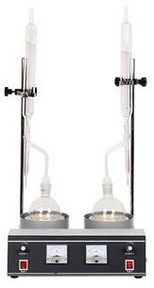
SYNERGY MINERAL RESOURCES LIMITED
8. Water Content Tester (Double Units)
Order Id: PT-SYD-260A
Summary
This instrument is made and designed as per GB/T260 Standard Test Method for Water in Petroleum Products and ASTM D95 Standard Test Method for Water in Petroleum Products and Bituminous Materials by Distillation. This instrument is suitable to determine the water content of petroleum products according to the test method specified in GB/T260. It is also suitable to determine the water content of lubricating grease according to the test method specified in GB/T 512 Test Method for Water Content of Lubricating Grease. This instrument adopts double-unit structure. It can do determination for two samples.
I. Main
The instrument is designed totally
The gripper is designed reasonably. The
technical
meeting the installation and
requirements dismantlement
features
of GB/T260. are convenient.
The heating power is continuously adjustable. The voltmeter displays the power intuitionally. The temperature control is reasonable.
It can do parallel test for two samples.The working efficiency is high.
II. |  | Main |  | technical | specifications
1. |  | Power |  | supply： | AC(220±10%)V，50Hz
2. | Heating | power | of | electric | furnace： 1000W×2

Slide 72
SYNERGY MINERAL RESOURCES LIMITED
3. Heat | ing control： Can | be continuously | adjusted | by a silicon knob
4. | Ambient | temperature： |  | ≤35℃
5. | Relative |  | humidity： |  | ≤85%
6. Maximum power consumption： 2200W
Note: we can customize the electric jacket model for none naked fire test as customer’s need.III、Water Content Tester Accessories and Documents List
No. | Name | Unit | Qty | Memo
1 | Main unit | Set | 1
2 | Standing rod | Piece | 2
3 | Clamps for condensation tube | Pair | 2
4 | Condensation tube | Piece | 2
5 | Receiving tube | Piece | 2
6 | Round bottom flask | Piece | 2
7 | Fuse 10A(Ф5×20) | Piece | 2
8 | Rubber hose(Ф22×3)——0.2 meter | Piece | 1
9 | Silicone tube(Ф12×2)——6 meter | Piece | 1 | Select according to the demand
10 | Inlet pipe connection head | Piece | 1
11 | Three way cock components | Pair | 1 | Used in water inlet branch
12 | Operation manual | Piece | 1
13 | Quality certificate | Piece | 1
14 | Product Warranty Card | Piece | 1
IV、Water Content Tester's Reagent and Auxiliary Equipments
No. | Name | Specification | Qty | Memo
1 | Xylene | 500ml | 3 bottles

Slide 73
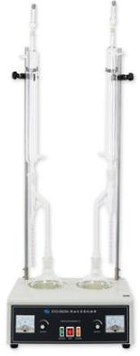
SYNERGY MINERAL RESOURCES LIMITED
2 | No glaze of porcelain |  | 1 box | Alternative
3 | Pumice stone |  | 1 box
Notes：
1、The reagent and equipments for installing the instrument are supplied by end-users themselves.
2、The usage, management and saving of poisonous and harmful reagent, pls operate according to the relative principle.
3、PLS read the operation manual and industry standard before using the instrument.
9. Crude Oil Water Content Tester
Order Id: PT-SYD-8929A
The instrument is designed and made as per the National Standard of People’s Republic of China GB/T8929 Standard Test Method for Water Content in Crude Oil (Distillation method) and ASTM D4006 Standard Test Method for Water in Crude Oil by Distillation. It is used to determine the water in crude oils.
I. Main technical features
Desktop structure and double units. It can do two determinations at the same time.
Equipped with heating mantle cap. Heating power can be adjusted continuously. No naked fire, safe to use.

Slide 74
SYNERGY MINERAL RESOURCES LIMITED
Distillation flask, receiver and condenser are all designed as per standard.
This instrument is equipped with tip shape small tools, scrapers and sprayers, which fully meet the requirements of GB / T 8929-2006 standard. The biggest feature of this instrument: heating without open flame, two samples can be made at a time.
II. Main technical specifications
Power supply: AC (220±10%) V, 50Hz
Heater: heating mantle cap, 500W×2, continuous adjustment.
Distillation flask: 1000 ml
Receiver: 5ml, graduation is 0.05 ml
Condenser: 400mm±5mm
Ambient temperature: -10℃～+35℃
Relative humidity: ≤85％
Dimension: 425mm×330mm×150mm( The test vessels are not included) 425mm×330mm×1180mm( The test vessels are included)
SYD-8929A Crude Oil Water Content Tester Accessories and Documents List
No. | Name | Unit | Qty | Memo
1 | SYD-8929A Crude Oil Water Content Tester | Set | 1
2 | Drying tube | Piece | 2
3 | Silica gel stopper (3#) | Piece | 2
4 | Condensation tube | Piece | 2
5 | Receiver | Piece | 2
6 | Round bottom flask | Piece | 2

Slide 75
SYNERGY MINERAL RESOURCES LIMITED
7 | Standing rod | Pair | 2 | Upper and lower standing rod each 2
8 | Condenser pipe holder | Pair | 2
9 | Tip shape small tools | Piece | 1
10 | Scraper | Piece | 1
11 | Sprayer | Piece | 1
12 | Operation Manual | Piece | 1
13 | Quality Certificate | Piece | 1
14 | Repair Guarantee | Piece | 1
II,SYD-8929A Crude Oil Water Content Tester's Reagent and Auxiliary Equipment
No. | Name | Specification | Quantity | Memo
1 | Anhydrous calcium chloride | Analytical pure 500g | 1 bottle | Sample dehydration
2 | Xylene | Analytical pure 500ml | 4 bottles
3 | Measuring cylinder | 5ml.10ml.20 (25) ml.100ml.200 (250) ml.50ml | Each 1 | 50ml 2pcs, one for measuring xylene as washing lotion
4 | No glazed tiles or pumice stones |  | 1 box
Notes:
The reagent and equipment for installing the instrument are supplied by end-users themselves.
The usage, management and saving of poisonous and harmful reagent, pls operate according to the relative principle.
PLS read the operation manual and industry standard before using the instrument.

Slide 76
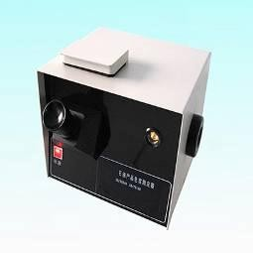
SYNERGY MINERAL RESOURCES LIMITED
10. Colorimeter for petroleum products
Order ID: PT-HK-1033
Overview
Colorimeter for petroleum products conforms to the ASTM D1500 Standard Test Method for ASTM Color of Petroleum Products (ASTM Color Scale). The apparatus covers the visual determination of the color of a wide variety of petroleum products, such as lubricating oils, heating oils, diesel fuel oils, and petroleum waxes.
Experimenter pours different kinds of lubricating oil, kerosene, diesel and other petroleum product samples into colorimetric cylinder, then compare with normal glass color piece, determining the colourity by the
corresponding colour number.
Features
The standard color disk adopts 25 kinds of color number of standard color sheet glass.
The optical microscope adopts observation optical lens, be provided with focusing function.
The standard illuminant adopts inside-frosted bulb as luminous source.
Turning of the standard color disk adopts manual adjustment.
Easy operate with rational construction and attractive appearance.
Technical parameters
Rated voltage: AC220V±10% 50Hz
Standard illuminant: 100W Temperature: 2750K±50K

Slide 77
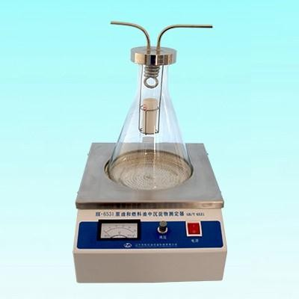
SYNERGY MINERAL RESOURCES LIMITED
Standard color disk: No.1~25
Colorimetric cylinder: inner diameter 33*125±5mm
Ambient requirement: temperature: 10~40°C Humidity≤85%
Net dimension: 310*280*320mm,6kg
11. Sediment Extraction in Crude Oil and Fuel Oil
Model ID: PT-HK-6531
Overview
Sediment extraction in Crude Oils and Fuel Oil, the apparatus conforms to the ASTM D473 Standard Test Method for Sediment in Crude Oils and Fuel Oils by the Extraction Method, is used for testing sediment in crude oils and fuel oils by extraction with toluene. The precision applies to a range of sediment levels from
0.01 to 0.40 % mass, although higher levels may be determined.
Features
Electric heating with uniform temperature
Standard plating on the cover, condenser pipe 3.Stainless steel basket, glass water receiver Technical parameters
Rated voltage:AC220V±10% 50Hz

Slide 78
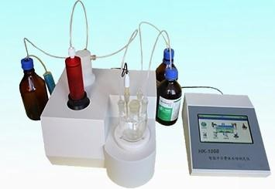
SYNERGY MINERAL RESOURCES LIMITED
Power: 0~700W continuous adjustable
Temperature controlling mode: Solid state voltage regulator, stepless voltage regulation. 4.Adjustable display: AC 0~250V
Erlenmeyer flask: 2000ml
Ambient requirements: Temperature 10~40℃; Humidity≤85
Net dimension: 330*340*400mm, 10kg
12. Volumetric Karl Fischer Moisture Titrator Model ID: PT-HK-1058
Overview
Volumetric Karl Fischer Moisture Titrator is a new generation product. It is designed with new mechanical- electronic technology and human oriented idea. It is high precise and easy for using. Based on Karl Fischer volume method, it can measure the crystal water, absorbed water, free water in liquid, solid, or gas samples. It is widely used in petrochemical, pharmaceutical, agricultural, food fields.
Features
Polarization voltage of the double platinum poles estimates the end point and stop titration
The whole system is sealed to keep the bad from escape, it can automatically change the solvent and discharge the waste
Store the results automatically
Agitating PWM is stepless adjustable, select from the menu. 5.Extra-big TFT touch LCD display, touch LCD menu operation

Slide 79
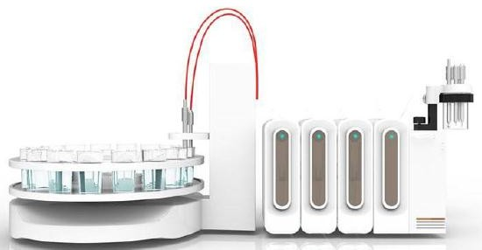
SYNERGY MINERAL RESOURCES LIMITED
On line direction, WINDOWS style, easy in using
Multi-parameter display (water content, percent, ppm content, karlfischer solvent consumption at the same time), colorful titrating curves display
Display instrument status, sample volume of the controlled volume pump, time,3-way valve status, etc.
Technical Parameter
Metering range: 0.001%~100% (H2Omass) 2.Accuracy:0.001ml
System error: ≤2%
End point resistance: 600~5000Ω continuous adjustable
Quick titrateposition:1000~9999 continuous adjustable
End point delay time:10~300second continuous adjustable
13. AUTOMATIC TAN/TBN TITRATOR Model ID: PT-HK-1060A
1. Introduction
The alkalinity value of petroleum represents the standard for the content of alkaline substances in petroleum, usually expressed in mgKOH / g, which represents the neutralization capacity of petroleum. Diesel engines, especially ships, often mix sulfur-containing heavy oil fuel oil and diesel engine oil in the engine, causing the engine to generate acidic substances during operation. The significance of the existence of a base number is to neutralize the acidic substances and prevent equipment corrosion. For metalworking fluids, many petroleum additives can easily fail or deteriorate in an acidic environment. A certain alkali value can ensure the activity of additives in petroleum. Determining the degradation of petroleum additives in

Slide 80
SYNERGY MINERAL RESOURCES LIMITED
lubricating oil by determining the basic components in petroleum by means of acid-base titration can
determine the necessary practical waste limit.
Instruments and reagents
Instrument
PT-HK-1060A Automatic Potentiometric Titrator, Hamilton's pH Nonaqueous Composite Electrode, 10mL Burette Unit
Reagents
Sodium perchlorate electrolyte (saturated solution of sodium perchlorate in glacial acetic acid), titration solvent (mixed with 50 mL of glacial acetic acid and 100 mL of chlorobenzene), perchloric acid glacial acetic acid solution (0.1mol / L)
Experimental methods
Experimental steps
Electrode preparation: Fill the pH non-aqueous composite electrode with sodium perchlorate electrolyte.
Approximately 2.5 g of petroleum is weighed and placed in a titration cup. First add 40mL of chlorobenzene and stir the solution with a stirrer on a potentiometer until the sample is completely dissolved. An additional 20 mL of glacial acetic acid was added. After mixing, titrate to the end point with perchloric glacial acetic acid solution.
Instrument parameters
Titration mode: Dynamic titration
Stirring speed: 6
Electrode equilibration time: 4s
Pre-stirring time: 8s
Electrode equilibrium potential: 2mv
Titration speed: standard
Minimum addition volume: 0.03mL
Pre-titration addition volume: 0.5mL
End volume: 10mL
Stirring time after pre-titration: 6s
Potential jump: 200

Slide 81
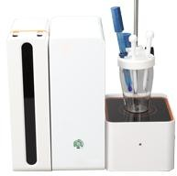
12.
SYNERGY MINERAL RESOURCES LIMITED
Pre-control mv value: None
13. The instrument can automatically determine TBN / TAN value through built-in software and display TBN / TAN value on equipment's screen after completion of test. it will automatically take all the chemical & Show the result on the screen.
14. Automated TAN & TBN Titrator
Model ID: PT-HK-1060Z
Automated TAN & TBN Titrator conforms to ASTM D664 Standard Test Method for Acid Number of Petroleum Products by Potentiometric Titration & ASTM D2896 Standard Test Method for Base Number of Petroleum Products by Potentiometric Perchloric Acid Titration. PC-controlled, fully automatic analysis system for the direct determination of TAN or TBN values in mineral oil products. The system is noteworthy for its special resistance to the solvents used in this application. The data acquisition and the complete control of the system takes place via the proven titration software.
Features
Unique built-in dosing unit to avoid the harmless chemical leak Multiple self-checking function to avoid mis-operating
Flexible application edit functions, operator can store the dedicated titration mode to the test and adopt this mode next time by one click
RS232/USB port, with networked CAN but communication functions. Very easy to use - intuitive keypad and function guide display Programmable – TAN, TBN software built-in

Slide 82
SYNERGY MINERAL RESOURCES LIMITED
Results expressed in mg KOH/g
Connects to external pc keyboard for easy text and sample information data entry Connects to different types printers, pc and balances
Data Logger – automatic data storage of last 55 analysis results Hamilton electrode, model number: 238060 FLUSHTRODE made in Swiss
Technical Parameters
Measuring range: -2500.0MV~+2500.0MV, ±0.1MV
Temperature measuring range: 0~100℃, ±0.1℃ PH measuring range: -20.000PH~+20.000PH Burette: 5ml, 10ml, 25ml
PH resolution: 0.001PH, Accuracy: ±0.003PH Burette resolution: 1/48,000
Operation: PC controlled
Burette rehydration time: 16s (100% filling rate

Slide 83
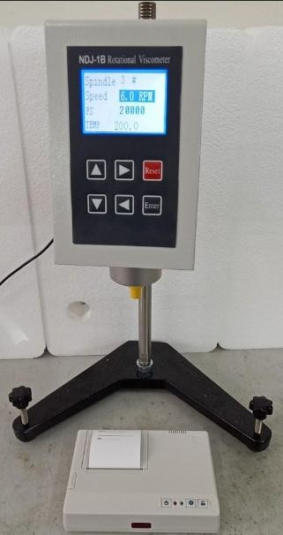
SYNERGY MINERAL RESOURCES LIMITED
15. Rotational Viscometer
Order ID: PT-NDJ-1B
Summary
The instrument adopts advanced mechanical design technology, manufacture technique and microcomputer controlling technology. It can collect data accurately. Using white background light and ultra-bright LCD, it can show test data clearly. Equipped with a special printer interface, it can print out measurement data through a printer.
The instrument has the characteristics of high sensitivity, reliability, convenience and good looking. It is used to determine absolute viscosity of Newtonian liquids and apparent viscosity of Non-Newton liquids. It is widely used to determine the viscosity of liquids such as greases, oil paints, plastics, pharmaceutics, coatings, adhesives, washing solvents, and other fluids.
II. Main technical specifications
Measurement range: 10 mPa•s～2000000 mPa•s
Spindle: No.1～No.4, four spindles

Slide 84
SYNERGY MINERAL RESOURCES LIMITED
Rotation speed: 0.3 RPM, 0.6 RPM, 1.5 RPM, 3 RPM,6 RPM, 12 RPM, 30 RPM, and 60 RPM; Also, can do
stepless speed regulation.
Measuring accuracy: ±1% (F•S)
Power supply: AC 220 V±10%, 50 Hz±10%;
Ambient temperature: 5 ℃～35 ℃;
Relative humidity: ≤80%;
Printing output: needle printer 9.Comunication port:RS232 port
III. Optional parts
HWY-10 Circulation water bath
Double-layer sample cup
No.0 spindle and Low viscosity adapter
Small sample adapter
PT-NDJ-1B Rotational Viscometer Accessories
No. | Name | Unit | Quantity
1 | Main units | Set | 1
2 | No.1 to No.4 spindle | Piece | 1 for each type
3 | Spindle protective sleeve | Piece | 1
4 | Stand column | Piece | 1
5 | Pedestal (With two adjustment bolts) | Pair | 1
6 | Spindle protective shelf | Piece | 1
7 | Power supply adapter | Piece | 1
8 | Printer (including connecting cable and power line) | Set | 1
9 | Aluminum alloy case (including instrument head, spindle, spindle protecting holder, etc.) | Piece | 1
10 | Operation Manual | Piece | 1
11 | Quality Certificate | Piece | 1

Slide 85
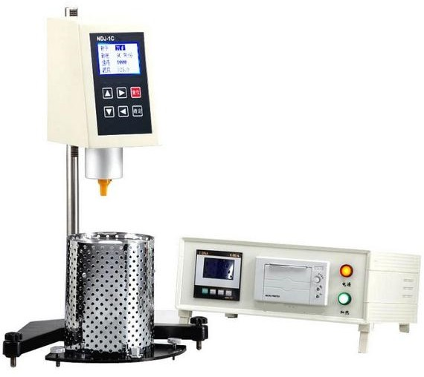
SYNERGY MINERAL RESOURCES LIMITED
12 | Repair Guarantee | Piece | 1
16. Brookfield Rotational Viscometer
Model ID: PT-NDJ-1C
Summary
The instrument is designed and made as per T0625 “Asphalt Brookfield Rotational Viscosity Test (Brookfield Viscometer Method)” in the Industry Standard of People’s Republic of China JTJ052 Specification and Test Methods of Bitumen and Bituminous Mixture for Highway Engineering. It is suitable to determine absolute viscosity of Newtonian liquids and apparent viscosity of Non-Newtonian liquids.
The instrument adopts the advanced mechanical design technologies and manufacturing techniques, and uses microcomputer technologies for temperature control, data collection and data process. The display is a background light, ultra-brighten LCD. It is also equipped with a micro-printer for printing. The test data can be shown on the LCD in real time or printed out through the printer. It can also connect to a computer through the RS232 communication port.
The instrument has characteristics of high measurement sensitivity, reliable measurement data, convenience, and good looking. It can be widely used to determine viscosity of asphalt, hot melt adhesive, paraffin, high polymer, and various fluids.

Slide 86
SYNERGY MINERAL RESOURCES LIMITED
I. Main technical specifications
Measurement range: 100 mPa•s～2×10⁵mPa•s (If you select the No.30 spindle, the measurement range can be extended to 4×10⁵mPa•s)
Spindle: No.21, 27, 28 and 29 total 4 pieces of spindles (the No.30 spindle is optional)
Rotation speed: 5RPM, 10 RPM, 20 RPM, and 50 RPM; Also, can do stepless speed regulation.
Measurement error: ±1% (F•S); (If you select the No.30 spindle, it will be ±3% (F•S)
Temperature control range: 45 ℃～200 ℃
Temperature control accuracy: ±0.1 ℃
Sample cylinder: 20 ml
Power supply: AC 220V±10%, 50 Hz
Ambient temperature: 5 ℃～35 ℃ (when the controlling temperature is close to ambient temperature, please run the air conditioner to let the ambient temperature be 5 ℃ lower than the controlling temperature)
Relative humidity: ≤80% 11.Printing output:needle printer 12.Comunication port:RS232 port
III. Optional accessories
PT-NDJ-1C Brookfield Viscometer and Computer communication software(CD)
300℃ high temperature heating furnaces
30# rotator
Brookfield Viscometer Accessories
No. | Name | Unit | Quantity
1 | Head of viscometer | Set | 1
2 | Pedestal of instrument (having two level adjustment bolts) | Set | 1

Slide 87
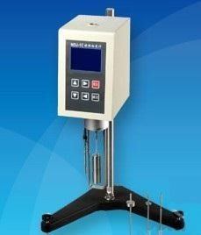
SYNERGY MINERAL RESOURCES LIMITED
3 | Toothed rod | Piece | 1
4 | Auxiliary controlling case (containing a temperature controller and a micro-printer) | Set | 1
5 | Heater | Piece | 1
6 | Spindle (No.21, 27, 28 and 29) | Piece | 1 for each
7 | Connection hook and transition bolt | Piece | 1 for each
8 | Power supply wire (250 V 6 A) | Piece | 1
9 | Serial port wire | Piece | 1
10 | Heater connection wire | Piece | 1
11 | Sensor wire | Piece | 1
12 | Sample cylinder, sample cylinder holder, special forceps | Piece | 1 for each
13 | Fuse (Φ5×20) 5 A | Piece | 2
14 | CD for communication with a PC | Piece | 1
15 | Operation Manual | Piece | 1
16 | Quality Certificate | Piece | 1
17 | Repair Guarantee | Piece | 1
17. Rotational Viscometer
Model ID: PT- NDJ-1E
Summary
The instrument is one of the upgraded products in our company. Adopting the advanced mechanical design technology, the manufacture techniques and the microcomputer technology, it can collect data accurately.

Slide 88
SYNERGY MINERAL RESOURCES LIMITED
Using white background light and ultra-bright LED display screen, it can show data clearly. With a special
printing interface, it can plot out the measurement data through a printer.
The instrument has the characteristics of high measurement sensitivity, reliable results and beautiful model, as well as convenience to be operated. It is suitable to determine the absolute viscosity of the Newton liquids and the apparent viscosity of non-Newtonian liquids. It can be widely used to determine the viscosity of various liquid such as greases, oil paints, plastic, pharmaceuticals, dopes, adhesives, and detergents, etc.
I. Main technical specification and parameters
Measurement range: (1～6000000) mPa•s
Spindle: No.0～No.4, five kinds of spindles
Spindle speed:( 0.1, 0.2, 0.3, 0.6, 1.5, 3, 6, 12, 30, 60, 120) RPM. Also, can do stepless speed regulation.
Accuracy: ±1% (F.S);
Power supply: AC 220 V±10 %, 50 Hz±10 % (24V adapter)
Working environment:
(1) Ambient temperature: 5～35℃ (2) Relative humidity: ≤80%
8.Printing output: needle printer 9.Communication port:RS232 port
II. Optional accessories
1.PT-HWY-10 circulating thermostatic water bath 2.Professional double-deck sample cup
3.Small sample adaptor
Rotational Viscometer Accessories and Documents List
No. | Name | Unit | Quantity
1 | Main units | Set | 1
2 | No.0 to No.4 spindle | Piece | 1 for each type
3 | Spindle protective sleeve | Piece | 1

Slide 89
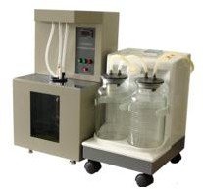
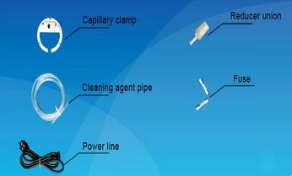
SYNERGY MINERAL RESOURCES LIMITED
4 | Stand column | Piece | 1
5 | Pedestal (With two adjustment bolts) | Pair | 1
6 | Spindle protective shelf | Piece | 1
7 | Power supply adapter | Piece | 1
8 | Printer (including connecting cable and power line) | Set | 1
9 | Aluminum alloy case (including instrument head, spindle, spindle protecting holder, etc.) | Piece | 1
10 | Operation Manual | Piece | 1
11 | Quality Certificate | Piece | 1
12 | Repair Guarantee | Piece | 1
c. Kinematics Viscometer
18. Capillary Viscometer Washer
Model ID: PT-SYD-265-3
I. Summary
The instrument is designed and made specially for washing the capillary viscometers, which are used for testing petroleum products. It can be used to wash glass capillary viscometer of various types, such as Pinkevitch viscometer, Ubbelohde viscometer, Cannon-Fenske routine viscometer, Cannon-Fenske opaque

Slide 90
SYNERGY MINERAL RESOURCES LIMITED
viscometer. It can clean as many as three viscometer tubes at a time. It is high-efficient and time saving
especially for the capillary viscometers, which are used for testing heavy oil with high viscosity.
It adopts micro-controller control technology, program control, automatic washing. It needs less solvent oil and it is convenient, efficient. It can be widely used in the enterprises producing and using petroleum products, colleges and universities, and scientific research institutes and so on, where capillary viscometer are used.
II. Main technical specifications
Power supply: AC 220V±10%, 50 Hz
Maximum power consumption: 700 W
Water bath temperature control range: Ambient to 80 ℃
Ambient temperature: Room temperature~35℃
Relative humidity: ≤85％
Dimension of washer: 320mm×300mm×500mm (excluding the aspirator)
Net weight of washer: 10Kg (excluding the aspirator)
Ⅲ. Accessories
PT-SYD-265-3 Cappilary Viscometer Washer Accessories and Documents List
No. | Name | Unit | Qty | Memo
1 | PT-SYD-265-3 Automatic Capillary Viscometer Washer (main unit) | Set | 1
2 | Electric vacuum aspirator (refer to aspirator manual for accessories) | Set | 1
3 | Capillary clamp | Set | 1
4 | Reducer union (one has been installed on washing pipe) | Piece | 2
5 | Fuse 6A (Ф5×20) | Piece | 2
6 | Power line (220V.6A) | Piece | 1
7 | Cleaning agent pipe (Length 0.8 meter. Outside diameter Ф4.0. Inside diameter Ф2.5) | Piece | 1
8 | Operation manual | Piece | 1
9 | Electric vacuum aspirator 's operation manual | Piece | 1
10 | Quality certificate | Piece | 1

Slide 91
SYNERGY MINERAL RESOURCES LIMITED
11 | Product warranty card | Piece | 1
PT-SYD-265-3 Cappilary Viscometer Washer's Reagent and Auxiliary Equipment
No. | Name | Specification | Quantity | Memo
1 | Petroleum products solvent | 500ml | 3 bottles
Notes:
The reagent and equipment for installing the instrument are supplied by end-users themselves.
The usage, management and saving of poisonous and harmful reagent, pls operate according to the relative principle.
PLS read the operation manual and industry standard before using the instrument.

Slide 92
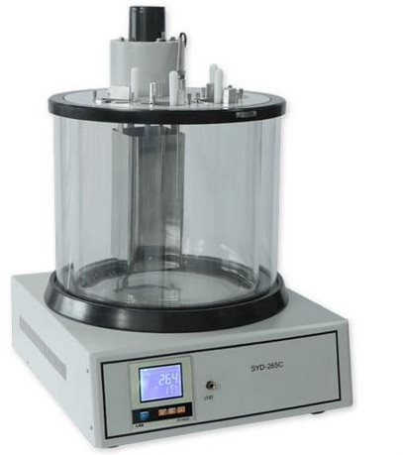
SYNERGY MINERAL RESOURCES LIMITED
19. Petroleum Products Kinematic Viscosity Tester
Order Id: PT-SYD-265C
This instrument is designed and made as per the industrial standard of People’s Republic of China SY/T5651 Technical Condition of Petroleum Products Kinematic Viscosity Tester. It is suitable to determine kinematic viscosity of liquid petroleum products (Newtonian liquids) at a constant temperature as per the stipulation in the national standard of People’s Republic of China GB/T265 Petroleum Products-Determination of kinematic viscosity and calculation of dynamic viscosity.
I. Main technical features
With line control timing button, it is convenient for timing and controlling the test.
The instrument adopts hard glass bath and heat preservation shell (double shell structure). The heat preservation property is good. Easy to observe the sample.
It can test 2 samples at a time.
II. Main technical specifications
Power supply: AC (220±10%) V, 50Hz±5%
Stirring motor: 1200RPM
Temperature control range: Ambient to 100℃
Temperature control accuracy: ±0.1℃

Slide 93
SYNERGY MINERAL RESOURCES LIMITED
Timing range: 0s ～ 9999.9s
Constant temperature bath: 20L, double shell structure
Working environment: Ambient temperature: room temperature15～35℃ Relative humidity: ＜85％
Temperature sensor: Industrial platinum resistance Pt100
Maximum power consumption: ≤1800W
Capillary viscometer: (Pinkevitch Viscometer, Cannon-Fenske Routine Viscometer, Standard Ubbelohde Viscometer)
Dimension: 530mm×400mm×670mm
Net weight: 20.5kg
Ⅲ. Accessories
1.PT-SYD-265C Kinematic Viscometer Accessories and Documents List
No. | Name | Unit | Qty | Memo
1 | PT-SYD-265C Kinematic Viscometer (Including inner/external glass cylinder, stirring device, rubber ring etc.) | Set | 1
2 | Capillary viscometer (Pinkevitch Viscometer, Cannon- Fenske Routine Viscometer, Standard Ubbelohde Viscometer) | Group | 1 | Capillary characteristic, specification, quantity will be confirmed in contract
3 | Rod type mercury thermometer (0~50℃.50~100℃, scale divisions of them are both 0.1 ℃; ) | Piece | Each 1
4 | Plumb bob | Piece | 1
5 | Sensor | Piece | 1
6 | Bakelite cover | Piece | 4
7 | Capillary clamp | Piece | 4
8 | Silical gen stopper (3#) | Piece | 2
9 | Round glass | Piece | 1
10 | Stopping ring of thermometer (1#) | Piece | 4
11 | Line control timing button | Piece | 1
12 | Ear washing bulb | Piece | 1
13 | Operation manual | Piece | 1
14 | Quality certificate | Piece | 1

Slide 94
SYNERGY MINERAL RESOURCES LIMITED
15 | Product warranty card | Piece | 1
2.PT-SYD-265C Kinematic Viscometer's Reagent and Auxiliary Equipment
No. | Name | Specification | Quantity | Memo
1 | Glycerol or mineral oils |  | 20L | The test temperature above 80℃
2 | Petroleum ether 60-90℃ | Analytical pure 500ml | 1 bottle
3 | Distilled water | 3 grades | Some
Notes:
The reagent and equipment for installing the instrument are supplied by end-users themselves.
The usage, management and saving of poisonous and harmful reagent, pls operate according to the relative principle.
PLS read the operation manual and industry standard before using the instrument.

Slide 95
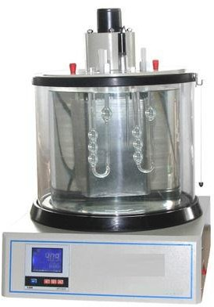
SYNERGY MINERAL RESOURCES LIMITED
20. Asphalt Kinematic Viscosity Tester (Capillary Method)
Order Id: PT-SYD-265E
Purpose:
The instrument is designed and made as per the national standard of People’s Republic of China GB/T1841 and ASTM D2170 Standard Test Method for Viscosity of Polyolefin Resin Solution. It is used to determine the viscosity of decahydronaphthalene solution of polythene and polypropylene at the stipulated temperature. The instrument can also be used to determine the viscosity of asphalt at the stipulated temperature as per the industrial standard of People’s Republic of China T0619 Asphalt Kinematic Viscosity Test (Capillary Viscometer Method).
I. Main technical features
With high precision temperature control, digital display instrument, electric device, temperature control accuracy of plus or minus 0.1 ℃.
The use of high temperature resistant, hard glass and thermal insulation coat cylinder (called a duplex), heat preservation performance is good, clear sample observation.
Adopts desktop, all-in-one design method, adopt a set of 7 Cannon-Fenske Routine Viscometer capillary viscometers
The instrument comes with a timing device, so no additional stopwatch is needed.
II. Main technical specifications
Power supply: AC 220 V±10%, 50 Hz
Heating power: 1700 W

Slide 96
SYNERGY MINERAL RESOURCES LIMITED
Temperature range: Ambient to 180℃
Temperature control accuracy: ±0.1℃
Timing range: 0s to 9999.9s
Mercury-in-glass thermometer: Scale division 0.1℃.
Range 100℃~150℃
Bath capacity: about 23 L
Stirring motor (1) Power: 6W (2) Speed: 1200 RPM
Ambient temperature: -10℃～+35℃
Relative humidity: ＜85％
Temperature sensor: Industrial platinum resistance, Pt100
Maximum power consumption: 1800 W
Capillary viscometer: Capillary viscometer characteristics, specification, quantity according to business agreement
Overall dimension:530mm×400mm×670mm (Bath is included)
PT-SYD-265E Kinematic Viscometer Accessories and Documents List
No. | Name | Unit | Qty | Memo
1 | PT-SYD-265E Kinematic Viscometer (Including glass inside and outside cylinder, stirring device, rubber ring etc.) | Set | 1 | High temperature 180℃
2 | Capillary viscometer (Pinkevitch Viscometer, Cannon- Fenske Routine Viscometer, Standard Ubbelohde Viscometer) | Group | 1 | Capillary viscometer characteristics, specification, quantity according to business agreement
3 | Mercury thermometer (100~150℃, scale division is 0.1℃) | Piece | Each 1

Slide 97
SYNERGY MINERAL RESOURCES LIMITED
 | (150~200℃, scale division is 0.1℃)
4 | Weight ball | Piece | 1
5 | Sensor | Piece | 1
6 | Bakelite cover | Piece | 4
7 | Stopping ring for thermometer (1#) | Piece | 2
8 | Capillary viscometer holder | Piece | 4
9 | Silica gel stopper (3#) | Piece | 2
10 | Fuse 10A(Ф6×30) | Piece | 4
11 | Round glass | Piece | 1
12 | Wire control timer (Plug in when using by clients) | Piece | 1
13 | Washing ear ball | Piece | 1
14 | Operation manual | Piece | 1
15 | Temperature control device usage manual | Piece | 1
16 | Quality certificate | Piece | 1
17 | Product warranty card | Piece | 1
PT-SYD-265E Kinematic Viscometer's Reagent and Auxiliary Equipment
No. | Name | Specification | Quantity | Memo
1 | Glycerol or silicone oil | Open flash point ＞ 215℃ | 20L | When test temperature above 180℃,using silicone oil
2 | Petroleum solution | 1L | 1L/bucket | Trichloro ethylene, gasoline, kerosene, choose one only
3 | Distilled water | Three grades | 1 liter
4 | Washing ear ball |  | 1 piece
Notes:
The reagent and equipment for installing the instrument are supplied by end-users themselves.
The usage, management and saving of poisonous and harmful reagent, pls operate according to the relative principle.
PLS read the operation manual and industry standard before using the instrument.

Slide 98
SYNERGY MINERAL RESOURCES LIMITED
21. Distillation Tester
Order Id: PT-SYD-6536
This instrument is designed and made as per standards GB/T6536 Test Method for Distillation Characteristics of Petroleum Products and ASTM D86 Standard Test Method for Distillation of Petroleum Products at Atmospheric Pressure. It is suitable to determine the distillation characteristics of gasoline, aviation gasoline, jet fuels, and solvent having special boiling point, naphtha, diesel oil, distillate fuels and similar petroleum products.
I. Main technical features
1. It adopts a special heating furnace to ensure the safety. The heating power can be adjusted continuously.

Slide 99
SYNERGY MINERAL RESOURCES LIMITED
The rising up and lowering down of distillation flask can be adjusted free by lifting device. Flexible and
convenient to operate.
The condensing tube water bath has the function of temperature control, which can be set and adjusted in the range of (room temperature + 10) ℃～ 60 ℃. The temperature in the bath is uniform and meets the requirements of the test.
II. Main technical specifications
Power supply: AC (220±10%) V, 50Hz
Total power consumption: ≤2000W;
Receiving cylinder: 100ml，scale division 1ml
Distillation flask: 125mL. It can meet requirements GB/T 6536 and ASTM D86
Water bath’ temperature controlling:
Range: (ambient temp.+10)℃～60℃
Accuracy: ±0.5℃
Ambient temperature: 15℃～35℃ Relative humidity: ≤85%
Dimension: 460mm×400mm×550mm
Net weight: 18.5kg.

Slide 100
SYNERGY MINERAL RESOURCES LIMITED
22. Distillation Tester (Double Units)
Order Id: PT-SYD-6536A
This instrument is designed and made as per standards GB/T6536 Test Method for Distillation Characteristics of Petroleum Products and ASTM D86 Standard Test Method of Distillation for Petroleum Products at Atmospheric Pressure. It is suitable to determine the distillation characteristics of gasoline, aviation gasoline, jet fuels, solvent having special boiling point, naphtha, diesel oil, distillate fuels, and other petroleum products.
I. Main technical features
The instrument adopts double units working mode, can do test for one sample as well as two samples which having the same specification or different specifications. It highly improves the work efficiency.
The sample heating consists of two independent control circuits. Users can adjust the heating power of each control box according to different requirements.
It adopts special heating furnace to ensure the safety of test. Heating power can be continuously adjusted to meet the requirements of test.
II. Main technical specifications
1.Power supply: AC (220±10%) V, 50Hz 2.Receiving cylinder: 100ml, division value 1ml. 3.Distillation flask: 125ml
4.Thermometer: (-2~300)℃ and (-2~400)℃

Slide 101
SYNERGY MINERAL RESOURCES LIMITED
Flask support board: SiC, bore diameter φ32mm, φ38mm, φ50mm.
Temperature controller: 1) Range: (Ambient +10)℃～60℃2) Accuracy: ±0.5℃3) Display: LED
Ambient temperature: 15℃～35℃
Relative humidity: ≤85%
Power consumption: ≤4000W 10.Dimension:760mm×520mm×500mm
11. Net weight: 40kg
Ⅲ. Accessories
PT-SYD-6536A Distillation Apparatus Accessories and Documents List
No. | Name | Unit | Qty | Memo
1 | PT-SYD-6536A Distillation Apparatus (Double Units) | Set | 1
2 | Distillation flask (125 ml) | Piece | 2
3 | Thermometer (－2∼300)℃.(－2∼400)℃, scale division is 1℃ | Piece | Each 2
4 | Glass container (Φ100mm×240mm) | Piece | 2
5 | Silica gel stopper (3#) | Piece | 4
6 | Silica gel stopper (4#) | Piece | 4
7 | Silicon carbide board, pore size Φ32mm.Φ38mm.Φ50mm | Piece | Each 2
8 | Graduated flask (100 ml) | Piece | 2
9 | Iron block | Piece | 2
10 | Test platform (pad under the test vessel) | Piece | 2
11 | Fuse 10A (Ф5×20) | Piece | 3
12 | Stopping ring for thermometer (1 #) | Piece | 8
13 | Observation window glass | Piece | 2
14 | Condensate pipe outlet cover | Piece | 2
15 | Pull rope | Piece | 1
16 | Operation Manual | Piece | 1
17 | Quality Certificate | Piece | 1
18 | Repair Guarantee | Piece | 1
PT-SYD-6536A Distillation Apparatus's Reagent and Auxiliary Equipment
No | Name | Specification | Quantity | Memo

Slide 102
SYNERGY MINERAL RESOURCES LIMITED
1 | Petroleum ether60-90℃ | Analytical pure 500ml | 2 bottles
2 | Distilled water | 6L | 1 bottle
Note
The reagent and equipment for installing the instrument are supplied by end-users themselves.
The usage, management and saving of poisonous and harmful reagent, pls operate according to the relative principle.
PLS read the operation manual and industry standard before using the instrument.
23. Petroleum Product Distillation Tester
Model ID: PT-SYD-6536B
Summary
The instrument is designed and made as per standards GB/T6536 Test Method for Distillation Characteristics of Petroleum Products and ASTM D86 Standard Test Method of Distillation for Petroleum Products at Atmospheric Pressure. It is suitable to determine the distillation characteristics of gasoline, aviation gasoline, jet fuels, solvent having special boiling point, naphtha, diesel oil, distillate fuels, and other petroleum products.

Slide 103
I. Main
SYNERGY MINERAL RESOURCES LIMITED
technical features
It adopts special heating furnace to ensure the safety of test. Heating power can be continuously adjusted to meet the requirements of test.
The height of the flask is adjusted by the lifting device, and the high temperature resistant and heat insulation glass observation window is equipped to observe the whole test process.
Condensing tube water bath has the function of temperature control, which can be set and adjusted in
the range of 0 ℃ ~ 60 ℃. The temperature in the bath is uniform and meets the requirements of the test.
The instrument adopts advanced PID self-tuning temperature control system, with high temperature
control precision (up to ± 5 ℃), and is stable.
The instrument is equipped with a measuring cylinder receiving chamber,It can be used for independent test or two samples of the same specification at the same time, which greatly improves the work efficiency.
II. Main technical
Power supply:
Total power consumption: ≤3500W;
Cool mode: compressor refrigeration;
AC(220±10%)V,
specifications
50Hz
4.Furnace heating power: 1300W*2;
Receiving
Distillation flask:
cylinder:
125ml,meet
100ml,
division
value
6536 and value
1ml.
ASTM D86
1℃.
the requirements
(-2~400)℃.
of GB/T
is
Thermometer:(-2~300)℃
Flask support board:
and SiC,
Division φ32mm,
Condenser temperature controlling :
Range: 0 ℃ to 60 ℃
Accuracy: ±0.5℃
Display: LED 10.Receiving chamber:
(1)Range：（0-room temp.） (2)Display: LED
11.Suitable environment:
bore diameter
is:
φ38mm,
φ50mm.
Ambient
Relative humidity: ≤85%
temperature:15℃～28℃
Dimension: 700mm×520mm×580mm
Net weight: 60kg.

Slide 104
SYNERGY MINERAL RESOURCES LIMITED
d. Density Tester
24. Petroleum Products Density Tester
Order Id: PT-SYD-1884
This instrument is designed and manufactured in accordance with the requirements stipulated in the Standard GB/T 1884-2000 of the People's Republic of China for Density Measurement of Petroleum and Liquid Petroleum Products (Densimeter Method). It is the latest developed density tester for liquid petroleum products. It is suitable for Density Determination of crude oil and liquid petroleum products.
I. Main technical features
The instrument is in the form of an integrated machine. The control box is designed with humanization. The control switch is in the form of touch keys. The design is novel, the structure is compact, the operation is comfortable and the appearance is generous.
Intelligent liquid crystal display temperature controller is adopted, which has the advantages of fast temperature control, fast response, small overshoot and high temperature control accuracy of (+0.2 C).
Using hard glass cylinder and electric stirring device, the sample can be observed clearly and the temperature in the bathtub is uniform.

Slide 105
SYNERGY MINERAL RESOURCES LIMITED
The biggest features of this instrument are: with 500 ml test tube, the sample can be saved by 50%; the use
of light touch keys and liquid crystal display screen, highlighting the advanced and high-grade technology of the instrument; full plastic spraying treatment, excellent anti-corrosion performance, durable.
II. Main technical specifications
Power supply: AC (220±10％) V,50Hz
Dimension of constant temperature bath: Ф300mm×340mm
Capacity of cylinder: 500ml
Heating power: 700W,1000W
Temperature controller:
Range: (Room temp. + 5) ℃ ～ 100 ℃
Accuracy: ±0.2℃
Sensor: Industrial platinum resistance, Pt100
Thermometer: Full immersion mercury thermometer. Scale division is 0.2℃.
Dimension: 560mm×380mm×580mm
PT-SYD-1884 Petroleum Products Density Tester Accessories and Documents List
No. | Name | Unit | Qty | Memo
1 | PT-SYD-1884 Petroleum Products Density Tester | Set | 1
2 | Thermometer(-20～102℃,scale division 0.2℃) | Piece | 1
3 | SY—05 Petroleum density meter (10 pieces/group) | Set | 1
4 | Sensor | Piece | 1
5 | Thermometer stopper (3#) | Piece | 2
6 | 500ml test tube | Piece | 2
7 | Stopping ring for thermometer (1#) | Piece | 4
8 | Rubber stopper (22#) | Piece | 1
9 | Sample tube holder | Piece | 2
10 | Operation Manual | Piece | 1
11 | Temperature controller usage manual | Piece | 1
12 | Quality Certificate | Piece | 1
13 | Repair Guarantee | Piece | 1

Slide 106
SYNERGY MINERAL RESOURCES LIMITED
25. Petroleum Products Low Temperature Density Tester
Model ID:PT-SYD-1884A-1
This instrument is designed and made as per standards GB/T 1884 Crude petroleum and liquid petroleum products — Laboratory determination of density — Hydrometer method and ASTM D1298 Standard Test Method for Density, Relative Density (Specific Gravity), or API Gravity of Crude Petroleum and Liquid
Petroleum Products by Hydrometer Method. It’s our newest liquid petroleum product low temperature density tester to promote in the market. Through the glass petroleum densimeter in the laboratory, It is used to determine the low temperature density of crude petroleum, liquid petroleum products, petroleum products and the mixture of non-petroleum products.
I. Main technical features
1. This instrument is a kind of all-in-one machine, with stainless steel constant temperature bath, heater, automatic stirrer, transparent glass observation window at the front.

Slide 107
SYNERGY MINERAL RESOURCES LIMITED
It adopts intelligent LED temperature controller, and realize PID temperature control and adjustment. The control rate is fast and overstrike is small. The temperature control can reach ±0.25℃.
The advanced imported compressor with the fast cooling speed. The group of 10 pcs densimeters with wide range of application.
II. Main technical specifications
Power supply: AC( 220±10％) V, 50Hz
Capacity of cylinder: 500ml
Minimum temperature control value: 20℃
Temperature control accuracy: ±0.25℃
Temperature sensor:PT100
Test tubes quantity: 2pcs
Thermometer: －1℃～38℃, Scale division is 0.1℃
Total power consumption: 3000W
Environment temperature: 5℃～30℃
Humidity: ≤85%
Dimension: 510mm×360mm×660mm(L*W*H) , 35kg
PT-SYD-1884A -1 Petroleum Products Low Temperature Density Tester Accessories/Documents List
No. | Name | Unit | Quantity
1 | PT-SYD-1884A -1 Petroleum Products Low Temperature Density Tester | Set | 1
2 | Temperature sensor | Piece | 1
3 | Cylinder 500ml | Piece | 2
4 | Cylinder clamp | Set | 2
5 | Thermometer (-1～38℃) | Piece | 1

Slide 108
SYNERGY MINERAL RESOURCES LIMITED
6 | SY—05 Petroleum density meter (10 pieces/group) | Set | 1
7 | Fuse 10A (Φ6×30) | Piece | 1
8 | Operation Manual | Piece | 1
9 | Quality Certificate | Piece | 1
10 | Repair Guarantee | Piece | 1
26. Density, Kinematic Viscosity, Viscosity Index Tester
Model ID: PT-SYD-1884B
Summary
This instrument is designed and made as per national standard of People’s Republic of China GB/T 1884, GB/T 265 and GB/T 1995. It can determine the density (liquid petroleum products) as per GB/T 1884, the kinematic viscosity (Newtonian liquids) as per GB/T 265 and viscosity index (Lubricating oils) as per GB/T 1995. It also conforms to ASTM D1298, ASTM D445 and ASTM D2270.

Slide 109
SYNERGY MINERAL RESOURCES LIMITED
I. Main technical features
Multifunctional instrument. It can determine the density of crude oil and liquid petroleum products, kinematic viscosity of liquid petroleum products and viscosity index of lubricating oils.
Microprocessor and colored LCD technology. English bilingual menu. Light-touch screen. Easy to operate.
It can test 4 samples at a time. Two for kinematic viscosity test and another two for density test. Or 4 kinematic viscosity tests. The parameters such as temperature, time, coefficient of capillary viscometer tube and density value can be inputted in or displayed on the light-touch screen.
New-type temperature sensor. The temperature resolution is 0.01℃. Temperature control precision is
±0.04℃.
The internal semiconductor refrigeration device is installed, and the refrigeration device will start automatically when the test temperature is set to 20 ℃∼ 35 ℃.6. It can save 99 coefficients of capillary viscometer.
II. Main technical specifications
Capacity of bath: Ф300mm×340mm
Temperature range: (20~100)℃
Resolution: 0.01℃
Temperature precision: ±0.04℃ 5.Temperature sensor: PT100
Timing precision: ±0.01s
Display: 5.6-inch colored LCD
Sample amount: 4 samples
Power supply: AC(220±10%)V, 50Hz±1Hz
Total power consumption: ≤1500W
Working environment: Ambient temp.: (15~35) ℃, RH＜85%
Dimension: 620mm×510mm×600mm

Slide 110
SYNERGY MINERAL RESOURCES LIMITED
13. Net weight: 41.5kg
27. Electronic liquid density meter
Model ID: PT-4052
U-tube oscillating density meter, electronic liquid density meter is based on the principle of different oscillating frequency when the double U-tube is filled with different media. After pumping the sample into the resonance tube sensor, the measurement data is processed by the single chip microcomputer, it features fast direct, and has high sensitivity. It consists of a dual tuning fork density sensor, vibrating tube circuit, temperature measuring circuit, CPU, display, constant temperature bath, liquid inlet pump and control panel.
applications: petroleum, diesel, cleaning fluids, lubricating fluids, chemical liquids, fluxes, crude oils, chemical reagents, stupid, toluene, flavors, essential oils, alcohol, beverages, etc. Density testing for alcohol and sulfuric acid solutions, can convert the concentration.
Applicable standard: GB/T29617, ISO12185, ASTM D4052/D5002, GB/T29617-2013, GB/T2013-2010, GB23971-2009, GB4747-2009, SH/T0604-2000, SN/T2383-2009, SH/T0729-2004, ASTMD4052, ASTMD5002, ASTM D1250, ASTM D3505, ISO 12185:1996
Features:
1. Constant temperature control: The thermostat is used to control the sensor, its components and sample liquid in the constant temperature tank. The temperature sensor detects the temperature of the oscillation tube (sample liquid). The temperature in the constant temperature bath is stable within the range of 20 ° C ±
0.1 ° C.
2. Directly display the density value of the liquid at 20 ℃, and have a temperature display window.

Slide 111
SYNERGY MINERAL RESOURCES LIMITED
Automatic sampling: adopting single-chip microcomputer to control stepper motor to drive the peristaltic
pump to suck samples, which improves the degree of automation
Data storage and transmission: Built-in storage chip, can store 80 sets of test data, and can be recalled and deleted. Can be connected to the computer through the 232 interfaces according to user requirements (customized).
Calibration function: Calibrate the instrument by 20 ℃ pure water as a standard which is not available for glass densitometer.
Advantage:
Measuring range width: One instrument can directly measure the liquid density of the density range of 0 ~ 1999.99kg / m3.
Small comprehensive error: Because many error factors are reduced, the overall error of the instrument is reduced.
Small workload: Because there is no work such as conversion, the workload is reduced.
Save resources: each sample volume is only 2ml, which reduces the waste of sample liquid resources.
High degree of automation: automatic injection of peristaltic pump, self-calibration.
Test steps:
Insert the liquid inlet tube into the liquid sample and press the "Sampling" key. The sample liquid is sucked into the vibration cylinder by the liquid inlet pump. After the temperature is constant, the density of the liquid is displayed directly after the alarm.
Technical parameters
Density measurement range: 0 ～ 1.9999g / cm3
Density accuracy: ± 0.0005g / cm3
Sampling capacity: about 2ml for each injection (automatic injection and manual injection);
Ambient temperature: 5 ℃ ～ 35 ℃;
Temperature control function: Constant temperature of the measured sample to 20 ± 0.1 ℃
Data storage capacity: up to 80 sets of data, density value or concentration value;

Slide 112
SYNERGY MINERAL RESOURCES LIMITED
Power supply: 220V ± 22V, 50Hz ± 1Hz, 50VA.
Automatic calibration: Use pure water at 20 ℃ as calibration
Cleaning function: automatic cleaning
28. Density determination apparatus for crude petroleum and liquid petroleum products (hydrometer method)
Order ID: PT-HK-1028
Overview
Density determination apparatus for crude petroleum and liquid petroleum products (hydrometer method) conforms to ASTM D1298 Standard Test Method for Density, Relative Density, or API Gravity of Crude Petroleum and Liquid Petroleum Products by Hydrometer Method, the apparatus covers the laboratory determination using a glass hydrometer in conjunction with a series of calculations, of the density, relative density, or API gravity of crude petroleum, petroleum products, or mixtures of petroleum and nonpetroleum products normally handled as liquids, and having a Reid vapor pressure of 101.325 kPa (14.696 psi) or less. Values are determined at existing temperatures and corrected to 15°C or 60°F by means of a series of calculations and international standard tables.
Features
The instrument can proceed two-way experiments, greatly improves test efficiency.
The instrument adopts stainless steel heater anti-corrosion, long working life.

Slide 113
SYNERGY MINERAL RESOURCES LIMITED
Digital display meter to show temperature, high precision of temperature control.
Simple operation with elegant structure.
Technical parameters
Rated voltage: AC 220V±10% 50Hz
Power: 2000W
Bath temperature: 20 ~ 95°C (use our PT-HK-1028A when room temperature is higher than 20°C)
Graduate flask: 1000ml
Temperature control: Digital display temperature controller
Temperature sensor: Pt100
Precision of temperature control: ± 0.2°C
Slot holes: Two holes
Mixing method: Mixing motor, 1200r/min
Ambient requirement: Temperature 10~40°C, Humidity≤85%
Net dimension: 400*440*780mm,20kg
29. Pressure Hydrometer Apparatus
Order ID: PT-HK-3004

Slide 114
SYNERGY MINERAL RESOURCES LIMITED
Overview
Pressure Hydrometer Apparatus conforms to the ASTM D1657 Standard Test Method for Density or Relative Density of Light Hydrocarbons by Pressure Hydrometer, is used for testing the density or relative density of light hydrocarbons including liquefied petroleum gases (LPG) having Reid vapor pressures exceeding 101.325 kPa (14.696 psi).
Features
The apparatus comprises of pressure gauge, which makes easier to observe the pressure of the inner tube. Ensure the operating safety.
A polymethylmethacrylate pressure cylinder, clear observation of the hydrometer and thermometer
Reasonable structure with decent appearance.
Technical parameter
Working pressure:1.2MPa
Inlet and outlet mouth diameter:6mm
Pressure cylinder diameter:51mm, thickness: 6.5mm
Length of the cylinder:445mm
Ambient requirements: Temperature 10~40°C; Humidity≤85%
Net dimension: 220*760mm, 10kg

Slide 115
SYNERGY MINERAL RESOURCES LIMITED
30. Pressure Hydrometer Apparatus bath
Order ID: PT-HK-3004A
Overview
Pressure Hydrometer Apparatus bath conforms to the ASTM D1657 Standard Test Method for Density or Relative Density of Light Hydrocarbons by Pressure Hydrometer, is used for testing the density or relative density of light hydrocarbons including liquefied petroleum gases (LPG) having Reid vapor pressures exceeding 101.325 kPa (14.696 psi).
Features
Digital display temperature controller, easy and flexible operation with high temperature controlling precision.
The heating output adopts solid-state relay, contactless, sparkless, and noiseless. Long life time, safe and reliable.
The heater adopts stainless steel material. The heating rate is fast and the life time is long.
The apparatus adopts compressor to do cooling. Good temperature stability with fast cooling speed.
The apparatus adopts pump loop, stirring regularly and noiselessly
Rational design with attractive appearance and easy operation.
Technical parameters
Rated voltage:AC220V±10% 50Hz or 110V±10% 60Hz 2.Power:1500W
3.Temperature controlling mode: Digital display 4.Temperature controlling range:10~25℃
5.Temperature controlling precision: ±0.1℃

Slide 116
SYNERGY MINERAL RESOURCES LIMITED
Stirrng mode: Pump loop
Ambient requirements: Temperature:10~40℃; Humidity≤85%
Net dimension: 460*650*850mm, 39kg
31. Copper Strip Corrosion Tester
Order Id: PT-SYD-5096A
The instrument is designed and made as per national standard of People’s Republic of China GB/T 5096 Standard Test Method for Detection of Copper Corrosion from Petroleum Products by the Copper Strip Tarnish Test and ASTM D130 Standard Test Method for Detection of Copper Corrosion from Petroleum Products by Copper Strip Tarnish Test. It is suitable to determine the corrosiveness to copper of aviation gasoline, aviation turbine fuels, automotive gasoline, tractor fuels, washing solvent, kerosene distillate, lubricating oil, and other petroleum products.
I. Main technical features
1. It adopts LCD temperature controller, heater and electric stirrer to form the constant bath. The temperature in bath is uniform. The temperature controller has timing function. It can control the test time and automatically timing. There will be alarm when finished.

Slide 117
SYNERGY MINERAL RESOURCES LIMITED
The instrument has four sample holes. One bomb or three tubes can be put in each hole to be determined.
The test efficiency is high.
The instrument equips a standard color board imported from USA. It can meet requirements of test method.
II. Main technical specifications
Power supply: AC 220 V±10%, 50 Hz
Temperature sensor: Industrial platinum resistance, Pt100
Temperature range: Ambient to 100 ℃,can be set at will
Temperature control accuracy: ±1 ℃
Temperature display mode: LCD
Heating power: 1600 W
Time controlling range: 1 minute～24 hours, can be settled at will
Sample testing positions: Four positions
Sample quantity at one test: 4 pieces～12 pieces
Ambient temperature: Room temperature～35 ℃
Relative humidity: ≤ 85%
Maximum power consumption: 1800 W
Dimension: 440mm×330mm×560mm
PT-SYD-5096A Copper Strip Corrosion Tester Accessories and Documents List
No. | Name | Unit | Qty | Memo
1 | PT-SYD-5096A Copper Strip Corrosion Tester | Set | 1
2 | Test bomb bracket | Piece | 2
3 | Test tube bracket | Piece | 2
4 | Copper strip | Piece | 8
5 | Test tube | Piece | 8
6 | Test bomb | Piece | 2
7 | Observation tube | Piece | 5
8 | Grinding device | Piece | 1
9 | Thermometer 0℃～100 ℃, scale division is 0.5 ℃ | Piece | 1

Slide 118
SYNERGY MINERAL RESOURCES LIMITED
10 | 3 # Silica gel plug | Piece | 1
11 | Temperature sensor | Piece | 1
13 | “O” type ring (Φ40mm×3.5mm, Φ42mm×3.5mm) | Piece | Each 2
14 | Standard color board | Piece | 1
15 | Stopping ring for thermometer (1 #) | Piece | 4
16 | Stopper of test tube | Piece | 8
17 | Operation manual | Piece | 1
18 | Temperature control device usage manual | Piece | 1
19 | Quality Certificate | Piece | 1
20 | Repair Guarantee | Piece | 1

Slide 119
SYNERGY MINERAL RESOURCES LIMITED
32. Copper Strip Tarnish Test Apparatus
Model ID: PT-HK-5096C
Overview
Copper Strip Tarnish Test Apparatus conforms to the ASTM D130 standard the apparatus can determinate of the corrosiveness to copper of aviation gasoline, aviation turbine fuel, automotive gasoline, cleaners (Stoddard) solvent, kerosine, diesel fuel, distillate fuel oil, lubricating oil, and natural gasoline or other hydrocarbons having a vapor pressure no greater than 124 kPa (18 psi) at 37.8°C (930mmHg). It is a good laboratory special-purpose instrument in petroleum chemical industry, transportation, scientific research colleges and universities.
Features
The instrument could be conducted four-way experiments, greatly improving the test efficiency.
The instrument provides a wide range of water bath, to make more stable results.
Digital display water temperature, temperature control accuracy of ± 0.1 ℃, temperature range from room temperature to 100 ℃.
The instrument is simple with elegant structure.
Technical parameters
1. Rated voltage: AC 220V±10% 50Hz

Slide 120
SYNERGY MINERAL RESOURCES LIMITED
Power: 1800W
Precision of control: ±0.5℃
Ambient temperature:Temperature:10～40℃;Humidity≤85%
Net dimension: 400*430*620mm,18kg
e. Sulphur Content Tester
33. Portable XRF Sulfur in Oil Analyzer Model ID: PS-4294
Background
Quick on-site analyzing the Sulphur content of fuel oil on-board a ship with minimum operation is essential for the shipowners and operators to comply with the latest IMO(MARPOL) regulations.
The IMO(International Maritime Organization) continuously sets new standards to minimize and control the harmful polluting exhausts from vessel engines. IMO is the World's largest maritime organization with over 170 member states and acts as a regulatory agency for the international maritime industry.
These regulations are enforced both globally and locally by each country and failure to comply can lead to heavy penalties.
Based on standard method such as ASTM D4294 and ISO 8754, XRF spectrometer is one of the most effective technology of establishing fuel compliance with the Sulphur and other elements regulations.
It will be essential and compulsory for each vessel to comply with the Sulphur limits of 0. 10%m/m in SECAs or 0.50% m/m in all other areas worldwide.

Slide 121
SYNERGY MINERAL RESOURCES LIMITED
Meanwhile other similar sulfur control is widely applied, for example In India, all automotive diesel and
gasoline was transitioned to Bharat IV with a 50 ppm maximum sulfur in April 2017.
Maximum permissible level of sulfur in fuel in Europe for 2003/17/EC (or EURO VI) directive requires a maximum amount of sulfur in fuel of 10 ppm.
Aviation Turbine Fuels specifications such as ASTM D1655 and D6615 require a maximum sulfur of 3000 ppm.
Introduction
The PS-4294 Energy-Dispersive X-Ray Fluorescence(EDXRF) systems was especially designed for on-board total sulfur content analysis in wide concentration range from ppm to percent levels. The portable compact design with low detection limits and high accuracy makes the PS-4294 the ideal tool for sulfur testing at sea, offshore or on land.
Features and Benefits
Portable, rugged, compact design for total non-destructive sulfur analysis
Quick analysis in 130 seconds per sample with minimum sample preparation
User-friendly software and One-touch measurement start for testing
Training for routine analysis takes only minutes
Low cost of daily analysis without any gas consume
Built for tough environments
Intuitive interface displayed on the large 8 inches touchscreen
Low cost of maintenance
Key Applications
Analysis of Sulfur content in bunker diesel fuels
Analysis of hydrocarbon samples of heating oil, kerosene, jet A, vacuum gas oil (VGO), and crude oil Analysis of Cl, Mg and K in marine fuel
Analysis of catalysts in the fuel- avoiding engine failure
Specifications
Detector | High ResolutionSDD
Excitation Source | 4 watts high efficiency microtube 50kv Max，200uA Max
working temp. | -20 to 50℃
Test environment | Air(4294) and vacuum(4294 plus)
Measuring time per sample | 130seconds

Slide 122
SYNERGY MINERAL RESOURCES LIMITED
Sample type | Liquid, powders and solids
Factory calibration | Low sulfur: 10ppm-100ppm High sulfur: 0.01%~5%
Detection limit of sulfur | 3.8ppm(air)-PS-4294 1.0ppm(vacuum)-PS-4294 plus
Instrument dimension | 270*320*230mm(L*W*H)
Sample chamber dimension | 170*110*17mm(L*W*H)
Weight | 9.4kg
Operation touch screen(1280*800) | 8 inches windows 10 based OS
External connection | USB Port, blue-tooth, Wi-Fi, GPS
Test report | Excel, PDF
Consumables | Sample test mylar Oil analysis sample cup Sampling pipette Test window film
High precision results without daily calibration needed.
Test report of sulfur in oil standard samples
Model | PS-4294 | Test time: 130seconds
No. | Calibration curve | Sample 1 | Sample 2 | Sample 3
1 | Mineral oil | 315 | 0.1035 | 1.0085
2 | Mineral oil | 303 | 0.1026 | 0.9905
3 | Mineral oil | 305 | 0.1021 | 0.9995
4 | Mineral oil | 299 | 0.1035 | 1.0095
5 | Mineral oil | 292 | 0.1025 | 0.9978

Slide 123
SYNERGY MINERAL RESOURCES LIMITED
6 | Mineral oil | 307 | 0.1033 | 1.0088
7 | Mineral oil | 311 | 0.1048 | 0.9986
8 | Mineral oil | 305 | 0.1016 | 0.9999
9 | Mineral oil | 307 | 0.1015 | 1.0095
10 | Mineral oil | 295 | 0.0995 | 0.9988
Certified value |  | 300ppm | 0.1000% | 1.0000%
Average test result |  | 304 | 0.1025% | 0.0021
Standard deviation Sn |  | 6.9992 | 0.0014 | 0.0065
RSD |  | 2.30% | 1.41% | 0.65%
34. X-ray Fluorescence Sulfur in Oil Analyzer
Order ID: PT-SA-01
Description:
Environment pollution is attracting more and more governments and public concern. The cry for protection to ecological environment and atmospheric environment is increasingly louder. The key culprit to atmospheric destruction and pollution is discharge of CO2 and SO2, which are from combustion of power fuels. Lowering down the sulfur content in the gasoline, diesel oil, heavy oils used in vehicles, ships, and airplanes will highly reduce pollution to atmosphere. Europe and our government have promulgated a series of standards on sulfur content of petroleum products to restrict its production and discharge. SO2 may also cause catalyst poisoning in petrochemical industry and form acid rain in the atmosphere.

Slide 124
SYNERGY MINERAL RESOURCES LIMITED
ray Fluorescence Sulfur in Oil Analyzer instrument is specially designed to determine sulfur content in the
petroleum products. Adopts energy-dispersive principle, and with integrated design, it is rapid and accurate. It can meet the requirements of National Standard GB/T 17040 and GB/T11140 on repeatability and reproducibility, and it can also meet requirements of ASTM D4294-03 on these indexes. It provides a measure to determine sulfur content during petroleum or petrochemical production process.
It can be used to determine mass% of total sulfur in the crude petroleum, petroleum, heavy oil, diesel oil, gasoline, and naphtha.
It can be used to determine total sulfur content in the products of coal chemical industry, such as primary benzene.
It can be used to determine total sulfur or sulfide in other liquid or solid powder samples.
Characteristics:
Electromechanical integration, microprocessor control, large screen LCD display, Man-machine conversation, simple and beautiful
It can determine various products and in a wide measurement range. It is rapid for analysis and it only need little standard sample.
Adopts fluorescence intensity ratio analysis methods, it can make correction to temperature and pressure automatically and it can also make correction to ratio of carbon and hydrogen (C/H).
It has self-diagnostic function, so it can determine its working state and electric parameters.
It takes disposable sample cell with Mylar film, so it can avoid cross contamination. Sample cell is made by a multifunction pressure device, so it is rapid and convenient. It can record sample serial number, S% (m/m), and date.
The sample holder can be precisely located. It can move out from inside of the instrument for sample location and anti-leakage parts replacement. It is convenient and it can avoid any contamination to detection system.
It can save large quantity of test data. You can browse test data and calibration curve at any time.
It uses a thermal printer, so it is easy to replace printing paper. It is needed to speed money on printing ribbon.
Equipped with a RS232 serial port, it can connect with any computer or web system.
It’s safe X-ray protection measures can keep people from injury of X-ray radiation.
Technical parameters:
Measurement range: 7 ppm to 5%

Slide 125
SYNERGY MINERAL RESOURCES LIMITED
Precision:
Repeatability: <0.029 (S+0.6)
Reproducibility: <0.063 (S+0.6)
Sample quantity: 2 to 3 ml (it is equal to sample depth of 3 mm to 4 mm)
Measurement time: 60, 120, 240, 300, and 600 s at random
It can make determination automatically for single sample. Measurement times: can set 2, 3, 5, 10, and 50 times at random, it will show average value and standard deviation at end of measurement.
Calibration curve numbers: it can save 9 calibration curves. 5 pieces of them are linear equation in one unknown and 4 pieces of them are binomial parabola.
Working condition:
Temperature: 5 to 40 ℃
Relative humidity: ≤85% (30 ℃)
Power supply: AC 220V±20V, 50 Hz
Rated power: 30 W
8. Size and weight: 468 mm×368 mm×136 mm, 13 kg
35. XRF Sulfur & Chlorine Analyzer
Model ID: EDX3300S
Description

Slide 126
SYNERGY MINERAL RESOURCES LIMITED
Nowadays, controlling the sulfur content in petrochemical products, especially 1n oil products (such as
gasoline, diesel, lubricating oil, etc.) has become the focus of environmental protection worldwide. When oil
with high sulfur content is combust, carbon dioxide will be generated and then be cooled to generate water. Water and sulfur are combined to generate sulfurous acid or sulfuric acid which will corrode the engine.
When large amount of sulfur oxides get into air, air pollution can be caused, including forming acid rain. Excessive sulfate will be formed after the sulfur in gasoline is combusted, and will be attached to the precious metal coating surface of the catalyst, resulting in excessive emissions of automobile exhaust. Therefore, it is
very important to reduce the sulfur content in gasoline.
EDX 3300S X-ray Fluorescence Sulfur Detector is more efficient and intelligent than EDX 3200S PLUS which is previously launched. The instrument complies with national standards, including the Limits and measurement methods for emissions from light-duty vehicles (CHINA 5), GB252-2015, GB/T17040-2008,etc., and international standards , including ASTM 7039 and so on.
Application:
Petrochemical engineering, crude oil exploration and refining, liquid element analysis, refined oil, refinery product line monitoring.
Performance advantages:
Small and exquisite appearance, simple and integrated design equipped with integrated computer, can be used in both vehicles and laboratories, easy to use.
Vacuum system with no need to fill with helium, reducing test costs. Ultra- short test distance, improving the precision of tested samples.
Down-lighting design, avoiding light tube and beryllium window being contaminated by sample volatilization; capable of measuring light oil such as gasoline and diesel, and improving measurement precision.
High excitation efficiency side-window, high-power X-ray tube, most advanced SDD detector, and good heat dissipation ensure the
high efficiency and stability of the test.
Automatic calibration after power on, ensuring consistent test precision.

Slide 127
SYNERGY MINERAL RESOURCES LIMITED
Intelligent sulfur measuring and analyzing software, one-click operation, intelligent algorithm equipped for
detecting low-content sulfur, high-content sulfur and different oil, no need to manually select curves, reducing test error resulted from manual curve selection.
X-ray shielded design for safe operation.
Technical Parameters:
Analyzed Element: S, Cl
Analysis Range: 1ppm-20% Limit of Detection: 1ppm
Function: Special for petroleum element analysis Integrated PC: 1O" industrial tablet PC
Analytical Precision: 1Oppm, the precision can be controlled to <10% Measuring Time: 200-600S Measuring Object: Liquid, Solid, Powder
Working Voltage: AC110V/220V
Working Temperature: 10-35 °C
Dimension: L/W/H< 400mm, Volume: 0.06m' (can be mounted on vehicle) Weight: <30kg

Slide 128
SYNERGY MINERAL RESOURCES LIMITED
36. MEDXRF Trace Sulfur and Chlorine Analyzer
Model ID: DM2400S/Cl
Use
DM2400S/ Cl monochromatic excitation energy dispersive X-ray fluorescence micrometer for sulfur and chlorine, referred to as DM2400S/ Cl MEDXRF micrometer for sulfur and chlorine. It uses the following technologies and devices to realize monochromatic focusing excitation, which improves the excitation intensity and reduces the background signal. Compared with the traditional XRF instrument, the energy spectrometer DM2400S/Cl with 50W light tube significantly reduces the detection limit, improves the accuracy and reduces the sensitivity to the matrix effect. In fact, modern science and technology has been brought into full play. MEDXRF is a direct measurement technique that does not require gas consumption or sample conversion.
DM2400S/Cl is a simplified version of the DM2400 MEDXRF light element spectrometer, which is specially designed for the determination of sulfur and chlorine. Because of its high selectivity, the monochromatic crystal used in the instrument is much smaller than that of DM2400, and the crystal price of the monochromatic excited instrument accounts for a large proportion of the cost, so that DM2400S/Cl is a truly cost-effective product.
Scope
It is suitable for simultaneous measurement of S and Cl elements in refineries, testing and certification agencies, oil depots, laboratory measurements ranging from 0.5ppm to 10% of various oils (such as gasoline, diesel, heavy oil, residual fuel oil, etc.), additives, lubricating oils containing additives, and products in the refining process.
It is also suitable for the simultaneous measurement of chlorine in aqueous solution and S and Cl elements in any material in various industries.

Slide 129
SYNERGY MINERAL RESOURCES LIMITED
Characteristics
Fast simultaneous--The required measuring elements are analyzed quickly at the same time, and the content results are generally given in tens of seconds.
Low detection limit--The use of advanced MEDXRF technology, LSDCC core technology, to achieve a very low detection limit. It has high repeatability and reproducibility.
Long-term stability--The use of digital multi-channel, with PHA automatic adjustment, drift correction, deviation correction and other functions, with excellent long-term stability.
Environmental protection and energy saving--Radiation protection reaches exemption requirements. During the analysis, there is no contact, no damage to the sample, no pollution, no chemical reagents, and no need for combustion.
Easy to use--touch screen operation. The sample is directly loaded into the sample cup, and after putting it into the instrument, you only need to press the *start+ key to realize one-button operation.
High reliability--Integrated design, high degree of integration, strong environmental adaptability, strong anti- interference ability, high reliability.
Cost-effective--No cylinder gas, extremely low cost of operation and maintenance. The price is half of that of similar foreign products. It is a real cost-effective product.
Technical parameters
Measuring element | S、Cl
X-ray tube | Voltage: ≤ 50keV, current: ≤ 2mA, power ≤ 50W, target: Ag
Detector | SDD, Effective area: 20mm2, resolution: ≥ 123eV, counting rate: ≤ 2mps, incident window: 8 μ m beryllium
Detection limit (300s) | S: 0.26ppm，Cl: 0.18ppm
Measuring range | 3 times ~ 9.99% of the detection limit
Linear error Analysis precision | Test S: Meet the related requirements of GB/T 11140, ISO20884, ASTM D2622, D7039, D7220, etc. Measuring Cl: Meet the related requirements of ASTM D4929Magi ASTM D7536 ISO 15597 and so on.
System analysis time | 1: 999s, recommended value: 300s for micro measurement and 60s for constant measurement

Slide 130
SYNERGY MINERAL RESOURCES LIMITED
Conditions of use | Ambient temperature: 5-40 ℃, relative humidity: ≤ 85% (30 ℃), power supply: 220V ±20V, 50Hz, ≤ 200W
Measuring atmosphere | Self-inflatable system or helium
Size and weight | 330mm×460mm×350mm，25kg
37. Smoke point tester for kerosene
Model ID:PT-HK-1036
Overview
Smoke point apparatus for kerosene conforms to the ASTM D1322 Standard Test Method for Smoke Point of Kerosene. The apparatus provides an indication of the relative smoke producing properties of kerosines in a diffusion flame. The smoke point is related to the hydrocarbon type composition of such fuels. Generally, the more aromatic the fuel the smokier the flame. A high smoke point indicates a fuel of low smoke producing tendency.
Features
The instrument consists of bottom case, oil conservator stand, oil conservator, terrace, wick pipeline, ruler and smoke flue.
The oil conservator is composed by wick tube and air tube. The wick tube is tightened in the oil conservator. Then, install the oil conservator in the smoke point lamp.
The stroke adjustment range of the oil conservator lifting device Is 0~10mm. Convenient and flexible to operate.

Slide 131
SYNERGY MINERAL RESOURCES LIMITED
The bottom case is composed by wick pipeline and ruler. The measuring range of the ruler is 0~50mm,
easy to observe.
Reasonable design with safe and reliable operation, attractive appearance.
Technical parameters
Testing range: 0～50mm
Oil reservoir: 25ml
Oil reservoir rising and falling device: 0～10mm
4.Ambient requirement: temperature: 20～30℃
Humidity≤80%
5. Net dimension: 160*160*320mm,3kg
38. Total Acid number tester for Jet Fuel
Order ID: PT-HK-1040
Overview
Total Acid Value Tester for Jet Fuel conforms to the ASTM D3242 Standard testing methodof total acid value for jet fuel. It is used to test the total acid value of jet fuel. The measuring range is0.000~0.100mgKOH/g, can link the automatic equipment of nitrogen generator.
Features

Slide 132
SYNERGY MINERAL RESOURCES LIMITED
The instrument adopts solid state voltage regulator, stepless to change temperature, easy to adjust
temperature.
Voltage regulator outputs without contact, sparkle and noise and it is stable.
Heating system adopts heating jacket, Temperature uniformity, high Insulation performance and safe to operate.
Voltmeter is used to show the voltage changed by the solid-state voltage regulator, convenient to direct- view.
The instrument has reasonable structure, beautiful shape, safe and reliable to operate.
Technical parameters
Rated voltage: AC 220V±10% 50Hz
Heating power: 0~700W (Continuously adjustable)
Temperature control mode: Solid-state voltage regulator (Stepless)
Display of accommodation: AC voltmeter 0~500V
Flow of nitrogen: 600~800ml/min
Ambient requirement: temperature: 10~40°C Humidity≤85%
Net dimension: 400*400*560mm,12kg
39. Automatic Total Acid Value Titration for Jet Fuel
Order ID: PT-HK-1040A
Overview

Slide 133
SYNERGY MINERAL RESOURCES LIMITED
Automatic Total acid value titration for jet fuel conforms to the ASTM D3242 Standard Test Method for
Acidity in Aviation Turbine Fuel. It is used to test the total acid value; measurement range is 0.000 - 0.100 mgKOH/g.
Features
The instrument adopts digital shows parameters, friendly human-computer interface, easy to use.
The instrument can do blank and oil sample test, save the blank sample result automatically.
The instrument adopts imported sensor to distinguish colors, test results consistent, narrowing the error.
The Instrument automatically fill in nitrogen, titer and stir, automatically detect destination, and automatically calculate results.
The Instrument adopts micro-needle type valve collocate with import flow meter to control nitrogen flow, accurate stability. Intuitive show.
The Instrument saves data automatically and gorge line is connected with upper computer, printing and
uploading data automatically.
The stirrer device adopts adjustable magnetic force, working equably.
Preparation device equipped with magnetic stirring
Technical Parameters
Rated voltage: AC220V±10% 50Hz
Power: 750W
Heating mode: heating jacket (0~220V continuously adjustable)
Thermoregulation:stepless voltage regulation by solid-state voltage regulator.
Voltage show: digital voltmeter
Stirring mode: magnetic stir
Tittering mode: trace pump linear titration
Detecting mode: imported sensor
Flowmeter: digital flow meter 0~2L/min
Communication port: 232 gorge lines
Printer:thermosensitive type micro-printer
Ambient temperature: 10~40°C Humidity≤85%
Net dimension: 300*510*680mm,13kg

Slide 134
SYNERGY MINERAL RESOURCES LIMITED
40. Water soluble acid and alkali tester for petroleum products
Order ID: PT-HK-2027
Overview
PT-HK-2027 Water soluble acid and alkali tester for petroleum products conforms to GB/T 259 standard. It is used to test the water-soluble acid and alkali of the liquid petroleum products, assistive, grease, olefin, ozocerite and the parts with wax. It uses distilled water and alcohol to refine water soluble acid and alkali of sample and then test the extractive with PH indicator.
Features
Output adopts solid state relay without contact, sparkle, noise long operating life.
The instrument got reasonable structure, beautiful shape and friendly to environment.
Technical parameters
Rated voltage: AC220V±10% 50Hz
Heating Power: 0~1000W (Continuously adjustable)
Temperature control mode: Solid-state voltage regulator (stepless)
PH indicator: Range from 0 to 14pH, precision±0.01pH
Ambient requirement: Temperature: 20~30°C, Humidity≤85%

Slide 135
SYNERGY MINERAL RESOURCES LIMITED
f. Ash Content Tester Ash Content Tester Order Id: PT-SYD-508
The instrument is designed and made as per national standard of People’s Republic of China GB/T508 and ASTM D482 Standard Test Method for Ash Content of Petroleum Products. It is suitable to determine ash content in the petroleum products as per GB/T508. It could not be used to determine ash content in the petroleum products containing ash-forming additives (including additives containing certain phosphorus compounds), lubricating oils containing lead, and used engine crankcase oils.
I. Main technical features
The instrument is composed of a box-type heating furnace, a temperature control stand and an electric heating plate. It is small size and needs less land.
The box-type furnace adopts all-in-one structure. Special fire-resistant material and heating components. The heating time is short and it has a long lifetime.
An adjustable LED temperature controller is equipped in the control stand. The overshoot is small and temperature control is stable.
The size of heating plate is Φ85mm. Small size and good durability.
II. Main technical specifications
1. Box-type heating furnace

Slide 136
SYNERGY MINERAL RESOURCES LIMITED
Rated power: 2500W;
Rated voltage: AC (220 ± 10%) V, 50Hz;
Temperature control: (775 ± 25) ℃;
Empty furnace heating time: ≤50 min;
Furnace temperature uniformity: ≤15 ℃;
Furnace size: 200mm*120mm *80mm (length*width *height);
Dimensions: 490mm* 450mm*450mm (length * width * height);
Weight: about 35kg.
2. Temperature control stand
Rated and controllable power: 5000W;
Working voltage: AC (220 ± 10%) V, 50Hz;
Maximum control temperature: 1200 ℃;
Supporting temperature controller: Digital temperature controller;
Dimensions: 320mm*315mm* 245mm (length * width * height);
Weight: about 5kg.
3. Electric heating plate
Rated power: 1500W
Power supply: AC (220±10%) V, 50Hz
Rated temperature: 400℃
Heating power: ( 1～6) grades, continuously adjustable.
Ambient temperature: 5 ℃ ～ 40 ℃;
Relative humidity: not more than 80%
Diameter of heating plate: Φ85mm
Dimension: 280mm×250mm×90mm

Slide 137
SYNERGY MINERAL RESOURCES LIMITED
PT-SYD-508 Ash Content Tester Accessories and Documents List
No. | Name | Unit | Qty | Memo
1 | High temperature heating furnace (Including accessory) | Set | 1
2 | Temperature control stand (Including accessories) | Set | 1
3 | Electric heating furnace (including accessories) | Set | 1
4 | Thermocouple | Piece | 1
5 | Compensating lead wire (has been connected with thermocouple) | Piece | 1
6 | Ceramic crucible (50 ml) | Piece | 10
7 | Ceramic crucible (100 ml) | Piece | 10
8 | Crucible tongs (16 inch) | Pair | 1
9 | Operating Manual | Piece | 1
10 | Quality Certificate | Piece | 1
11 | Repair guarantee | Piece | 1
PT-SYD-508 Ash Content Tester's Reagent and Auxiliary Equipment
No. | Name | Specification | Quantity | Memo
1 | Quantitative filter paper diameter 9cm |  | 1 box
2 | Hydrochloric acid | Analytical pure 500ml | 3 bottles | Used to wash crucible, the ratio 1:4 solvent, put in crucble and boil it for many munities and then clean it by distilled water.
3 | Ten thousandth一 Balance | Range 200g | 1 set
4 | Distilled water | 3 grades | Some
5 | Glass dry vessel |  | 1 piece
Notes:
The reagent and equipment for installing the instrument are supplied by end-users themselves.
The usage, management and saving of poisonous and harmful reagent, pls operate according to the relative principle.
PLS read the operation manual and industry standard before using the instrument.

Slide 138
SYNERGY MINERAL RESOURCES LIMITED
Petroleum products ash content tester
Order ID: PT-HK-1044
Overview
this apparatus conforms to the ASTM D482 Standard Test Method for Ash from Petroleum Products, it is used for determination of ash in the range 0.001–0.180 mass %, from distillate and residual fuels, gas turbine fuels, crude oils, lubricating oils, waxes, and other petroleum products, in which any ash-forming materials present
are normally considered to be undesirable impurities or contaminants. The apparatus is limited to petroleum
products which are free from added ash-forming additives, including certain phosphorus compounds.
Technical parameters
Rated voltage: AC220V±10% 50Hz
heating power: 5000W
Temperature control mode: temperature controller
Temperature measurement mode: nickel-chromium――Nickel-silicon galvanic couple 5.Temperature control precision: ±5℃
Temperature control range: 100～1200℃
Ambient requirements: Temperature: 5～40℃, Humidity≤90%
Net dimension: 500*700*700mm, 50kg
Structure
The inner furnace adopts sealed structure, and we adopt high temperature resistant lightweight refractory for the furnace mouth and furnace door.

Slide 139
SYNERGY MINERAL RESOURCES LIMITED
The insulating layer between the inner furnace and the furnace shell
adopts refractory fibre, expanded perlite products, there is trace amounts of heat on the outer shell, even if
the temperature in the furnace rises to 775℃,
The furnace door adopts clip-on structure, only one action to close or open, conforms to quick take of the ASTM D482 standard
g. Aniline Point Tester Aniline Point Tester Order Id: PT-SYD-262A
Purpose:
Aniline Point Tester is designed and made as per the National Standard GB/T262 Test Methods for Aniline Point of Petroleum Products. It is suitable to determine aniline point of light petroleum products and dark petroleum products.
Technical characteristics
1. It is in accord with GB/T262.

Slide 140
SYNERGY MINERAL RESOURCES LIMITED
It has two set of testing devices-heavy oil (dark petroleum products) testing device and light oil (light
petroleum products). It is used to determine aniline point of heavy oil and light oil respectively.
Adopt a digital PID temperature controller for temperature controlling, so it can control temperature precisely, reliably and conveniently.
Technical parameters
Power supply: AC 220V±10%, 50Hz;
Power of motor: 6 W;
Heating power: 2 kW;
Temperature controlling range: room temperature~200;
Temperature controlling accuracy: ≤0.5;
Power supply for illumination: 5 V Aniline Point Apparatus
Model ID: PT-HK-262
Overview
This apparatus conforms to ASTM D611 Standard Test Methods for Aniline Point and Mixed Aniline Point of Petroleum Products and Hydrocarbon Solvents, mainly used for determination of the aniline point of petroleum products and hydrocarbon solvents, also can be used for testing the mixed aniline point of

Slide 141
SYNERGY MINERAL RESOURCES LIMITED
petroleum products and hydrocarbon solvents having aniline points below the temperature at which aniline
will crystallize from the aniline-sample mixture.
Features
four testing model standard test model (SP); rapid test model (QP);·search test model(SR);·special oil sample test model(TP)
automatic heating, heat preservation, cooling, dimming, automatic display and store testing data.
the instrument is equipped with auto diagnosis and Self-protection program.
the instrument can store 99 groups of tested data.
also equipped with print port, RS-232C interface.
LCD can show following contents, date and time, oil batch No., test model, sample temperature, photolepsy and malfunction.
Technical parameter
aniline point measuring range:40℃~ 170℃
output: parallel printer interface (printer UP-A24P); RS232 interface
aniline point plasma: for Light oil±0.2℃;for dark oil ±0.4℃
temperature sensor: Pt 100 RTD
heating power:30W
motor power:6W AC220V
LCD: plasma VFD

Slide 142
SYNERGY MINERAL RESOURCES LIMITED
Pour Point&Cloud Point Tester
Model ID: PT-SYD-510D
Summary
The instrument is designed and made as per ASTM D97,ASTM D2500, ASTM D5853;GB/T3535 Standard Test Method for Pour Point of Petroleum Oils and GB/T6986 Test Method for Cloud Point of Petroleum Oils in the National Standard of People’s Republic of China. It is suitable to determine pour point and cloud point of petroleum oils.
I. Main technical features
The working table is stainless steel material. It has two chambers(chamber I and chamber II) .Each chamber equipped two cooling baths.The temperature of these two baths are the same. All cooling baths can determine pour point and cloud point.
It is no need to use coolant in the chamber. The cooling speed is fast and cooling efficiency is high. The temperature controller I controls the temperature of chamber I and temperature controller II controls the
temperature of chamber II. The minimum temperature of chamber II can reach -70℃ and temperature
control
3. The
II.
precision
bench structure, concise
technical
is
design and easy to
±1℃.
use.
instrument adopts
Main
specifications

Slide 143
SYNERGY MINERAL RESOURCES LIMITED
1.
2.
Chamber I: Ambient
Chamber II: Ambient
3. Refrigeration
4.
5.
6.
supply: AC
Temperature
V±10%,
of
of two cooling of two cooling refrigeration
≤30
Hz; chamber: the same. the same. compressor
℃
≤85%
W
Power
220
50
to -51 ℃,
to -70 ℃, system:
control
±1 ℃, temperatures
±1 ℃, temperatures
baths baths
New type temperature:
Ambient
Relative
Maximum
humidity: consumption:
7. Dimension: 800mm×580mm×400mm
41. Automatic Pour Point Tester
Model ID:PT-BWNQ-6A
power
1500
Theinstrumentis
designed and
manufacturedin accordance for the determination ofthe freezing
withtheNationalStandardGB/T510andGB/T3535provisions,
pointvalue/ pour point valueoftransformer oil, lubricating oil and light oil,
theLCDscreenEnglishinteractive interface, parameters as refrigeration depth, test oillabel, test pressure,testdate have menu-oriented input, convenient and intuitive. English operatingsoftwarepromptmodificationfunction, clear interface, easy to operate, toprinttest data, the whole test process realizedcomputerautomation,istheidealalternative productsof imported equipment.
Instrument features:
★Graphical display ofdynamicsimulation testprocess
★Real-time tracking oftheoiltemperature changing state
★Semiconductorrefrigeration,test speed fast,accurateresults

Slide 144
SYNERGY MINERAL RESOURCES LIMITED
★Separatetestcondensation/pour point, can also be tested simultaneously, in one machine
★Oiling,test, put the oil,print testdatamicrocomputer automatically finished
Technical parameters:
Cooling rate: 10 min> 40 ℃
Refrigeration depth: -60 ° C
Freezing point repeatability: ±1℃
Pour point repeatability: ± 2 ℃
Operation environment: 5 ~ 40 ° C
Frequency: 50Hz ± 5%
Relative humidity: <85% Power supply voltage: AC220V ± 10%
42. Solidifying point tester for petroleum products
Order ID: PT-HK-1012
Overview
Solidifying point apparatus conforms to the ASTM D3944 Standard Test Method for Solidification Point of Petroleum Wax, used for determining the solidification point of petroleum wax and also it can be used for testing dark petroleum products lubricants
Features
1.The apparatus adopts stainless steel bath, anti-corrosion, one bath with two holes, can do the parallel oil sample test at the same time, improving the working efficiency.

Slide 145
SYNERGY MINERAL RESOURCES LIMITED
The apparatus adopts advanced refrigeration technique by hermetically sealed compressor, the
refrigerating output is big and cooling speed is fast.
The cooling rate is rapid.
The apparatus adopts digital display temperature controller. The temperature controlling precision is high. And the temperature setting adjustment is convenient.
The output adopts solid-state relay, sparkless, contactless, noiseless, stable and safe. Having long lifetime.
The item is equipped with motor-driven stirring device, small, low in noise, easy and reliably to use.
Rational design with attractive appearance and easy operation. Friendly to the environment.
Technical parameters
Rated voltage:AC220V±10% 50Hz or 110V±10% 60Hz 2.Power:1800W
Bath temperature:30~-30°C
Precision of temperature control: ±0.5°C
Temperature control mode: Digital display temperature controller
Bath holes: one bath with two holes
Timer: timing alarm device
Motor stirrer:1450r/min; 15W
Cooling medium: anhydrous ethyl alcohol
Ambient requirements: Temperature: 10~40°C; Humidity≤85%

Slide 146
SYNERGY MINERAL RESOURCES LIMITED
43. Pour and Cloud Apparatus for petroleum products
Model ID: PT-HK-1015
Overview
Pour and Cloud Apparatus for petroleum products is suitable to the standards of ASTM D97 Standard Test Method for Pour Point of Petroleum Products, ASTM D2500 Standard Test Method for Cloud Point of Petroleum Products, It is used to test the pour and cloud point of petroleum products.
Features
Professional cooling structure, imported compressor compound cooling, fast cooling and stable
Apparatus adopts stainless steel bath, anti-corrosion, two baths with four test holes, be able to do 3 kinds of tests
Digital display temperature controller, high precision, digital timing alarm, easy to adjust
Apparatus adopts integrated design, don't need to do the installation work
Reasonable structure design, attractive appearance, easy and convenient to operate
Technical parameter
Rated voltage: AC 220V±10% 50Hz
Bath power: 350W×2 (700W)
Bath holes: Two baths and four holes
Bath volume:3.9L

Slide 147
SYNERGY MINERAL RESOURCES LIMITED
Temperature control: 20～-70℃
Temperature control: digital temp. controller
Accuracy: ± 0.1°C
Temperature sensor: PT100
Timer: two groups of timers with alarm devices 10.Stirring motor: Motor stir
Ambient requirement: temperature:5~40°C, humidity≤85%
Net dimension: 570*600*670mm,80kg
44. Solidifying, pour, cloud & cold filter plugging point tester
Order ID: PT-HK-1015A
Overview
Solidifying, pour, cloud & cold filter plugging point tester is suitable to the standards of ASTM D 3944, ASTM D97, ASTM D2500 & ASTM D6371. It is used to test the solidifying, pour, cloud and cold filter plugging point of petroleum products.
Features
Imported compressor, compound cooling, 2 baths with 4 holes, equipped with digital timer
Technical parameters

Slide 148
SYNERGY MINERAL RESOURCES LIMITED
Rated voltage: AC 220V±10% 50Hz
Slot power: 350W×2 (700W)
Slot holes: Two slots and four holes
Bath volume: 5L
Temperature control: Digital display temperature control 6.Temperature range: Room temperature ~ -70°C 7.Temperature accuracy: ± 0.1°C
Temperature sensor: Pt100 (Platinum resistor)
Timer: Two timer devices
Mixing method: Mixing motor, 1200r/min
Ambient temperature: 15~30°C Humidity≤85%
Net dimension: main host: 570*600*670, 80kg Suction device: 240*540*380,7kg

Slide 149
SYNERGY MINERAL RESOURCES LIMITED
45. Freezing Point Apparatus for Engine Coolant
Model ID: PT-HK-0090
Overview
Freezing Point Apparatus conforms to ASTM D1177 Standard Test Method for Freezing Point of Aqueous Engine Coolants. and ASTMD2386 Standard Test Method for Freezing Point of Aviation Fuels.
This apparatus covers the determination of the temperature below which solid hydrocarbon crystals may form in aviation turbine fuels and aviation gasoline, also it can be tested an aqueous engine coolant solution in the laboratory.
Features
The apparatus adopts SPCC and surface electrostatic spray, so it has high corrosion resistance and easy to clean
The apparatus adopts the compound compression refrigerator, green refrigerants and fast refrigerating
The apparatus adopts butt-joint, no welding spot with a good exterior
Dewar bottle as the cooling bath, so as to keep the low temperature
The glass test tubes conform conforms to ASTM standard
Unique damping technology with less noisy
Good quality motor, 0-80rpm adjustable8.The apparatus equips guide crystal hole9.Integrative structure, easy to move

Slide 150
SYNERGY MINERAL RESOURCES LIMITED
Technical parameters
Standard: ASTM D1177
Temperature control: PID digital display temperature control
Temperature accuracy:-45±0.1℃(-70℃ can be selected)
Cooling method: Compound compression refrigerator
Stirring method: Motor stir
Timing method: Digital display timer
46. Freezing Point for Aviation Fuels Model ID: PT-HK-0090A
Overview
This Apparatus for determination of freezing point for Freezing Point of Aviation Fuels and cloud & crystallization point for light petroleum products, conforms to the ASTM D2386 Standard Test Method for Freezing Point of Aviation Fuels and SH/T0179 Light Petroleum Cloud and Crystallization Point Test Method. The apparatus covers the determination of the temperature below which solid hydrocarbon crystals may form in aviation turbine fuels and aviation gasoline. And, can detect the cloud & crystallization point of the light petroleum products

Slide 151
SYNERGY MINERAL RESOURCES LIMITED
Features
The apparatus adopts LCD to show temperature value, high precision temperature control, easy to adjust.
The apparatus adopts Dewar cold bath, which features transparent function and good thermal insulation property.
Hlighting device facilitate observation of the sample in cold bath.
The apparatus adopts advanced compressor as refrigeration device which got big cooling capacity and speed.
Using magnetic stirrer to ensure a constant agitation condition. 6.Reasonable structure with beautiful shape and easy operation.
Technical parameters
1.Rated voltageAC220V±10% 50Hz 2.Power1200W
Heating power:800W
Cryostat volume:8L
Temperature control method: Digital display temperature control 6.Temperature control range: room temperature ~ -68℃
7.Temperature control precision:0.1℃
8.Sensor: Pt100(platinum resistor) 9.Agitation mode: Magnetic force stir.
10.Ambient requirements:Temperature:10～40℃;Humidity≤85%

Slide 152
SYNERGY MINERAL RESOURCES LIMITED
Residue Carbon Tester
Carbon Residue Tester (Electric Furnace Methods)
Order Id: PT-SYD-30011
The instrument is designed and made as per industrial standard of People’s Republic of China SH/T 0170 and ASTM D524 Test Method for Carbon Residue of Petroleum Products-electric furnace method. It is suitable to determine the carbon residue of lubricating oils, heavy liquid fuels and other petroleum products.
I. Main technical features
The instrument adopts desktop configuration. The heating furnace and controller are assembled to all-in- one machine. Small dimension and easy to use.
The max temperature of heating furnace can reach 520℃. It adopts digital temperature controller. The temperature control accuracy can reach ±5℃.
It can do four sample determinations concurrently. The test efficiency is high.
II. Main technical specifications
Power supply: AC (220±10%) V, 50Hz
Heating mode: Electric furnace

Slide 153
SYNERGY MINERAL RESOURCES LIMITED
Heating power: 1150W(230W×5) in total
Temp. Control range: (0～520) ℃
Temp. Control accuracy: ±5℃
Test furnace: One furnace with four holes
Ambient temperature: Room temperature～ 35℃
Relative humidity: ≤85％
Maximum power consumption: 1300W
Dimension: 350mm×360mm×365mm
PT-SYD-30011 Carbon Residue Tester (Electric Furnace Method) Accessories and Documents List
No. | Name | Unit | Qty | Memo
1 | PT-SYD-30011 Carbon Residue Tester (Electric Furnace Method) | Set | 1
2 | Steel bath cover | Piece | 4
3 | Porcelain crucible (18ml) | Piece | 12
4 | Cover of crucible | Piece | 4
5 | Tweezers pliers (Length 250 mm) | Pair | 1
6 | Operation manual | Piece | 1
7 | Temperature control device usage manual | Piece | 1
8 | Quality certificate | Piece | 1
9 | Product warranty card | Piece | 1
PT-SYD-30011 Carbon Residue Tester (Electric Furnace Method)'s Reagent and Auxiliary Equipment
No. | Name | Specification | Quantity | Memo
1 | Fine sand |  | 500g

Slide 154
SYNERGY MINERAL RESOURCES LIMITED
2 | Glass drying dish | 240mm or 300mm | 1 piece
3 | Desiccant | 500g | 1 box
4 | Ten thousandth-Balance | Range 200g | 1 set
Notes:
The reagent and equipment for installing the instrument are supplied by end-users themselves.
The usage, management and saving of poisonous and harmful reagent, pls operate according to the relative principle.
PLS read the operation manual and industry standard before using the instrument.
47. Ramsbottom Carbon Residue Apparatus(Electric furnace method)
Order Id: PT-HK-1025
Overview
Ramsbottom Carbon Residue Apparatus conforms to the ASTM D524 standard for Ramsbottom Carbon Residue of Petroleum Products. It is used for testing the amount of carbon residue left after evaporation and pyrolysis of an oil, and it is intended to provide some indication of relative coke-forming propensity. This test method is generally applicable to relatively nonvolatile petroleum products which partially decompose on distillation at atmospheric pressure.
Features
The apparatus can proceed four experiments at the same time, improving working efficiency.
The apparatus adopts metal bath temperature, constant temperature rapid, and bath temperature even.

Slide 155
SYNERGY MINERAL RESOURCES LIMITED
The apparatus adopts digital display temperature controller, convenient to adjust the temperature controlling precision is high.
The output adopts solid-state relay, contactless, sparkles and noiseless. It is safe and reliable and with long lifetime.
Rational designed with easy operation and attractive appearance.
Technical parameters
Rated voltage: AC 220V±10%, 50Hz
Heating power: 2000W
Temperature controlling mode: Digital display
Temperature control point: 520°C±5°C
Sensor: Pt100 (platinum resistor)
Bath holes: four holes
Ambient requirements: Temperature 10~40°C, Humidity≤85%
Conradson Carbon Residue Apparatus
Order ID: PT-HK-2014
Overview
Conradson Carbon Residue Apparatus conforms to the ASTM D189 standard Test Method for Conradson Carbon Residue of Petroleum Products. This apparatus covers the determination of the amount of carbon residue left after evaporation and pyrolysis of an oil, and is intended to provide some indication of relative coke-forming propensities. This test method is generally applicable to relatively nonvolatile petroleum products which partially decompose on distillation at atmospheric pressure, our PT-HK-2014 Provides an indication of relative coke forming properties of petroleum oils. The residue remaining after a specified period of evaporation and pyrolysis is calculated as a percentage of the original sample.
Features
The apparatus is equipped with covered burning body, blow lamp and triangular support.
The adjustment of the blow lamp is safe and reliable.
Rational design with attractive appearance and easy operation.

Slide 156
SYNERGY MINERAL RESOURCES LIMITED
Technical parameters
Blowtorch: Mig kerosene blowtorch, aperture Φ25mm
Cover flame body: Back cut diameter 90±2mm End opening diameter 82±2mm
Round iron shield: Φ125±5mm
Porcelain crucible: 30ml±1ml
Internal iron crucible: Φ55±2mm
External iron crucible: Φ80±2mm
Net dimension: 200*200*340mm, 4kg
h. Existent Gum Tester
Existent Gum Tester(5 holes motor gasoline type)
Model ID: PT-SYD-8019A
Summary
This instrument is designed and made as per standards GB/T 8019 Standard test method for gum content in fuels by jet evaporation and ASTM D381 Standard test method for gum content in fuels by jet evaporation. It is suitable to determine the existent gum content of aviation gasoline and motor gasoline (Not suitable to determine the existent gum content of aviation turbine fuel)
I. Main technical features
1. It equips a specially designed heating bath. The gas circuit is designed reasonably and the effect of evaporation is good.

Slide 157
SYNERGY MINERAL RESOURCES LIMITED
The material of working bench is stainless steel. It has 5 sample holes. Each jet flow can be adjusted and
controlled by an independent flowmeter. It can do 1 ~ 4 determinations at the same time.
The instrument is desktop structure. Simple design and easy to operate. It equips an air compressor to make it meet requirements of standard.
Each test hole equips unique flowmeter. It can control the hot-air flow rate of each test hole correctly.
The instrument is equipped with an oil-water separator to prevent oil gas and water vapor from entering the instrument.
II. Main technical specifications
Power supply: AC (220±10%) V,50Hz，3500W
Dimension of evaporation bath: φ260mm×130mm
Sample positions: 5 positions
Dimension of sample position: φ51mm×70mm
Working temperature: (160～165)℃
Temperature control method: Automatic
Temperature display: Digital
Flow rate display: Float ball type
Working pressure of reducing valve: 0.07MPa
Air flow rate of jet outlet: 600mL/s for each hole
Overall dimension: 590mm×480mm×340mmm(Thermometer holder is not included)
Note: An air compressor is equipped

Slide 158
SYNERGY MINERAL RESOURCES LIMITED
Existent Gum Tester
Order Id: PT-SYD-509A
The instrument is designed and made as per the National Standard of People’s Republic of China GB/T509 and ASTM D381“Test Methods for Existent Gum of Engine Fuels”. It is suitable to determine tendency of fuels (gasoline, kerosene and diesel oil) to form gum when the fuels are used in the engine.
I. Main Technical characteristics
It is composed of oil bath and control cabinet, small volume and reasonal structure design.
The oil bath is the interlayer roundness steel container, the dimension Φ195 mm×255 mm, and with the inner
Electric heater 1000W, the temperature control accuracy (150±3) ℃, (180℃±3) ℃, (250±5) ℃.
The control cabinet is to manage the temperature of the oil bath, and control the air flux from the external source.
II. Main technical specifications
Power supply: AC 220 V±10%, 50 Hz;
Bath type: oil bath;
Oil bath specification: Φ195 mm×255 mm;
Oil bath cubage: 5000 ml±50 ml;

Slide 159
SYNERGY MINERAL RESOURCES LIMITED
Heating mode: heated by an electric heater;
Heating power: 1000 W;
Temperature controlling range: room temperature～250 ℃;
Temperature controlling accuracy: 150 ℃±3 ℃, 180 ℃±3 ℃, 250 ℃±5 ℃;
Ambient temperature: room temperature～+35 ℃;
Relative humidity: ≤85%;
Total power consumption: less 1200 W;
Outline dimension: control cabinet 280*260*380mm(L*W*H) oil bathФ250*450mm (Diameter*H)
PT-SYD-509A Motor Fuels Existent Gum Tester Accessories and Documents List
No. | Name | Unit | Qty | Memo
1 | PT-SYD-509A Motor Fuels Existent Gum Tester | Set | 1
2 | Rod type mercury thermometer 0～300℃ | Piece | 1
3 | No mouth high beaker | Piece | 2
4 | Rearview device | Set | 1
5 | Air pump connecting pipe | Meter | 2
6 | Fuse 6A (Ф6×30) | Piece | 2
7 | Air compressor | Set | 1 | Including usage manual and spares etc.
8 | Operation manual | Piece | 1
9 | Temperature control device usage manual | Piece | 1
10 | Quality certificate | Piece | 1
11 | Product warranty card | Piece | 1
PT-SYD-509A Motor Fuels Existent Gum Tester's Reagent and Auxiliary Equipment
No. | Name | Specification | Quantity | Memo
1 | Methyl silicone oil or mineral oil | Open cup flash point>310℃ | 5 litres | Oil bath injection around 4300ml
Notes:
The reagent and equipment for installing the instrument are supplied by end-users themselves.
The usage, management and saving of poisonous and harmful reagent, pls operate according to the relative

Slide 160
SYNERGY MINERAL RESOURCES LIMITED
principle.
3.PLS read the operation manual and industry standard before using the instrument.
Air Method Existent Gum Content Apparatus
Order ID: PT-HK-1010 (1010A)
Overview
PT-HK-1010A Air Method Existent Gum Content Apparatus (3 holes), conforms to ASTM D381 standard. It is used to test existent gum content of aviation fuels, and the gum content of motor gasolines or other volatile distillates in their finished form, (including those containing alcohol and ether type oxygenates and deposit control additives)
PT-HK-1010: equips with 3 holes PT-HK-1010A: equips with 5 holes
Features
The instrument adopts metal bath, easy to use, safe and reliable.
Three-hole can be experimented in the same time, three-group flowmeter show flow rate, efficient and fast.
Digital display temperature control, bath temperature is constant and accurate, digital timing device.

Slide 161
SYNERGY MINERAL RESOURCES LIMITED
Instrument heating device adopts Stainless steel heating band to heat, warming speedy.
The instrument looks beautiful, good stability and long life.
Technical parameters
Rated voltage: AC 220V±10% 50Hz
Power: 2000W
Temperature controlling method: Digital display temperature controller 4.Evaporation bath temperature: 160~165 °C
5.Temperature controlling point: 162 °C 6.Temperature accuracy: ± 2 °C
Temperature sensor: Pt100 (Platinum resistor)
Metal bath Holes: Three holes
Air flow: 1000±150ml/s
Ambient requirement: Temperature:10~40°C, Humidity≤85%
Net dimension: 730*480*510mm,37kg
Existent Gum Tester for Fuel (Air jet evaporation method)
Order ID:
PT-HK-1010B
(HK-1010C)
Overview

Slide 162
SYNERGY MINERAL RESOURCES LIMITED
PT-HK-1010C Existent Gum Tester for Fuel (Air jet evaporation method) is suitable to the standards of
GB/T8019 and ASTM D381.It is applying to test the existent gum of jet fuel, motor gasoline and other volatile distillates including the products containing alcohol, ethers oxygenated chemicals and sediment inhibit
additives.
PT-HK-1010B: equips with 3 holes PT-HK-1010C: equips with 5 holes Features
The instrument consists of metal bath, temperature controlling device, heating device, air source adjusting system etc.
The metal bath comprises 3 holes or 5 holes, easy to operate, safe to use, efficient to use. improve working efficiency a lot.
the instrument adopts digital display temperature controller, temperature controlling precision is high. heating output adopts solid-state relay, contactless, sparkless, noiseless, long life time, safe and reliable.
The dedicated steam generator processes overheat; water lack and pressure safety. trebling protection
The instrument adopts 5-hole metal constant temperature, easy to use, safe and reliable, friendly to the environment. Improve the testing efficiency.
Technical Parameters
Rated voltage:AC220V±10% 50Hz
Power of main engine: 2000W
Power of steam generator: 0~5000W 4.Temperature controlling method: Digital display
Evaporation bath temperature:232~246°C
Hole of metal bath:3 holes or 5 holes
Air flow rate:1000±150ml/s
Ambient requirement: Temperature:10~40°C; Humidity≤85%
Net dimension: 720*410*390mm,38kg

Slide 163
SYNERGY MINERAL RESOURCES LIMITED
Existent Gum Bath (Air and Steam Method)
Model ID: HK-1010D(HK-1010E)
Overview
PT-HK-1010D(PT-HK-1010E) Existent Gum Bath is suitable to the standards of ASTM D381 Standard Test Method for Gum Content in Fuels by Jet Evaporation. It is applied to test the existent gum of jet fuel, motor gasoline and other volatile distillates including the products containing alcohol, ethers oxygenated chemicals and sediment inhibit additives.
PT-HK-1010D: equips with 3 holes
PT-HK-1010E: equips with 5 holes
Features
The instrument consists of metal bath, temperature controlling device, heating device, air source adjusting system etc.
The metal bath comprises 3 holes or 5 holes, easy to operate, safe to use, efficient to use. improve working efficiency a lot.
the instrument adopts digital display temperature controller, temperature controlling precision is high. heating output adopts solid-state relay, contactless, sparkless, noiseless, long life time, safe and reliable.

Slide 164
SYNERGY MINERAL RESOURCES LIMITED
4.The dedicated steam generator processes overheat; water lack and pressure safety. trebling
protection5.The instrument adopts 5-hole metal constant temperature, easy to use, safe and reliable, friendly to the environment. Improve the testing efficiency.
Technical Parameters
Rated voltage:AC220V±10% 50Hz
Power of main engine: 2000W
Power of steam generator: 0~5000W
Temperature controlling method: Digital display 5.Evaporation bath temperature:232~246°C
Hole of metal bath:3 holes or 5 holes
Air flow rate:1000±150ml/s
Ambient requirement: Temperature:10~40°C; Humidity≤85%

Slide 165
SYNERGY MINERAL RESOURCES LIMITED
i. Vapor Pressure Tester
48. Vapor Pressure Tester (Reid Method)
Order Id: PT-SYD-8017
This instrument is made and designed as per national standard of People’s Republic of China GB/T 8017 Petroleum Products- Determination of vapor pressure- Reid method. It is used to test make determination for vapor pressure of gasoline, volatile crude oil and other volatile petroleum products.
I. Main technical features
Floor type structure. Stainless steel working table. It is good looking and easy to operate. Accessories are complete.
Digital temperature controller. The temperature in water bath is uniform. Temperature control accuracy is high. It can meet the requirements of test.
Two precise pressure meters to detect the gas pressure inside the bomb.
Equipped with two sets of single-open steam bombs, which can be simultaneously placed in the instrument test port for simultaneous testing.
II. Main technical specifications
1. Power supply: AC (220±10%)V, 50Hz

Slide 166
SYNERGY MINERAL RESOURCES LIMITED
Heating power of bath: 1600W
Temperature control range of bath: (Room temp.~90)℃
Temperature control accuracy of bath: ±0.1℃
Accuracy of pressure meter: ±0.4％
Ambient temperature: (-10~35)℃
Relative humidity: ≤85%
Overall power consumption: not more than 1700W.
Dimension: 350mm×340mm×750mm
PT-SYD-8017 Vapor Pressure Tester (Reid Method) Accessories and Documents List
No. | Name | Unit | Qty | Memo
1 | PT-SYD-8017 Vapor Pressure Tester (Reid Method) | Set | 1
2 | Single opening pressure bomb | Set | 2
3 | Pressure gauge, 0 MPa～0.1 MPa | Piece | 2
4 | Mercury thermometer 0℃～50 ℃, scale division 0.1 ℃ | Piece | 1 | Suitable for Reid vapor pressure (20.0~75.0) kPa
5 | 000 # silicone plug | Piece | 6
6 | O-ring (outer diameter 26 × 2.4) | Piece | 2
7 | Sealing ring for pressure meter (outer diameter Φ18mm, inner diameter Φ6mm) | Piece | 4
8 | 8# Rubber stopper | Piece | 1
9 | Stopping ring for thermometer (1#) | Piece | 2
10 | sample container | Piece | 1
11 | Operation manual | Piece | 1

Slide 167
SYNERGY MINERAL RESOURCES LIMITED
12 | Quality certificate | Piece | 1
13 | Product Warranty Card | Piece | 1
14 | Temperature control device usage manual | Piece | 1
PT-SYD-8017 Vapor Pressure Tester (Reid Method)'s Reagent and Auxiliary Equipment
No. | Name | Specification | Quantity | Memo
1 | Naphtha | 500ml | 1 bottle | As the cleaning agent to for oxygen compound gasoline sample
2 | Acetone | 500ml | 1 bottle
3 | Refrigerator | Smallest | 1 set | Constant temperature 0- 1 ℃
Notes:
The reagent and equipment for installing the instrument are supplied by end-users themselves.
The usage, management and saving of poisonous and harmful reagent, pls operate according to the relative principle.
PLS read the operation manual and industry standard before using the instrument.

Slide 168
SYNERGY MINERAL RESOURCES LIMITED
Automatic Vapor Pressure Tester(Reid Method)
Order Id: PT-SYD-8017A
This instrument is designed and manufactured in accordance with the requirements of the People's Republic of China Standard GB / T8017 "Petroleum Product Vapor Pressure Determination Method (Reid Method)" and the American Society for Testing and Materials ASTM D323. Vapor pressure of volatile petroleum products (cannot be used to determine the vapor pressure of liquefied petroleum gas). It is a complete machine integrated fully automatic Redd method saturated vapor pressure tester.
I. Main technical features
This instrument consists of two parts: "built-in industrial computer and color touch screen" and "instrument host". Desktop structure, integrated machine form, reasonable instrument design, compact structure, low failure rate, stable and reliable work.
The instrument can automatically perform sample pressure and temperature detection during the test; automatic management and control of the test process; automatic sampling, analysis, and calculation of test data; real-time display of test curves during the test process; automatic display of test results, etc. The instrument has a high degree of automation, accurate test results, good repeatability and easy operation.
Advanced heating technology do separation of water and electricity meanwhile lower the height of water in bath. No blind angle in bath. It can save water and energy and convenient to be cleaned.

Slide 169
SYNERGY MINERAL RESOURCES LIMITED
The motion mode of the bomb can change from the horizontal axial to traditional 350-degree rotation into
a "seesaw" movement, which can make the sample stirring fully and it can meet the requirements of standard, the results of the vapor pressure is more accurate.
Built-in heating protection function. When there is no water or too little water in the water bath, the system will automatically cut off the heater and stop the pump. Avoid damage to heaters and pumps.
II. Main technical specifications
Power supply: AC(220±10%)V, 50Hz
Maximum power consumption: ≤1700W
Test bomb: Can do 3 bomb tests at the same time.
Water bath temperature: 37.8℃
Temperature control accuracy: ±0.1℃
Heating power: 1600W
Pressure range: (0～200)kPa or (0～29)psi
Ambient temperature: (15～35)℃
Relative humidity: ≤85% 10.Dimension: 600mm×500mm×456 mm
PT-SYD-8017A Automatic Vapor Pressure Tester (Reid Method) Accessories and Documents List
No. | Name | Unit | Qty | Memo
1 | PT-SYD-8017A Automatic Vapor Pressure Tester (Reid Method) | Set | 1
2 | Oxygen bomb test assembly | Set | 3
3 | Thermometer 34~42℃, sale division is 0.1 ℃ | Piece | 1 | Specially used in saturation vapor pressure

Slide 170
SYNERGY MINERAL RESOURCES LIMITED
4 | Stainless steel bath cover | Piece | 1
5 | Manual drain | Piece | 1
6 | Fuse 15A (Φ5×20) | Piece | 2
7 | Calibrator of sturation vapor pressure | Set | 1
8 | Air chamber sealing plug | Piece | 2
9 | Liquid chamber sealing plug | Piece | 3
10 | Test bomb seal ring | Piece | 6
11 | Test bomb connection tube | Piece | 3
12 | Touch pen | Piece | 1
13 | Operation manual | Piece | 1
14 | Quality certificate | Piece | 1
15 | Product Warranty Card | Piece | 1
PT-SYD-8017A Automatic Vapor Pressure Tester (Reid Method)'s Reagent and Auxiliary Equipment
No. | Name | Specification | Quantity | Memo
1 | Naphtha | 500ml | 1 bottle | As the cleaning agent to for oxygen compound gasoline sample
2 | Acetone | 500ml | 1 bottle
3 | Hydrargyrum | 500g | 1 bottle | To calibrate the device
4 | Refrigerator | Smallest | 1 set | Constant temperature 0- 1 ℃
Notes:
The reagent and equipment for installing the instrument are supplied by end-users themselves.
The usage, management and saving of poisonous and harmful reagent, pls operate according to the relative principle.
PLS read the operation manual and industry standard before using the instrument.

Slide 171
SYNERGY MINERAL RESOURCES LIMITED
Reid Vapour Pressure Bath
Order ID: PT-HK-1022
Overview
Reid Vapour Pressure Bath conforms to ASTM D323 Standard Test Method for Vapor Pressure of Petroleum Products (Reid Method). It used fortesting the vapor pressure (Because the external atmospheric pressure is counteracted by the atmospheric pressure initially present in the vapor chamber, the Reid vapor pressure is an absolute pressure at 37.8°C (100°F) in kilopascals (pounds-force per square inch). The Reid vapor pressure differs from the true vapor pressure of the sample due to some small sample vaporization and the presence of water vapor and air in the confined space) of gasoline, volatile crude oil, and other volatile petroleum products
Features
The apparatus adopts pressure gauge with big dial plate, convenient to record the pressure.
The temperature controlling device adopts digital display temperature controller. The temperature controlling precision is high and easy to operate.
The heating output adopts solid-state relay, contactless, sparkless, noiseless. Long life time, safe and reliable.
The apparatus can do two groups of experiments at the same time, improve work efficiency.
The apparatus adopts pump loop, string regularly and noiseless. Bomb body is heated equably.

Slide 172
SYNERGY MINERAL RESOURCES LIMITED
6.Rational design with attractive appearance and easy operation.
Technical parameters
Rated voltage: AC220V±10% 50Hz
Heating power: 1500W
Temperature controlling mode: digital display temperature control
Temperature controlling point: 37.8°C
Temperature controlling precision: ±0.1°C
Testing bomb: 2 pairs of bombs
String mode: pump loop
Range of pressure: 0~0.16MPa
Ambient requirements: Temperature:10~40°C; Humidity≤85%
Net dimension: 530*420*1050mm,4.5kg

Slide 173
SYNERGY MINERAL RESOURCES LIMITED
Distillate Fuel Oil Oxidation Stability Tester
Order ID: PT-SYD-0175
This instrument is designed and manufactured in accordance with the requirements of SH/T 0175, an industry standard of the People's Republic of China, for the determination of oxidation stability of distillate fuel oil (accelerated method). It is suitable for the determination of intrinsic stability of intermediate distillate fuel oil by accelerated oxidation method according to SH/T 0175 standard. It is the preferred automatic instrument for testing oxidation stability of distillate fuel oil by units of oil exploitation, production and use, relevant universities and scientific research departments.
Main Technical Characteristics:
1. The instrument has a floor-mounted structure and stainless-steel working table. It is reasonable in design, convenient in use and complete in matching.

Slide 174
SYNERGY MINERAL RESOURCES LIMITED
The instrument adopts metal bath structure. It is clean, pollution-free, environment-friendly and energy-
saving without adding water during the test.
The instrument has six test baths and six flowmeters, which indicate the flow rate of gas into six oxidation pipes respectively. It can carry out six samples at the same time and has high efficiency.
The heating furnace is composed of heating electric furnace and silicon-controlled temperature regulating circuit. The heating rate can be continuously adjusted.
The greatest characteristic of this instrument is that it adopts metal bath structure to remove the influence of water bath and oil bath structure on the corrosion or pollution of the test device, and the instrument keeps dry and tidy all the time.
II. Main technical specifications
Power supply: AC 220 V±10%, 50 Hz
Power consumption: ≤1600W
Temperature control mode: Automatically controlled by digital temperature controller
Temperature control range: Ambient ～100℃
Temperature control accuracy: ±0.2℃
Temperature measuring component: Thermal resistance
Sample quantity: It can make determination for 6 pieces of samples at the same time 8.Dimensions: 700mm* 440mm* 1345mm (length* width * height, including dark box).
PT-SYD-0175 Distillate Fuel Oils Oxidation Stability Tester Accessories and Documents List
No. | Name | Unit | Qty | Memo
1 | PT-SYD-0175 Distillate Fuel Oils Oxidation Stability Tester | Set | 1
2 | Oxidation tube | Piece | 6
3 | Condenser | Piece | 6
4 | Oxygen pipe | Piece | 6
5 | Glass thermometer (50℃～100℃,scale mark 0.1℃) | Piece | 1
6 | Bath cover | Piece | 6
7 | Silicone tube (inner diameter φ6) (Between flowmeter and glass oxygen pipe—250mm/piece) | Piece | 6

Slide 175
SYNERGY MINERAL RESOURCES LIMITED
8 | Silicone tube (inner diameter φ6) (Glass condenser in series, water inlet and outlet, cut the length to the real condition) | Piece | 3 meters
9 | Steel bottle connecting pipe (Between oxygen bottle and instrument, with connector of bottle) | Meter | 4 meters
10 | Fuse (φ6×30, 10A) | Piece | 2
11 | Operation manual | Piece | 1
12 | Quality certificate | Piece | 1
13 | Product warranty card | Piece | 1
PT-SYD-0175 Distillate Fuel Oils Oxidation Stability Tester's Reagent and Auxiliary Equipment
No. | Name | Specification | Quantity | Memo
1 | Methylbenzene | Analytical pure 500ml | 3 bottles
2 | Acetone | Analytical pure500ml | 3 bottles
3 | Methyl alcohol | Analytical pure 500ml | 3 bottles
4 | Oxygen | Purity≥99.5﹪ | 1 bottle | With reducing valve
5 | Isooctane | Purity≥99.75﹪500ml | 3 bottles
6 | Distilled water | 3 grades | Some | Used to clean glass ware
7 | Electric hot plate | 135℃ | 1 Set
8 | Filter | Filtration membrane (cellulose film) | 1Box (50 pieces)
9 | Drying oven | 80℃/105℃ | 1 set
10 | Drying apparatus | Medium-sized | 1 set
Notes:
The reagent and equipment for installing the instrument are supplied by end-users themselves.
The usage, management and saving of poisonous and harmful reagent, pls operate according to the relative principle.
PLS read the operation manual and industry standard before using the instrument.
Automatic Gasoline Oxidation Stability Tester
Model ID: PT-SYD-8018D-1

Slide 176
SYNERGY MINERAL RESOURCES LIMITED
Summary
This instrument is designed and manufactured in accordance with the requirements of the people's Republic of China Standard GB / T 8018-2015 determination of oxidation stability of gasoline (induction period method). It is applicable to the determination of oxidation stability of gasoline under accelerated oxidation conditions in accordance with the requirements of GB / T 8018-2015 standard.
This instrument also meets the test requirements of ASTM D525.
I. Main technical features
Desktop structure, integrated design, the test part and control part united as one, high integration, no external computer, mouse and key board.
Adopting built-in industrial personal computer (IPC), automation work mode,10.1-inch color touch LCD display, Windows operation system, all English version interface, good outlook and convenient operating.
Metal bath. No pollution. No need to adding water.
Double holes design to test two samples at the same time. It’s easy to do the parallel test.
Well designed heat preservation system. It can save energy as well as prevent operator from scalding.
The bomb assembly is unit-body design. It shorts the pressure testing pipe and makes the pressure determination more accurate. It also guarantees the bomb being well sealed to make the test result more reliable.
Color LCD real-time display the two-bomb test curve chart, two bombs comparative curve chart, time and pressure etc. relative data. The time of curve graph will be changed automatically according to the real time length of curve, the maximum 3000 minutes, wide application and direct reading test results.
High automatic software design, automatically running, friendly human-machine interface.
Oxygen bomb location hole design, it’s convenient for operator to disassemble the cover of oxygen bom in holes, and easy to put the oxygen bomb during the test.
II. Main technical specifications
1. Power supply: AC220V±10％, 50Hz

Slide 177
SYNERGY MINERAL RESOURCES LIMITED
Heating power: Less 1000W, the actual heating power is automatically controlled by computer
Measuring range of oxygen bomb pressure transmitter:(0～1600)kPa, accuracy:±2‰
Temperature control point of metal bath: 100.0℃±1℃
Thermometer: Mercury-in glass thermometer, can correct coefficient as need.
Ambient temperature: ≤40℃
Relative humidity: ≤85%
Outline dimension: 470mm×380mm×320mm(L*W*H without test barrel) 470*380*600mm (L*W*H with test barrel)
PT-SYD-8018D-1 Automatic Gasoline Oxidation Stability Tester Accessories and Documents List
No. | Item | Unit | Qty | Remarks
1 | PT-SYD-8018D-1 Automatic Gasoline Oxidation Stability Tester | Set | 1
2 | Oxygen bomb test assembly | Set | 2
3 | Glass mercury thermometers 95-103℃, sale division is 0.1 ℃ | Piece | 1
4 | Fuse 15A | Piece | 2 | I
5 | Oxygen cylinder and instrument connection tube and two terminal joint,6 mm PU tube 3 meters | Set | 1
6 | Bath test hole cover | Piece | 2
7 | Glass test bottle and cover | Set | 4
8 | O type sealing ring for oxygen bomb | Set | 10
9 | Thermometer frame | Piece | 1
10 | Operation manual | Piece | 1
11 | Quality certificate | Piece | 1
12 | Product warranty card | Piece | 1
PT-SYD-8018D-1 Automatic Gasoline Oxidation Stability Tester Reagent and Auxiliary Equipment
No. | Name | Specification | Quantity | Memo
1 | Oxygen | Purity 99.5% | 1 bottle | With reducing valve

Slide 178
SYNERGY MINERAL RESOURCES LIMITED
2 | Methylbenzene | Analytical pure 500ml | 1 bottle
3 | Acetone | Analytical pure 500ml | 1 bottle
4 | Distilled water | 3 grade 2.5L | 1 bottle
5 | Measuring cylinder | 50ml | 1 Piece
Notes:
The reagent and equipment for installing the instrument are supplied by end-users themselves.
The usage, management and saving of poisonous and harmful reagent, pls operate according to the relative principle.
PLS read the operation manual and industry standard before using the instrument.
Gasoline Oxidation Stability Test Apparatus
Order ID: PT-HK-1008A
Overview
Gasoline Tester Oxidation Stability Test Apparatus conforms to ASTM D525 standard. It is used to test the stability of gasoline in finished form only, under accelerated oxidation conditions. (Warning! This test method is not intended for determining the stability of gasoline components, particularly those with a high percentage of low boiling unsaturated compounds, as these may cause explosive conditions within the apparatus.)
Features
1. The temperature control adopts human-computer interface of touch screen, easy to use, convenient to observe.

Slide 179
SYNERGY MINERAL RESOURCES LIMITED
The screen shows terminal point after reaching the inflection point.
The instrument adopts advocate complementary type heating, warming fast and reducing the power consumption.
The instrument bath adopts stainless steel material, corrosion resisting and antioxidant. The inner of the instrument is equipped with automatic water charging system, keeping the water level.
The instrument can do two groups of experiment improving the working efficiency.
The instrument can detect the leakage of testing bomb and show the result automatically.
The instrument adopts imported AJG, high accuracy, good stability, can revise the pressure.
Technical Parameters.
Rated voltage:220V±10% 50HZ Main heating power:1000W Auxiliary heating power:1500W Temperature controlling point:100°C
Temperature controlling precision: ±0.5°C Operation mode: Four-strand touch screen type Sensor: Pt100 (platinum resistor)
Bath hole:2 holes
Ambient requirement: Temperature:15~30°C; Humidity≤85%
Automatic gasoline oxidation stability tester (Induction Period Method)
Model ID:PT-HK-1008B

Slide 180
SYNERGY MINERAL RESOURCES LIMITED
Overview
Automatic gasoline oxidation stability tester (Induction Period Method) conforms to ASTM D525 Standard Test method for Oxidation Stability of Gasoline (Induction period method). It is used to test the stability of gasoline in finished form only, under accelerated oxidation conditions
Features
Metal bath heating to solve the problem of different boiling point under different atmospheric pressure and don’t need medium
Imported 0.1 grade pressure transmitter, do the pressure relief automatically
Pressure transmitter processor measured via Agilent signal
Precise and convenient oxygen filling joint form Germany, keep inner constant pressure automatically
It equipped with spanner and pressure gauge calibration
Touch screen operation, it displays the value and end point, highly efficient and stable performance
Technical Parameters
Rated voltage:220V±10% 50Hz
3.Heating power:1500W 4.Temperature control point:100°C
Temperature control precision: ±0.5°C
Operation mode: Four wire touch screen
Sensor: Pt100

Slide 181
SYNERGY MINERAL RESOURCES LIMITED
8.Bath hole:6 holes
9.Ambient requirement: Temperature:0~50°C; Humidity≤50%
9. Net dimension: 570*600*420mm,48kg
49. Automatic gasoline oxidation stability tester (Induction Period Method)
Model ID: PT-HK-1008C
Overview
Automatic gasoline oxidation stability tester (Induction Period Method) conforms to ASTM D525 Standard Test Method for Oxidation Stability of Gasoline (Induction period method). It is used to test the stability of gasoline in finished form only, under accelerated oxidation conditions. (Warning This test method is not intended for determining the stability of gasoline components, particularly those with a high percentage of low boiling unsaturated compounds, as these may cause explosive conditions within the apparatus.).
Features
The temperature control adopts human-computer interface of touch screen, easy to use, convenient to observe. The screen shows terminal point after reaching the inflection point.
Adopts advocate complementary type heating, warming fast and reducing the power consumption.
The instrument bath adopts stainless steel material, corrosion resisting and antioxidant. The inner of the instrument is equipped with automatic water charging system, keeping the water level.
The instrument can detect the leakage of testing bomb and show the result automatically.

Slide 182
SYNERGY MINERAL RESOURCES LIMITED
The instrument adopts imported AJG, high accuracy, good stability, can revise the pressure.
There are two groups, four groups and six groups of test bombs to be selected
Technical Parameters
Rated voltage:220V±10% 50Hz
Main heating power:1000W 3.Auxiliary heating power:1500W 4.Temperature controlling point:100°C
5.Temperature controlling precision: ±0.5°C 6.Operation mode: Four-strand touch screen type
Sensor: Pt100 (platinum resistor)
Bath hole:2 holes
Ambient requirement: Temperature:10~40°C; Humidity≤85%
Net dimension: 820*480*330mm,40kg
Automatic gasoline oxidation stability tester (Induction Period Method) Model ID: PT-HK-1008D
Overview
Automatic gasoline oxidation stability tester (Induction Period Method) conforms to ASTM D525 Standard Test method for Oxidation Stability of Gasoline (Induction period method). It is used to test the stability of gasoline in finished form only, under accelerated oxidation conditions

Slide 183
SYNERGY MINERAL RESOURCES LIMITED
Features
Metal bath heating to solve the problem of different boiling point under different atmospheric pressure and don’t need medium
Imported 0.1 grade pressure transmitter, do the pressure relief automatically
Pressure transmitter processor measured via Agilent signal
Precise and convenient oxygen filling joint form Germany, keep inner constant pressure automatically
It equipped with spanner and pressure gauge calibration
Touch screen operation, it displays the value and end point, highly efficient and stable performance
Technical Parameters
Rated voltage:220V±10% 50Hz
3.Heating power:1500W 4.Temperature control point:100°C
5.Temperature control precision: ±0.5°C 6.Operation mode: Four wire touch screen
Sensor: Pt100
Bath hole:2 holes
Ambient requirement: Temperature:0~50°C; Humidity≤50%
9. Net dimension: 570*600*420mm,48kg
j. OCTANE & CETANE ANALYZER OCTANE & CETANE ANALYZER Model ID: PT-SX-150

Slide 184
SYNERGY MINERAL RESOURCES LIMITED
Introduction
The modification of gasoline quality analyzer supports connection with a PC. The octane analyzer can be used in conjunction with a computer.
New oil products grade tester is manufactured on the basis of SX-300 analyzer. The instrument continues the “1XX” series and is designed for testing fuel quality. It has additional modes for
determination of gasoline oxidation breakdown time and kerosene percentage in diesel fuel. The device can be used together with a PC or a laptop through a USB interface. The analyzer supports the automatic computer-based calibration, saving the measurement results in the instrument memory, including the analysis date and time, followed by their transfer to the PC (in Microsoft Excel or txt format). The instrument has an 8-key antiglare keyboard which is easy for operation, wear-proof and resistant to aggressive environments (made in Germany).
A timer microchip is used in the analyzer.
New computer software is included into the set:
measurement results are reflected on the computer screen in a convenient form;
the saved data are uploaded from the instrument memory to the PC;
automatic calibration facilitates the correction.
The instrument is designed for determining the following:
Determining octane numbers for motor petrols;
Determining cetane numbers for diesel fuels;

Slide 185
•
SYNERGY MINERAL RESOURCES LIMITED
Determining solidification temperature and diesel fuel type;
•
Content of kerosene in diesel fuel;
•
Petrol breakdown time (oxidative stability);
The instrument is manufactured as a portable small-sized device and is intended for rapid petroleum products quality monitoring in field and laboratory conditions. Operating conditions: air temperature in the range from - 10 °С up to + 45 °С.
The device is powered from 4 elements of АА type (R6) or from computer USB port.

Slide 186
SYNERGY MINERAL RESOURCES LIMITED
Instrument Capabilities
Parameter | Description | Compliance
Measurement of gasoline octane level | Research (RON), motor (MON) method. Anti Knocking Index AKI (Pump octane number PON). | GOST 8226-82 (ASTM D 2699-86), GOST 511-82 (ASTM D 2700-86), GOST Р 51105-97, GOST Р 51866- 2002 (ЕН 228-99)
Measurement of diesel cetane level | In addition to cetane number, the diesel type and pour point are defined. | GOST 305-82 (ASTM D4737-03), GOST 3122-67 (ASTM D 613,EN ISO 5165)
Measurement of diesel fuel pour point | It is determined depending on the diesel fuel cetane number. | Informative parameter
Determination of diesel fuel type | Diesel fuel type (S-summer, W-winter, and A-arctic) is determineddepending on the pourpoint. | Informative parameter
Kerosene content in diesel fuel | Kerosene content in diesel fuel is determined as percentage. | Informative parameter
Gasoline breakdown time (oxidation stability) | Breakdown time is measured in minutes with prior selection of a gasoline grade. | GOST 4039-88 (ASTM D 525), GOST Р 52068-2003
Note! The measurement ranges can be customized.
Technical Parameters
# | Parameter description | Measurement units | Value
1 | Measured petrols octane numbers range | ON | 40-135
2 | Acceptable limit of octane number measurement basic error, max | ON | ±0.5
3 | Limit of acceptable difference between parallel octane number measurements, max | ON | ±0.2

Slide 187
SYNERGY MINERAL RESOURCES LIMITED
4 | Petrol oxidation breakdown time measurement range | Min | 50-2400
5 | Acceptable basic error limit of petrol oxidation breakdown time | min | 10
6 | Cetane numbers measurement range | CN | 20-100
7 | Acceptable basic error limit of cetane numbers, max | CN | ±1.0
8 | Acceptable difference limit between cetane numbers parallel measurements, max | CN | ± 0.5
9 | Acceptable error limit when determining diesel-fuel pour point | ºC | 5
10 | Kerosene content determination range in diesel fuels | % | 0-95
11 | Acceptable basic error limit when determining kerosene content in diesel fuels | % | 3
12 | Measurement time | sec | 1–5
13 | Insufficient power supply indication operation threshold | V | 5.4
14 | Instrument useful life | Minimum years | 6
15 | Overall dimensions of:
 | electronic module | mm | 100х210х40
 | sensor #1 | mm | 60х100
 | Instrument weight | g | 680
Supplying List
Electronic computing module
Sensor #1 1 piece
Sample imitator 1 piece
Mini-USB cable 1 piece
1 piece
(option) Power elements (can be removed)
User manual 1 piece
Warranty certificate 1 piece
Quick start 1 piece
Tool canvas bag 1 piece
4 pieces

Slide 188
SYNERGY MINERAL RESOURCES LIMITED
OCTANE & CETANE ANALYZER
Model ID: Lab130
Instrument introduction
Lab130 is a portable, digital display octane cetane number tester, it can be quick and easy, accurate and not damage the oil sample to detect octane number of gasoline and cetane number of diesel, applies to the laboratory, can also be used for site inspection. It is the domestic first instrument which can not only detect the gasoline octane number, can also be applied to diesel cetane number. It uses dielectric constant method to detect octane number and cetane number detection technology, fully in line with international standards (ASTM D2699-86, ASTM D2700-86), commonly used in motor gasoline and diesel quality analysis, and correspond to study method RON, motor octane number MON and cetane number CN.
Main features
Measure gasoline octane number and diesel cetane number.
With the most authoritative gasoline octane and diesel cetane number database
The repeatable error range is 0.2 octane units.
Measuring gasoline containing additives.
Display RON, MON and antiknock index (AKI).
Measuring diesel cetane number CN, diesel type.
Powerful processing chip can quickly and accurately process the data.
The instrument is equipped with six kinds of oil test data model to adapt to a variety of complex conditions under oil measurement.
Easy operation, small size, easy to carry, cabinet vibration-proof, anti-solvent, sealing, low-cost.
●Can be connected to the computer by RS232 data transmission lines, you can directly operate and print by the computer.
Traditional octane number test inspection machine and cetane number testing machine requires professional and technical personnel to operate, and the process is tedious, and need to consume a large number of reference fuel, the equipment maintenance cost is expensive. There are great difficulties in determination of octane number and cetane number for ordinary users. The efficiency of Lab130 fuel measurement method is higher than that of traditional method.
Measurement principle

Slide 189
SYNERGY MINERAL RESOURCES LIMITED
Octane number detector principle lies in the insulating permeability and charge characteristics of the electromagnetic induction of the octane number of petrol and cetane number of diesel to measure. By measuring the dielectric properties of the oil, compared to the data model of known existence in the
memory, thereby determining the results. The instrument is very sensitive and can measure the tiny dielectric parameters change to get ctane number, cetane number, and other petroleum products
parameters.
Technical parameters
Measurement project: all types of gasoline, diesel
Octane number measurement in line: ASTM D2699-86, ASTM D2700-86.
Diesel cetane number measurement in line: ASTM D4737-03, ASTM D613, EN ISO 5165.
Measuring range: octane number :40-120 (accuracy ± 0.5), cetane number :20-100 (accuracy ± 1)
Each sample measurement time: <8 seconds
Instrument current consumption: 30mA,
Battery standby time: 100 hours
Operating Range: temperature -10 ℃ to +40 ° C, relative humidity 30% to 81% R.H., atmospheric pressure 64 ~ 106kPa
Dimensions
Sensor: 60mm × 100mm,
Host machine: 236mmx130mmx43mm
Portable Octane and Cetane Tester Model ID: PT-HK-Lab 131
Overview
Portable Octane and Cetane Tester adopts International advanced integrated circuit technology and Precision inductive components, its various performance and indicators all reached or overreached the domestic advanced level It can be fast, convenient, precise to test the octane value of the gasoline without any damage of the sample. Suitable for the laboratory, also can be used in field test, instrument adopts artificial intelligence technology, strong function and easy to use.
Working environment

Slide 190
SYNERGY MINERAL RESOURCES LIMITED
The instrument got a portable special designed box can test the engine fuel in oil field or laboratory under
the conditions of measurement the Instrument’s working conditions and index range mainly includes:
Working temperature (environment temperature): -5°C~+30°C
Relative humidity: 80% (≤25°C) 4.atmospheric pressure: 84~106 KPa
5.power supply: DC (AA)6V
Features
It is Suitable for measuring motor gasoline’s octane value
Varieties of product inspection mode has been set into the instrument: such as, gasoline, octane value mode, General diesel mode, blended diesel mode, Methanol gasoline mode, Ethanol gasoline mode, stone brain gasoline mode, aromatic gasoline mode and the other five customer mode; diesel cetane value mode, general diesel mod, biodiesel mode and the other five customer mode.
The instrument got automatic proof function, the correction feature, can use standard oil to pursue one point, two-point, three-point correction, can automatically revise the system error.
The instrument is equipped with temperature adjustment function can regulate the octane value according to certain problems
The instrument got EL backlit display, it’s Convenient for using in dark situation
The instrument got directive function of the dump energy, which Can display battery’s left energy
The instrument possesses automatic sleep; Auto power-off and some other kinds of power saving function; can be connected to the micro printer (manufacturer’s designated model) to print measurement report directly.
The measured data can be storage management and printed.
The instrument is small, portable, and got high reliability, suitable for the harsh operating environment, resistance to vibration, impact and electromagnetic interference.
It can display measuring time.
Technical parameters
The instrument got a portable special designed box can test the engine fuel in oil field or laboratory under the conditions of measurement the instrument’s working conditions and index range
mainly includes: Working temperature (environment temperature): -5℃ -- +30℃
Relative humidity: 80% (≤25℃)

Slide 191
SYNERGY MINERAL RESOURCES LIMITED
Atmospheric pressure: 84—106KPa
Power supply: DC (AA) 6V
HK-LAB 132 Portable cetane analyzer for diesel 7.HK-LAB133 portable octane analyzer for gasoline
Octane Number & Cetane Number Tester (Desktop)
Model ID: SYD-QX-G
Summary
SYD-QX-G Octane number & cetane number tester is our company's new product. It is suitable to determine the octane number of aviation gasoline, motor gasoline, blended gasoline, ethanol gasoline, and it is also
suitable to determine the cetane number of automobile diesel fuels. It’s dual-use and meets the international standards to determine fast.
Main technical characteristics
With the innovative high precision digital sensor, strong anti-interference capability, less deviation, high precision, good reproducibility and repeatability.
With the automatic returning technical platform to realize the value transformation from the national standard CFR tester to SYD-QX-G and be geared with the China standard GB/T5487 and ASTM D2699, improve the measurement accuracy and expand the measurement range.
Establishing the technical platform to jointly do the auxiliary calculation with the traditional petroleum detecting instruments (Distillation tester, Densimeter), it makes sure that the cetane index of diesel fuels and the cetane number be measured more accurately, and could gear with the technical requirements GB/T386.

Slide 192
SYNERGY MINERAL RESOURCES LIMITED
It adopts the color LCD touch display, with simple and convenient man-machine conversation screen, and
guide the user to operate correctly according to the hints on the screen display.
It adopts automatic value assignment calibration technology. The calibration procedure is simple, the method is scientific, and the calibration result is accurate and reliable.
Gasoline octane number test: A test can display research octane number, motor octane number and antiknock index at the same time. Diesel fuels test can display the cetane number, to input standard density and mid-boiling point can get cetane index, to derive the correct the cetane number automatically.
It needs less test oil, every test only needs 150 ml samples; The test time is short, every test time is in 1 min.
Main technical specifications
Measurement range:
Aviation gasoline: 86.0～105.0/MON
Gasoline for motor vehicles: National standard: 65.0～110.0/RON National-V standard: 70～115.0/RON Blended gasoline: 75.0～120.0/RON Light gasoline:50.0～85.0 /MON
Isomerized gasoline: 85.0～120.0/RON Arene gasoline:90.0～120.0/RON
Ethanol: E93: 92.0～95.0/RON E97: 95.0～99.0/RON Judgement: 60.0～120.0/RON
Automobile diesel fuels:25～75/CN( cetane number) ; 20～80/CI( cetane index)
2. Accuracy: Aviation gasoline: ≤± 1.5/MON Gasoline for motor vehicles: ≤±1.5/RON ≤±1.5/MON Automobile diesel fuels: ≤±2.6/CN ≤±2.6/CI Regression sample retest: ≤±0.5/RON ≤±0.5/MON
Regression sample measurement: ≤±1.5/RON ≤± 1.5/MON Calibration accuracy: ≤±0.2/RON ≤±0.2/MON
3.Precision (confidence level 95%): Reproducibility: ≤±0.5/RON
Repeatability: ≤±0.2/RON
Minimum scale: 0.1/RON 0.1/MON 0.1/CI
Response time: 1s
Test result: LCD display, it can store and print
Power supply: AC (220±10%) V, (50±1) Hz
Working environment:10℃～35℃, relative humidity: ≤85%

Slide 193
SYNERGY MINERAL RESOURCES LIMITED
9.Dimension:330 mm×240 mm×170 mm
PT-SYD-QX-G Octane Number & Cetane Number Tester (Desktop) Accessories and Documents List
No. | Name | Unit | Qty | Memo
1 | PT-SYD-QX-G Octane Number & Cetane Number Tester (Desktop) | Set | 1
2 | #1 sensor (diameter Φ30, the side with hole) | Piece | 1
3 | Power line | Piece | 1
4 | Beaker (150ml) | Piece | 2
5 | Printer | Roll | 1
6 | Outer packing box (input above main uint and accessories) | Piece | 1
7 | Operation manual | Piece | 1
8 | Quality certificate | Piece | 1
9 | Product warranty card | Piece | 1
Octane Number & Cetane Number Tester
Model ID: SYD-QX-D
Summary
SYD-QX-D Octane number & cetane number tester is our company's new product. It is suitable to determine the octane number and cetane number of aviation gasoline, gasoline for motor vehicles, blended gasoline, ethanol gasoline, Methanol gasoline, automobile diesel fuels.
I. Main technical features

Slide 194
SYNERGY MINERAL RESOURCES LIMITED
It adopts high precision test sensor, comprehensive analysis of large data, advanced calculation methods,
the test result of gasoline octane number meets the requirement of GB/T 5487, GB/T 503 and ASTM D2699- 86, the test result of diesel fuels meets the requirement of GB/T 386.
Gasoline octane number test: A test can display research octane number, motor octane number and antiknock index at the same time. Diesel fuels test can display the cetane number, to input standard density and mid-boiling point can get cetane index, to derive the correct the cetane number automatically.
The sensor signal adopts digital transmission technology, powerful anti-jamming performance, small variation, high precision, good reproducibility and repeatability.
It needs less test oil, every test only needs 150 ml samples; The test time is short, every test time is in 1 min.
II. Main technical specifications
Working environment: Temperature rang: 10℃～35℃
Relative humidity: ＜85％
Test range:
Gasoline for motor vehicles:
National standard: 70.0～110.0/RON
blended gasoline: 75.0～110.0/RON
Ethanol: E93: 92.0～95.0/RON
Isomerized gasoline: 87.0～108.0/RON
Methanol: M93 85～100/RON
M97 92～110/RON
Methanol content:( M5～M25%) E97: 95.0～99.0/RON
( 2) Raw material: light gasoline:50.0～80.0/MON Arene gasoline:95.0～120.0/RON ( 3) Aviation gasoline: 85.0～105.0/MON
( 4) Diesel fuel: 25～75/CN( cetane number) ; 20～80/CI( cetane index) 3.Accuracy:
Aviation gasoline: ≤± 1.5/MON
Gasoline for motor vehicles: ≤±1.5/RON ≤± 1.5/MON

Slide 195
SYNERGY MINERAL RESOURCES LIMITED
Automobile diesel fuels: ≤±2.6/CN ≤±2.6/CI
Regression sample retest: ≤±0.5/RON: ≤±0.5/MON Regression sample measurement: ≤±1.5/RON ≤± 1.5/MON
Calibration accuracy: ≤±0.2/RON 4.Precision (confidence level 95%)
Reproducibility: ≤±0.5/RON Repeatability: ≤±0.2/RON
Minimum scale: 0.1/RON 0.1/MON
Response time: 1s
Test result: LCD display, it can store and print (External printer) 8.Dimension:210×100×40 mm
Power supply: Charger:AC220V±10V/4.2V, one charge can be used about a week.
Instrument with 16 keys board (At bottom from left port to right port as printer, charger, sensor)
PT-SYD-QX-D Octane Number & Cetane Number Tester Accessories and Documents List
No. | Name | Unit | Qty | Memo
1 | PT-SYD-QX-D Octane Number & Cetane Number Tester | Set | 1
2 | #1 sensor (diameter Φ30, the side with hole) | Piece | 1
3 | 220V/4.2V charger | Piece | 1
4 | Beaker (100ml) | Piece | 1
5 | Printer | Set | 1
6 | Outer packing box (input above main unit and accessories) | Piece | 1
7 | Operation manual | Piece | 1
8 | Operation guide | Piece | 1
9 | Quality certificate | Piece | 1
10 | Product warranty card | Piece | 1

Slide 196
SYNERGY MINERAL RESOURCES LIMITED
Portable octane tester
Order ID: PT-HK-4001
portable octane and cetane tester adopt International advanced integrated circuit technology and Precision inductive components, its various performance and indicators all reached or overreached the domestic advanced level It can be fast, convenient, precise to test the octane value of the gasoline without any damage of the sample. Suitable for the laboratory, also can be used in field test, instrument adopts artificial intelligence technology, strong function and easy to use.
Working environment
The instrument got a portable special designed box can test the engine fuel in oil field or laboratory under the conditions of measurement the Instrument’s working conditions and index range mainly includes:
Working temperature (environment temperature): -5°C~+30°C
Relative humidity: 80% (≤25°C)
atmospheric pressure: 84~106 KPa
power supply: DC (AA)6V
Features
It is Suitable for measuring motor gasoline’s octane value
Varieties of product inspection mode has been set into the instrument: such as, gasoline, octane value mode, General diesel mode, blended diesel mode, Methanol gasoline mode, Ethanol gasoline mode, stone

Slide 197
SYNERGY MINERAL RESOURCES LIMITED
brain gasoline mode, aromatic gasoline mode and the other five customer mode; diesel cetane value mode,
general diesel mod, biodiesel mode and the other five customer mode.
The instrument got automatic proof function, the correction feature, can use standard oil to pursue one point, two-point, three-point correction, can automatically revise the system error.
The instrument is equipped with temperature adjustment function can regulate the octane value according to certain problems
The instrument got EL backlit display, it’s Convenient for using in dark situation
The instrument got directive function of the dump energy, which Can display battery’s left energy
The instrument possesses automatic sleep; Auto power-off and some other kinds of power saving function; can be connected to the micro printer (manufacturer’s designated model) to print measurement report directly.
The measured data can be storage management and printed.
The instrument is small, portable, and got high reliability, suitable for the harsh operating environment, resistance to vibration, impact and electromagnetic interference.
It can display measuring time.
Technical parameters
The instrument got a portable special designed box can test the engine fuel in oil field or laboratory under the conditions of measurement the instrument’s working conditions and index range
Mainly includes: Working temperature (environment temperature): -5℃ -- +30℃
Relative humidity: 80% (≤25℃) 4.Atmospheric pressure: 84—106KPa
Power supply: DC (AA) 6V
Portable cetane analyzer for diesel
portable octane analyzer for gasoline
Octane Rating Unit
Model: PT-DW300TA

Slide 198
SYNERGY MINERAL RESOURCES LIMITED
Introduction
The oil testing instruments from U-THERM have been widely used in oil refineries and government laboratories. PT-DW300TA is an automatic model product launched recently. Used for measuring gasoline antiknock performance of vehicle and SI aero-engine, conforming to ASTM D2699/ D2700, IP 236/ 237 and
ISO 5163/ 5164. Its range of measurement is 40～120. PT-DW300TA has outstanding performance in automation level, and can provide test results with high accuracy andstability.
Technical Specification
Inner diameter of cylinder |  | 82.55mm
Stroke |  | 114.3mm
Range of compression ratio |  | 4:1~18:1
Rotate speed of engine | MON | 900±9r/min
 | RON | 600±6r/min
Temperature of intake air | MON | 38±1.0℃Adjustable
 | RON | 52±1.0℃Adjustable
Ignition advance | MON | 24°±2°（BTDC）
 | RON | 13°±1°（BTDC）

Slide 199
SYNERGY MINERAL RESOURCES LIMITED
Installation Dimension | 1800*1800*1500 (1200kg)
Power Source
Technical Features
Two methods (RON and MON) can be switched quickly; Combination Research & Motor Method for Octane Rating.
Supporting procedure A, B and C, more economic and efficient. Configuring 4 sample tanks.
Professional device DW30AU for air purification help meeting the standards by providing clean, dry, and constant temperature intakes air.
Curve of relationship between GON and compression ratio preset, and
automatic compensation be realized according to the atmospheric pressure detected automatically. Can store and print test results by panel printer, support LIMS network.
Operational software interface has high integration, all kinds of real-time condition monitoring information, and operation tips is timely and clear.
PT-DW300X has equipped an automation kit, then whole process test can be completed automatically by one key operation, and PT-DW300TA has not equipped.

Slide 200
SYNERGY MINERAL RESOURCES LIMITED
Globally Accepted Testing Method with High Precision
Stability Ensuring
High demands for metal materials and machining accuracy ensure its mechanicalstability.
Equipped with a special DT30DS (detonation signal pickup) and a digital detonationmeter.
Configuring circulating cooling water unit DW30CU, customers do not need to purchase a special cooling water system inlaboratory.
Two level filtering for lubricating oil.
Using the mature magnetic induction ignitiontechnology.
Safety & Health
Allthemechanicalmovingpartssafelyinterlockedcompletely,andanemergencystopbuttonis installed on the operation panel forsafety.
Keeps your laboratory quiet by usingmuffler.
Special treatment to the engine exhaust emission, meet the dischargestandards.
Safety signs on the instrument is clear andcomplete.

Slide 201
SYNERGY MINERAL RESOURCES LIMITED
Petroleum Products Color Tester
Order Id: PT-SYD-0168
The instrument is suitable to determine color of various lubricating oils and other petroleum products as per industrial standard of China SH/T 0168-92 and ASTM D1500 Standard Test Method for Color of Petroleum Products. The test methods are as follows: Fill test sample into color comparing tube and compare sample color with standard color to ascertain its color number. Please see the attached color number comparing sheet to find out the similarity between color number of the instrument and color number in standard GB/T6540.
II. Main technical specifications
Chroma:
Standard color from 1 to 25, glass sheet.
Standard light source:
The light source is 220V, 100W, and the inner frosted milk bulb with a temperature (color temperature) of 2750 ± 50K is the standard light source.
PT-SYD-0168 Petroleum Products Color Tester Accessories and Documents List

Slide 202
SYNERGY MINERAL RESOURCES LIMITED
No. | Name | Unit | Qty | Memo
1 | PT-SYD-0168 Petroleum Products Color Tester | Set | 1
2 | Colorimetrical cylinder | Piece | 4
3 | Milk white inner grinding lamp | Piece | 1 | 100W, 220V
4 | Operation manual | Piece | 1
5 | Quality certificate | Piece | 1
6 | Product guarantee | Piece | 1
II,PT-SYD-0168 Petroleum Products Color Tester's Reagent and Auxiliary Equipment
No. | Name | Specification | Quantity | Memo
1 | Kerosene | 100mL | 1 bottle | Used to dilute the dark oil, color white less than #1 chroma
2 | Lens wiping paper |  | 1 piece | Wiping the colorimetric tube
Notes:
The reagent and equipment for installing the instrument are supplied by end-users themselves.
The usage, management and saving of poisonous and harmful reagent, pls operate according to the relative principle.
PLS read the operation manual and industry standard before using the instrument.
Saybolt color tester for petroleum products (Saybolt colorimetric method)
Order ID: PT-HK-1031

Slide 203
SYNERGY MINERAL RESOURCES LIMITED
Overview
Saybolt Color Tester for Petroleum Products (Saybolt colorimetric method) conforms to ASTM D156 Standard Test Method for Saybolt Color of Petroleum Products (SayboltChromometer Method). The apparatus covers the determination of the color of refined oils such as undyed motor and aviation gasoline, jet propulsion fuels, naphthas and kerosine, and, in addition, petroleum waxes and pharmaceutical white oils.
Feature
1.The apparatus equips a matched set of sample and standard tube assemblies with optical viewer 2.Three-position turret on standard tube
Accessory Daylight Light provides standard light source per ASTM specifications
The sample tube has a 200W steel strip heater and a hinged cover to maintain even heat distribution
Optical viewer and stand are fully insulated from the heaters
Technical parameter
Rated voltage: AC220V±10% 50Hz
Specimen glass tube: Hard glass tube with a scale, the lower part is equipped with liquid discharge valve, tube inner diameter of 16.5-17.5mm, OD 21.3-22.7mm
Standard color glass tube: Hard glass tube, tube inner diameter of 16.5-17.5mm, OD 21.3-22.7mmStandard color glass sheet: The whole thick plate 3 pieces, semi-thick one piece.
Optical means: Sight glass 5.Dimension: 690mm×160mm×160mm
Weight: 5kg
Ambient requirement: 5-40℃ Humidity≤85%.

Slide 204
SYNERGY MINERAL RESOURCES LIMITED
Solid particulate pollutant tester for fuel jet
Order ID: PT-HK-1042
Overview
Solid particulate pollutant tester for fuel jet conforms to the ASTM D2276 Standard Test Method for Particulate Contaminant in Aviation Fuel by Line Sampling. The apparatus provides a gravimetric measurement of the particulate matter present in a sample of aviation turbine fuel by line sampling. The objective is to minimize these contaminants to avoid filter plugging and other operational problem. It is used to test particulate contaminant in aviation turbine fuel using a field monitor.
Features
The filter unit of the instrument is made of glass sand core, and the experimental result is obvious.
The apparatus base is made of stainless steel, good corrosion resistance.
The apparatus display shown by pressure gauge, pressure regulator with needle valve control, easy and intuitive.
The apparatus comprises with vacuum pump which process small and light weight. Low noise, easy to use, safe and reliable.
Reasonable design with attractive appearance and environment-friendly.
Technical parameters
Rated voltage:AC220V±10% 50Hz 2.Power:250W

Slide 205
SYNERGY MINERAL RESOURCES LIMITED
Pressure display:0~ 0.1 MPa
Glass sand core filter:5L
Filter film sheet:0.8um≤0.1g
Limit negative pressure value: ≥0.09 MPa 7.Adjustment range:0.02MPa ~ 0.09MPa
Exhaust rate:> 20L/min
Solvent bottle:500ml
Ambient requirementsTemperature:10~40°C; Humidity≤85%
Net dimension: 410*420*360mm,11.5kg
Automatic Water Reaction Tester for Jet Fuel
Model ID: PT-HK-1043
Overview
Automatic water reaction tester for jet fuel conforms to ASTM D1094 Standard test method for water reaction tester of aviation fuel. It is suitable for testing the presence of water-miscible components in aviation gasoline and turbine fuels, and the effect of these components on volume change and on the fuel- water interface.
Features

Slide 206
SYNERGY MINERAL RESOURCES LIMITED
The apparatus adopts gas drive to realize high-speed vertical reciprocating motion, domestic initiative.
The apparatus adopts microcomputer control, accurately control the experimental period and experimental route, calculate the number of the round-trips.
The apparatus provides different kinds of experimental form, route, period and other parameters are flexible and adjustable.
The apparatus shows quiescent time and alarm prompt after the experiment.
The apparatus provides soft light source to make the result observation convenient, compliant with experiments under different environment
The apparatus saves data automatically and gorge line is connected with upper computer, can print and upload data automatically.
Easy operation with attractive appearance and low noise.
Technical Parameters
1.Rated voltage: AC220V ± 10% 50Hz 2.Power:40W
Communication terminal: RS232
Printer: Thermosensitive micro-printer
Light source: LED lighting
Amplitude adjustment:120~250mm (every 5mm adjustable)
Speed adjustment:2~4Times / s
Regular time:115~125s 9.Quiescent time:5min
10.Ambient requirements: Temperature:10～40℃; Humidity≤85%

Slide 207
SYNERGY MINERAL RESOURCES LIMITED
50. Cone And Needle Penetration For Petroleum Products
Order ID: PT-HK-269A
Needle and cone penetration tester for petroleum products is in accordance with the requirements of GB/T4985, GB/T 4509, GB/T 269, ASTM D217, ASTM D1321 test methods. It is suitable for the determination of petroleum wax with needle penetration not greater than 250. Needle penetration ranges from (0 to 500) 1/10mm of solid and semi-solid bitumen materials, grease and petroleum grease (vaseline).
Features
LCD display distance, accurate to 0.1mm
Similar products
HK-269 type: lubricating grease and petroleum grease penetration tester.
Technical parameters
Rated voltage:AC220V±10% 50Hz
Timer controller:0~60 seconds automatic timing 3.Measuring accuracy:0. 01mm
Standard slider:47.5±0.05g
Standard cone:2.5±0.05g
Ambient requirements: Temperature:10~40°C; Humidity≤85%

Slide 208
SYNERGY MINERAL RESOURCES LIMITED
Automatic Cone and Needle Penetration Model ID: PT-HK-269B
OverviewAutomatic penetration tester (patented product), meets the requirements of GB/T269, ISO 2137, ASTM D217, IP 50 test method, suitable for measuring the consistency of lubricating grease and petroleum grease by the penetration method, also It is suitable for measuring the consistency of oily wax that has not been sweated and deoiled.
Patent number: 2017 2 1898858.X
Features
Touch screen operation, 5s direct display of results, convenient storage and upload of data
LED auxiliary lighting, multi-angle magnifying glass to facilitate needle and cone alignment
Japan imported laser sensor to measure the distance accurately, precision is 0.01mm
Thickened aluminum workbench, built-in level, with graduation line
Convenient to replace the cone and needle
The motor automatically lifts and lowers, and precise cone alignment is achieved through speed regulation.
Technical parameter
Power supply: AC 220V±10% 50Hz
Power: 500W

Slide 209
SYNERGY MINERAL RESOURCES LIMITED
Ranging method: laser ranging
Ranging accuracy: ±0.01mm
Timing: 5s±0.1s
Cone control: electromagnetic suction (manual and automatic integration)
Lifting method: stepless speed adjustment
Environmental requirements: temperature 5～45℃; humidity ≤85%
11. Net dimension: 480*430*620mm, 42kg
Softening Point of Asphalt (Ring-and-Ball test apparatus)
Order ID: PT-HK-3006
Overview
Softening Point of Asphalt (Ring-and-Ball test apparatus) conforms to the ASTM D36 Standard Test Method for Softening Point of Bitumen (Ring-and-Ball Apparatus). The apparatus covers the determination of the softening point of bitumen in the range from 30 to 157°C [86 to 315°F] using the ring-and-ball apparatus immersed in distilled water [30 to 80°C] or USP glycerin (above 80 to 157°C).
Features
The instrument is composed by bracket, which is made up by upper support plate, mid-support plate and lower support plate, test cup, steel ball locater, standard steel ball, flask and thermometer.
High-power adjustable heating instrument
Reasonable structure with beautiful shape, environment friendly.
Technical parameter
Test cup: Small partφ19±0.1mm, large partφ23-1.0mm, height 6.4±0.1mm
Steel ball: Covers on brass billet, the other three locating studs control the steel ball to fall

Slide 210
SYNERGY MINERAL RESOURCES LIMITED
Steel ball positioner: freely in the middle of the test cup through the gap over the locating studs.
Standard ball: Diameterφ9.5mm, weight 3.50g±0.05g
Bracket: It gets two pivots to contact upper support plate, mid-support plate and lower support plate and fix the distance 25mm. On the pivots, 51mm from mid-support plate there is a mark of scribed line which is as index of the height pouring water or glycerin.
Beaker: Volume 800ml, diameter is aboutφ90mm, height is no less than 140mm. 7.Thermometer: ASTM 15C and 16C.
8. Net dimension: 240*280*130mm, 8kg
Oil Test Centrifuge
Model ID: PT-HK-5Y
Overview
Our PT-HK-5Y conforms to the following ASTM standards, ASTM D1290, ASTM D1796, ASTM D2709, ASTM D4007, ASTM D91, ASTM D96.this Oil Test Centrifuge is fully programmable allowing automatic configuration to the specified oil test parameters. A four place swing out rotor and universal bucket assembly accommodates low cost adaptors and cushions suitable for borosilicate glass centrifuge tubes of the types specified for oil testing. This Centrifuge describes the laboratory determination of water and sediment in crude oils by means of the centrifuge procedure. This centrifuge is used for determining water and sediment in crude oils is not entirely satisfactory. The amount of water detected is almost always lower than the actual water content. When a highly accurate value is required, the revised procedures for water by distillation.
Features

Slide 211
SYNERGY MINERAL RESOURCES LIMITED
The machine adopts computer control, touch panel, LCD display, electronic locks, speed PMW control
method,12 programs can be stored, 19 levels and deceleration can be adjusted. Its features
Due to the unique of shock absorber, the anti-vibration effect is good.
The speed control adopt PID way, high precision can choose different raising and lowering speed time, Brushless motor make sure the machine working peacefully, to meet the requirements of the laboratory, it's no need to change carbon brush, and no dust pollution.
Automatic calculation RCF value; Have the point start function (short-term centrifugal);
Electronic locks security protection function; when the door does not cover well, the centrifuge can't work.
Technical Parameters
Host performance parameters. Max speed: 4000r/min
Max RCF:3400xgMax capacity:4×200ml
Speed accuracy:±10r/min Temperature range: indoor ＋10℃～70℃
Temperature control:±２℃
Time control:1min～99min/inching
Power supply:AC220V 50Hz 15ANoise < 60dB(A) Environmental requirement: 10℃～35℃
Relative humidity≤85% Dimensions:700mm*600mm*900mm Weight:130Kg
Rotor parameters
Rotor | capacity | Max speed | Max RCF
NO.1 | swing out rotor | 36*10ml 4000rpm | 3400xg
NO.2 | swing out rotor | 4*100ml 3000rpm | 2062xg
NO.3 | swing out rotor | 4*200ml 3000rpm | 2000xg

Slide 212
SYNERGY MINERAL RESOURCES LIMITED
Digital Conductivity Meter
Model ID: PT-HK-NIM1
Overview
PT-HK-NIM1 is designed by ASTM D2624 Standard Test Methods for Electrical Conductivity of Aviation and Distillate Fuels, which covers the determination of the electrical conductivity of aviation and distillate fuels with and without a static dissipator additive. The test methods normally give a measurement of the conductivity when the fuel is uncharged, that is, electrically at rest (known as the rest conductivity).
Features
This tester adopts single chip microcomputer photoelectric isolation technology, stability and repeatability is good, with short polarization, long sampling time, high accuracy, possesses with functions of temperature measurement. Conductivity detection is mainly used for light oil products, also can be used in the detection of fuel additive environmental protection Configuration: temperature measuring probe, conductivity pool, detector. Conductivity value: measuring range 1-2000 ps/m, resolution: 1 ps/m
Technical parameters
1.conductivity test
1)range:0 ～ 1999 pS/m 2)resolution:1pS/m 3)accuracy:< 2 ％±１ pS/m
4)measurement error: less than request of ASTM D2624

Slide 213
SYNERGY MINERAL RESOURCES LIMITED
ambient temperature:0℃～40℃
relative humidity: ≤85%RH 7)power:9V
8)dimension: 80 × 140 × 35(mm) 9)calibration value: certificate value± 2 pS/m
2.temperature test
temperature range:－ 50 ℃～ 50 ℃
resolution:0.1 ℃ 3)accuracy:＜ 1 ℃ FT-IR Spectrometer
Model ID: HK-FTIR-650
Overview
PT-HK-FTIR-650 conforms to ASTM D975 Standard Specification for Diesel Fuel Oils and ASTM D7371 Standard Test Method for Determination of Biodiesel (Fatty Acid Methyl Esters) Content in Diesel Fuel Oil Using Mid Infrared Spectroscopy (FT-IR-ATR-PLS Method).
The increasing importance of sustainability in energy production has led to a global commitment to the use of fuels derived from renewable biological sources, such as biodiesel produced from plant crops. Biodiesel consists of fatty acid methyl esters (FAME) and is produced in a transesterification reaction as depicted in figure 1. A range of feedstocks are used globally, including apeseed, soy, sunflower, palm and jatropha.
Features
1. The design integrates main components to an optical bench machined from a cast aluminum. Highly stable and no need for adjustment, removing troubles of maintenance of optical path

Slide 214
SYNERGY MINERAL RESOURCES LIMITED
Precision machinery ensures high repeatability of every scanning. Advanced design concept is adopted in
both optical path and every part
The system’s corner cube optics provides easy operation without requiring complicated electronics and additional moving parts. In addition, many components of the spectrometer are user replaceable which saves time over the lifetime of the instrument
Internal dynamic collimation system and movable mirror driving system keep the interferometer at optimum situation. Voice-coil driver and precision slide improves the ability of working in severe conditions
The spectrometer includes a container of desiccant that protects the beam splitter and other optical components from moisture damage.
Technical Parameters
Wavenumber Range:4000-10000px-1
Resolution: 37.5px-1
Signal Noise Ratio: 15000:1 (DTGS,100px-1, sample and background scan for 1min 52500px-1)
Detector: High resolution DTGS detector
Beam splitter: Multi-layer coated KBr
Light Source: Long life, air cooled IR light source
Electronic System: A/D converter of24bits at 500MHz, USB2.0
Power: AC110V-220V. 50Hz
Dimensions: Main machine:450mm×350mm×210mm Press:340mm×320mm×600mm
Weight: Main machine: 20kg Press:48.5kg other accessories: 4kg
Presser: 0-24Ton

Slide 215
SYNERGY MINERAL RESOURCES LIMITED
Atomic Absorption Spectrophotometer
Model ID: HK-SP-3000
Overview
HK-SP-3000 conforms to ASTM D3237Standard Test Method for Lead in Gasoline by Atomic Absorption Spectroscopy. It is a new generation of self-developed symbolical product. It broke the technology bottleneck of D-lamp background correction if domestic high-level product. And also provided a reliable safeguard for elements quantitative analysis.
Features
Unique full reflection optical system
D-lamp background correction
High resolution and exact peak seeking ability
Atomic temperature rise mode
Unique design automatic 8 lamps holder system
Steady flow full titanium burner
Intelligence control function
General safety precautions
Windows2000/XP conciseness, professional, automatic, full operation SPWin-AAS software QA/QC function
Full information measurement
Technical Parameters
Rated voltage: AC220V±10% 50Hz

Slide 216
SYNERGY MINERAL RESOURCES LIMITED
Atomization heating method: Optics control, high-power, general
Temperature heating range: Room temperature~3000℃
High-power Temperature heating range: 1500℃~3000℃
Graphite furnace controller dimension 150*160*73mm
Slope time and hold time 1s~255s
Heating range :Max 2000℃/s
Heating up step :9
PC control graphite furnace tube (Argon pressure 0.1-0.2MPa):1.0L/min

